Slide 1
CMSC424: Database Design Module: Relational Model; SQL
Instructor: Amol Deshpande
amol@umd.edu

Slide 2
CMSC424: Database Design Module: Relation Model + SQL
Relational Model
Instructor: Amol Deshpande
amol@cs.umd.edu

Slide 3
Relational Model
Book Chapters (6th Edition)
2.1, 2.2, 2.4
Key Topics
Relational Model Key Concepts
Domains of Table Attributes
Null Values
Schema Diagrams

Slide 4
Relational Data Model
Introduced by Ted Codd (late 60’s – early 70’s)
Before = “Network Data Model” (Cobol as DDL, DML)
Very contentious: Database Wars (Charlie Bachman vs. Ted Codd)
Relational data model contributes:
Separation of logical, physical data models (data independence)
Declarative query languages
Formal semantics
Query optimization (key to commercial success)
1st prototypes:
Ingres → CA
Postgres → Illustra → Informix → IBM
System R → Oracle, DB2

Slide 5
Key Abstraction: Relation
bname | acct_no | balance
Downtown Brighton Brighton | A-101 A-201 A-217 | 500 900 500
Account =
Terms:
Tables (aka: Relations)
Why called Relations?
Closely correspond to mathematical concept of a relation

Slide 6
Relations
bname | acct_no | balance
Downtown Brighton Brighton | A-101 A-201 A-217 | 500 900 500
Account =
Considered equivalent to…
{ (Downtown, A-101, 500),
(Brighton, A-201, 900),
(Brighton, A-217, 500) }
Relational database semantics defined in terms of mathematical relations

Slide 7
Relations
bname | acct_no | balance
Downtown Brighton Brighton | A-101 A-201 A-217 | 500 900 500
Account =
Considered equivalent to…
{ (Downtown, A-101, 500),
(Brighton, A-201, 900),
(Brighton, A-217, 500) }
Terms:
Tables (aka: Relations)
Rows (aka: tuples)
Columns (aka: attributes)
Schema (e.g.: Acct_Schema = (bname, acct_no, balance))

Slide 8
Definitions
Relation Schema (or Schema)
A list of attributes and their domains
E.g. account(account-number, branch-name, balance)
Relation Instance
A particular instantiation of a relation with actual values
Will change with time
Programming language equivalent: A variable (e.g. x)
bname | acct_no | balance
Downtown Brighton Brighton | A-101 A-201 A-217 | 500 900 500
Programming language equivalent: Value of a variable

Slide 9
Definitions
Domains of an attribute/column
The set of permitted values
e.g., bname must be String, balance must be a positive real number
We typically assume domains are atomic, i.e., the values are treated as indivisible (specifically: you can’t store lists or arrays in them)
Null value
A special value used if the value of an attribute for a row is:
unknown (e.g., don’t know address of a customer)
inapplicable (e.g., “spouse name” attribute for a customer)
withheld/hidden
Different interpretations all captured by a single concept – leads to major headaches and problems

Slide 10
Tables in a University Database
classroom(building, room_number, capacity)
department(dept_name, building, budget)
course(course_id, title, dept_name, credits)
instructor(ID, name, dept_name, salary)
section(course_id, sec_id, semester, year, building,
room_number, time_slot_id)
teaches(ID, course_id, sec_id, semester, year)
student(ID, name, dept_name, tot_cred)
takes(Id, course_id, sec_id, semester, year, grade)
advisor(s_ID, i_ID)
time_slot(time_slot_id, day, start_time, end_time)
prereq(course_id, prereq_id)

Slide 11
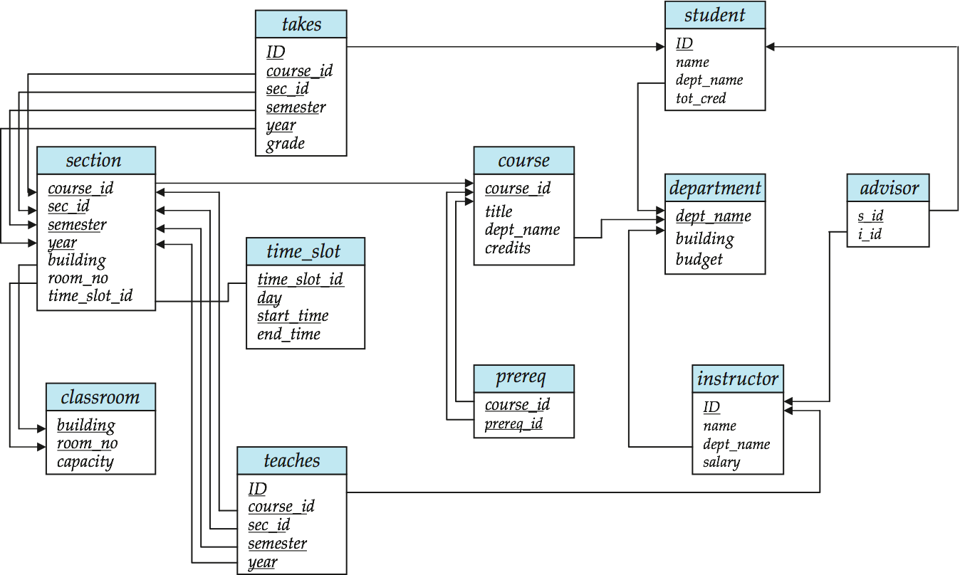
Schema Diagram for University Database

Slide 12
CMSC424: Database Design Module: Relation Model + SQL
SQL: Basics and DDL
Instructor: Amol Deshpande
amol@cs.umd.edu

Slide 13
SQL Basics and DDL
Book Chapters (6th Edition)
3.1, 3.2
Key Topics
SQL Overview
How to create relations using SQL
How to insert/delete/update tuples

Slide 14
History
IBM Sequel language developed as part of System R project at the IBM San Jose Research Laboratory
Renamed Structured Query Language (SQL)
ANSI and ISO standard SQL:
SQL-86, SQL-89, SQL-92
SQL:1999, SQL:2003, SQL:2008
Commercial systems offer most, if not all, SQL-92 features, plus varying feature sets from later standards and special proprietary features.
Not all examples here may work on your particular system.
Several alternative syntaxes to write the same queries

Slide 15
Different Types of Constructs
Data definition language (DDL): Defining/modifying schemas
Integrity constraints: Specifying conditions the data must satisfy
View definition: Defining views over data
Authorization: Who can access what
Data-manipulation language (DML): Insert/delete/update tuples, queries
Transaction control:
Embedded SQL: Calling SQL from within programming languages
Creating indexes, Query Optimization control…

Slide 16
Data Definition Language
The SQL data-definition language (DDL) allows the specification of information about relations, including:
The schema for each relation.
The domain of values associated with each attribute.
Integrity constraints
Also: other information such as
The set of indices to be maintained for each relations.
Security and authorization information for each relation.
The physical storage structure of each relation on disk.

Slide 17
SQL Constructs: Data Definition Language
CREATE TABLE <name> ( <field> <domain>, … )
create table department
(dept_name varchar(20),
building varchar(15),
budget numeric(12,2) check (budget > 0),
primary key (dept_name)
);
create table instructor (
ID char(5), name varchar(20) not null, dept_name varchar(20), salary numeric(8,2),
primary key (ID), foreign key (dept_name) references department
)

Slide 18
SQL Constructs: Data Definition Language
CREATE TABLE <name> ( <field> <domain>, … )
create table department
(dept_name varchar(20) primary key,
building varchar(15),
budget numeric(12,2) check (budget > 0)
);
create table instructor (
ID char(5) primary key,
name varchar(20) not null, d_name varchar(20), salary numeric(8,2), foreign key (d_name) references department
)

Slide 19
SQL Constructs: Data Definition Language
drop table student
delete from student
Keeps the empty table around
alter table
alter table student add address varchar(50);
alter table student drop tot_cred;

Slide 20
SQL Constructs: Insert/Delete/Update Tuples
INSERT INTO <name> (<field names>) VALUES (<field values>)
insert into instructor values (‘10211’, ’Smith’, ’Biology’, 66000);
insert into instructor (name, ID) values (‘Smith’, ‘10211’);
-- NULL for other two
insert into instructor (ID) values (‘10211’);
-- FAIL
DELETE FROM <name> WHERE <condition>
delete from department where budget < 80000;
Syntax is fine, but this command may be rejected because of referential integrity constraints.

Slide 21
SQL Constructs: Insert/Delete/Update Tuples
DELETE FROM <name> WHERE <condition>
delete from department where budget < 80000;
We can choose what happens:
Reject the delete, or
Delete the rows in Instructor (may be a cascade), or
Set the appropriate values in Instructor to NULL
Instructor relation

Slide 22
SQL Constructs: Insert/Delete/Update Tuples
DELETE FROM <name> WHERE <condition>
delete from department where budget < 80000;
create table instructor
(ID varchar(5),
name varchar(20) not null,
dept_name varchar(20),
salary numeric(8,2) check (salary > 29000),
primary key (ID),
foreign key (dept_name) references department
on delete set null
);
We can choose what happens:
Reject the delete (nothing), or
Delete the rows in Instructor (on delete cascade), or
Set the appropriate values in Instructor to NULL (on delete set null)

Slide 23
SQL Constructs: Insert/Delete/Update Tuples
DELETE FROM <name> WHERE <condition>
Delete all classrooms with capacity below average
delete from classroom where capacity <
(select avg(capacity) from classroom);
Problem: as we delete tuples, the average capacity changes
Solution used in SQL:
First, compute avg capacity and find all tuples to delete
Next, delete all tuples found above (without recomputing avg or retesting the tuples)
E.g. consider the query: delete the smallest classroom

Slide 24
SQL Constructs: Insert/Delete/Update Tuples
UPDATE <name> SET <field name> = <value> WHERE <condition>
Increase all salaries’s over $100,000 by 6%, all other receive 5%.
Write two update statements:
update instructor set salary = salary ∗ 1.06 where salary > 100000;
update instructor set salary = salary ∗ 1.05 where salary ≤ 10000;
The order is important
Can be done better using the case statement

Slide 25
SQL Constructs: Insert/Delete/Update Tuples
UPDATE <name> SET <field name> = <value> WHERE <condition>
Increase all salaries’s over $100,000 by 6%, all other receive 5%.
Can be done better using the case statement
update instructor set salary =
case
when salary > 100000
then salary ∗ 1.06
when salary <= 100000
then salary ∗ 1.05
end;

Slide 26
CMSC424: Database Design Module: Relation Model + SQL
SQL: Querying Basics
Instructor: Amol Deshpande
amol@cs.umd.edu

Slide 27
SQL Querying Basics
Book Chapters (6th Edition)
3.3
Key Topics
Single-table Queries in SQL
Multi-table Queries using Cartesian Product
Difference between Cartesian Product and “Natural Join”
Careful with using “natural join” keyword

Slide 28
Basic Query Structure
Attributes or expressions
select A₁, A₂, ..., A_{n} from r₁, r₂, ..., r_{m} where P
Relations (or queries returning tables)
Predicates
Find the names of all instructors: select name from instructor

Slide 29
Basic Query Structure
Attributes or expressions
select A₁, A₂, ..., A_{n} from r₁, r₂, ..., r_{m} where P
Relations (or queries returning tables)
Predicates
Find the names of all instructor departments: select dept_name from instructor

Slide 30
Basic Query Structure
Attributes or expressions
select A₁, A₂, ..., A_{n} from r₁, r₂, ..., r_{m} where P
Relations (or queries returning tables)
Predicates
Remove duplicates: select distinct name from instructor
Order the output:
select distinct name from instructor
order by name asc
Find the names of all instructors: select name from instructor
Apply some filters (predicates):
select name from instructor
where salary > 80000 and dept_name = ‘Finance’;

Slide 31
Basic Query Constructs
Select all attributes: select * from instructor
Expressions in the select clause:
select name, salary < 100000 from instructor
Find the names of all instructors: select name from instructor
More complex filters:
select name from instructor
where (dept_name != ‘Finance’ and salary > 75000)
or (dept_name = ‘Finance’ and salary > 85000);
A filter with a subquery:
select name from instructor
where dept_name in (select dept_name from
department where budget < 100000);

Slide 32
Basic Query Constructs
Renaming tables or output column names: select i.name, i.salary * 2 as double_salary from instructor i
where i.salary < 80000 and i.name like ‘%g_’;
Find the names of all instructors: select name from instructor
More complex expressions:
select concat(name, concat(‘, ’, dept_name))
from instructor;
Careful with NULLs:
select name from instructor
where salary < 100000 or salary >= 100000;
Wouldn’t return the instructor with NULL salary (if any)

Slide 33
Multi-table Queries
Cartesian product:
select * from instructor, teaches

Slide 34
Multi-table Queries
Use predicates to only select “matching” pairs: select * from instructor i, teaches t
where i.ID = t.ID;
Cartesian product:
select * from instructor, teaches
Identical (in this case) to using a natural join:
select * from instructor natural join teaches;

Slide 35
Multi-table Queries
Cartesian product:
select * from instructor natural join teaches

Slide 36
Multi-table Queries
Use predicates to only select “matching” pairs: select * from instructor i, teaches t
where i.ID = t.ID;
Cartesian product:
select * from instructor, teaches
Identical (in this case) to using a natural join:
select * from instructor natural join teaches;
Natural join does an equality on common attributes – doesn’t work here:
select *
from instructor natural join advisor;
Instead can use “on” construct (or where clause as above):
select *
from instructor join advisor on (i_id = id);

Slide 37
Multi-table Queries
3-Table Query to get a list of instructor-teaches-course information:
select i.name as instructor_name, c.title as course_name from instructor i, course c, teaches
where i.ID = teaches.ID and c.course_id = teaches.course_id;
Beware of unintended common names (happens often)
You may think the following query has the same result as above – it doesn’t
select name, title from instructor natural join course natural join teaches;
I prefer avoiding “natural joins” for that reason
Note: On the small dataset, the above two have the same answer, but not on the large dataset.
Large dataset has cases where an instructor teaches a course from a different department.

Slide 38
CMSC424: Database Design Module: Relation Model + SQL
Keys
Instructor: Amol Deshpande
amol@cs.umd.edu

Slide 39
Relational Model: Keys
Book Chapters (6th Edition)
2.3
Key Topics
Keys as a mechanism to uniquely identify tuples in a relation
Super key vs Candidate key vs Primary key
Foreign keys and Referential Integrity
How to identify keys of a relation

Slide 40
Keys
Let K ⊆ R
K is a superkey of R if values for K are sufficient to identify a unique tuple of any possible relation r(R)
Example: {ID} and {ID,name} are both superkeys of instructor.
Superkey K is a candidate key if K is minimal (i.e., no subset of it is a superkey)
Example: {ID} is a candidate key for Instructor
One of the candidate keys is selected to be the primary key
Typically one that is small and immutable (doesn’t change often)
Primary key typically highlighted (e.g., underlined)

Slide 41
Tables in a University Database
classroom(building, room_number, capacity)
department(dept_name, building, budget)
course(course_id, title, dept_name, credits)
instructor(ID, name, dept_name, salary)

Slide 42
Tables in a University Database
takes(ID, course_id, sec_id, semester, year, grade)
What about ID, course_id?
No. May repeat:
(“1011049”, “CMSC424”, “101”, “Spring”, 2014, D)
(“1011049”, “CMSC424”, “102”, “Fall”, 2015, null)
What about ID, course_id, sec_id?
May repeat:
(“1011049”, “CMSC424”, “101”, “Spring”, 2014, D)
(“1011049”, “CMSC424”, “101”, “Fall”, 2015, null)
What about ID, course_id, sec_id, semester?
Still no: (“1011049”, “CMSC424”, “101”, “Spring”, 2014, D)
(“1011049”, “CMSC424”, “101”, “Spring”, 2015, null)

Slide 43
Tables in a University Database
classroom(building, room_number, capacity)
department(dept_name, building, budget)
course(course_id, title, dept_name, credits)
instructor(ID, name, dept_name, salary)
section(course_id, sec_id, semester, year, building,
room_number, time_slot_id)
teaches(ID, course_id, sec_id, semester, year)
student(ID, name, dept_name, tot_cred)
takes(ID, course_id, sec_id, semester, year, grade)
advisor(s_ID, i_ID)
time_slot(time_slot_id, day, start_time, end_time)
prereq(course_id, prereq_id)

Slide 44
Keys
Foreign key: Primary key of a relation that appears in another relation
{ID} from student appears in takes, advisor
student called referenced relation
takes is the referencing relation
Typically shown by an arrow from referencing to referenced
Foreign key constraint: the tuple corresponding to that primary key must exist
Imagine:
Tuple: (‘student101’, ‘CMSC424’) in takes
But no tuple corresponding to ‘student101’ in student
Also called referential integrity constraint

Slide 45
Schema Diagram for University Database

Slide 46
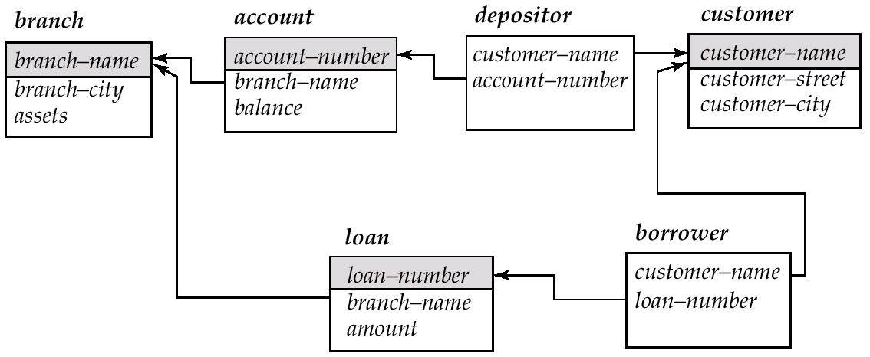
Schema Diagram for the Banking Enterprise

Slide 47
Examples
Married(person1_ssn, person2_ssn, date_married, date_divorced)
Account(cust_ssn, account_number, cust_name, balance, cust_address)
RA(student_id, project_id, superviser_id, appt_time, appt_start_date, appt_end_date)
Person(Name, DOB, Born, Education, Religion, …)
Information typically found on Wikipedia Pages

Slide 48
Examples
Married(person1_ssn, person2_ssn, date_married, date_divorced)
Account(cust_ssn, account_number, cust_name, balance, cust_address)
If a single account per customer, then: cust_ssn
Else: (cust_ssn, account_number)
In the latter case, this is not a good schema because it requires repeating information
RA(student_id, project_id, superviser_id, appt_time, appt_start_date, appt_end_date)
Could be smaller if there are some restrictions – requires some domain knowledge of the data being stored
Person(Name, DOB, Born, Education, Religion, …)
Information typically found on Wikipedia Pages
Unclear what could be a primary key here: you could in theory have two people who match on all of those

Slide 49
CMSC424: Database Design Module: Relation Model + SQL
SQL: Aggregates
Instructor: Amol Deshpande
amol@cs.umd.edu

Slide 50
SQL Aggregates
Book Chapters (6th Edition)
3.7.1-3.7.3
Key Topics
Basic aggregates
Aggregation with “grouping”
“Having” clause to select among groups

Slide 51
Aggregates
Other common aggregates:
max, min, sum, count, stdev, …
select count (distinct ID) from teaches where semester = ’Spring’ and year = 2010
Find the average salary of instructors in the Computer Science
select avg(salary) from instructor
where dept_name = ‘Comp. Sci’;
Can specify aggregates in any query.
Find max salary over instructors teaching in S’10.
select max(salary) from teaches natural join instructor where semester = ’Spring’ and year = 2010;
Aggregate result can be used as a scalar.
Find instructors with max salary:
select * from instructor where salary = (select max(salary) from instructor);

Slide 52
Aggregates
Aggregate result can be used as a scalar.
Find instructors with max salary:
select * from instructor where salary = (select max(salary) from instructor);
Following doesn’t work:
select * from instructor where salary = max(salary);
select name, max(salary)
from instructor where salary = max(salary);

Slide 53
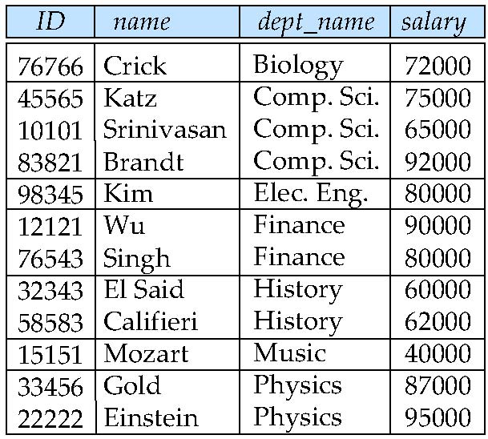
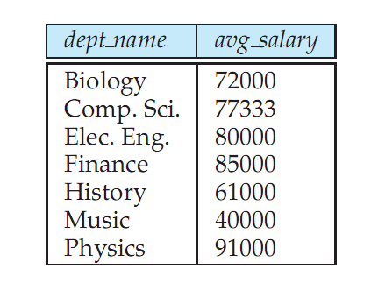
Aggregates: Group By
Split the tuples into groups, and computer the aggregate for each group
select dept_name, avg (salary) from instructor group by dept_name;

Slide 54
Aggregates: Group By
Find the number of instructors in each department who teach a course in the Spring 2010 semester.
Partial Query 1:
select
from instructor natural join teaches
where semester = ‘Spring’ and year = 2010

Slide 55
Aggregates: Group By
Find the number of instructors in each department who teach a course in the Spring 2010 semester.
Partial Query 2:
select dept_name, count(*)
from instructor natural join teaches
where semester = ‘Spring’ and year = 2010
group by dept_name
Doesn’t work – double counts “Katz” who teaches twice in Spring 2010
Final:
select dept_name, count(distinct ID)
from instructor natural join teaches
where semester = ‘Spring’ and year = 2010
group by dept_name

Slide 56
Aggregates: Group By
Attributes in the select clause must be aggregates, or must appear in the group by clause. Following wouldn’t work
select dept_name, ID, avg (salary) from instructor group by dept_name;
“having” can be used to select only some of the groups.
select dept_name, ID, avg (salary) from instructor group by dept_name
having avg(salary) > 42000;

Slide 57
CMSC424: Database Design Module: Relation Model + SQL
SQL: Different Types of Joins, and Set Operations
Instructor: Amol Deshpande
amol@cs.umd.edu

Slide 58
SQL Querying Basics
Book Chapters (6th Edition)
4.1, 3.5
Key Topics
Outer Joins
Anti-joins, Semi-joins
Set Operations

Slide 59
Multi-table Queries
Cartesian product:
select * from R, S
A | B
a | 1
b | 1
c | 2
B | C
1 | x
3 | y
4 | z
R.A | R.B | S.B | S.C
a | 1 | 1 | x
a | 1 | 3 | y
a | 1 | 4 | z
b | 1 | 1 | x
b | 1 | 3 | y
b | 1 | 1 | x
c | 2 | 3 | y
c | 2 | 1 | x
c | 2 | 3 | y
×
=
R
S

Slide 60
Multi-table Queries
Natural Join:
select * from R natural join S
A | B
a | 1
b | 1
c | 2
B | C
1 | x
3 | y
4 | z
R.A | B | S.C
a | 1 | x
b | 1 | x
⋈
=
R
S
Equivalent to:
select R.A, R.B, S.C from R, S
where R.B = S.B
Equivalent to:
select R.A, R.B, S.C from R join S on (R.B = S.B)
Equivalent to:
select R.A, R.B, S.C from R join S on (B)

Slide 61
Outer joins: Why?
Natural Join:
select * from R natural join S
A | B
a | 1
b | 1
c | 2
B | C
1 | x
3 | y
4 | z
R.A | B | S.C
a | 1 | x
b | 1 | x
⋈
=
R
S
Often need the ”non-matching” tuples in the result

Slide 62
“Left” Outerjoin
select * from R natural left outer join S
A | B
a | 1
b | 1
c | 2
B | C
1 | x
3 | y
4 | z
R.A | B | S.C
a | 1 | x
b | 1 | x
c | 2 | NULL
⟕
=
R
S
select * from R left outer join S on (R.B = S.B)

Slide 63
“Right” Outerjoin
select * from R right natural outer join S
A | B
a | 1
b | 1
c | 2
B | C
1 | x
3 | y
4 | z
R.A | B | S.C
a | 1 | x
b | 1 | x
NULL | 3 | y
NULL | 4 | z
⟖
=
R
S
select * from R right outer join S on (R.B = S.B)

Slide 64
“Full” Outerjoin
select * from R natural full outer join S
A | B
a | 1
b | 1
c | 2
B | C
1 | x
3 | y
4 | z
R.A | B | S.C
a | 1 | x
b | 1 | x
c | 2 | NULL
NULL | 3 | y
NULL | 4 | z
⟗
=
R
S
select * from R full outer join S on (R.B = S.B)

Slide 65

Semi-joins
R SEMI-JOIN S = tuples of R that do have a “match” in S
Not an SQL keyword, but useful concept to understand – often implemented in database systems as an operator
A | B
a | 1
b | 1
c | 2
B | C
1 | x
3 | y
4 | z
R.A | R.B
a | 1
b | 1
=
Can be written in SQL as:
select *
from R
where B in (select B from S);

Slide 66
Semi-joins
R SEMI-JOIN S = tuples of R that do have a “match” in S
Not an SQL keyword, but useful concept to understand – often implemented in database systems as an operator
A | B
a | 1
b | 1
c | 2
B | C
1 | x
3 | y
4 | z
R.A | R.B
a | 1
b | 1
=
A | B
a | 1
b | 1
c | 2
B | C
1 | x
3 | y
4 | z
S.B | S.C
1 | x
=

Slide 67
Anti-joins
R ANTI-JOIN S = tuples of R that do NOT have a “match” in S
Not an SQL keyword, but useful concept to understand – often implemented in database systems as an operator
A | B
a | 1
b | 1
c | 2
B | C
1 | x
3 | y
4 | z
R.A | R.B
c | 2
=
▷
Can be written in SQL as:
select *
from R
where B not in (select B from S);

Slide 68
Anti-joins
R ANTI-JOIN S = tuples of R that do NOT have a “match” in S
Not an SQL keyword, but useful concept to understand – often implemented in database systems as an operator
A | B
a | 1
b | 1
c | 2
B | C
1 | x
3 | y
4 | z
R.A | R.B
c | 2
=
▷
A | B
a | 1
b | 1
c | 2
B | C
1 | x
3 | y
4 | z
S.B | S.C
3 | y
4 | z
▷
=

Slide 69
Set operations
Find courses that ran in Fall 2009 or Spring 2010
(select course_id from section where semester = ‘Fall’ and year = 2009) union (select course_id from section where semester = ‘Spring’ and year = 2010);
In both:
(select course_id from section where semester = ‘Fall’ and year = 2009) intersect (select course_id from section where semester = ‘Spring’ and year = 2010);
In Fall 2009, but not in Spring 2010:
(select course_id from section where semester = ‘Fall’ and year = 2009) except (select course_id from section where semester = ‘Spring’ and year = 2010);

Slide 70
Set operations: Duplicates
Union/Intersection/Except eliminate duplicates in the answer (the other SQL commands don’t) (e.g., try ‘select dept_name from instructor’).
Can use “union all” to retain duplicates.
NOTE: The duplicates are retained in a systematic fashion (for all SQL operations)
Suppose a tuple occurs m times in r and n times in s, then, it occurs:
m + n times in r union all s
min(m,n) times in r intersect all s
max(0, m – n) times in r except all s

Slide 71
CMSC424: Database Design Module: Relation Model + SQL
SQL: Nested Subqueries
Instructor: Amol Deshpande
amol@cs.umd.edu

Slide 72
SQL Nested Subqueries
Book Chapters (6th Edition)
3.8
Key Topics
Subqueries
Boolean operations with Subqueries

Slide 73
Nested Subqueries
A query within a query – can be used in select/from/where and other clauses

Slide 74
Nested Subqueries
A query within a query – can be used in select/from/where and other clauses
Uncorrelated subquery – the subquery makes no reference to the enclosing queries, and can be evaluated by itself
* Correlated subquery – the subquery has a reference to the enclosing query
* For every tuple of department, the subquery returns a different result

Slide 75
Set Membership: ”IN” and “NOT IN”
Can also be written using Set Intersection
(select course_id from section where semester = ‘Fall’ and year = 2009) intersect (select course_id from section where semester = ‘Spring’ and year = 2010);

Slide 76
Set Membership: ”IN” and “NOT IN”
Can do this with “tuples” as well:

Slide 77
Set Comparisons

Slide 78
Testing for Empty Results
Also: “Not Exists”

Slide 79
Uniqueness
There are usually alternatives to using these constructs (e.g., group by + having instead of “unique”), but these can often make queries more readable and more compact

Slide 80
“With” Clause
Used for creating “temporary” tables within the context of the query

Slide 81
Scalar Subqueries
A scalar subquery is one that returns exactly one tuple with exactly one attribute (so typically some sort of aggregate) – can be used in “select”, “where”, and “having” clauses

Slide 82
CMSC424: Database Design Module: Relation Model + SQL
SQL: NULLs
Instructor: Amol Deshpande
amol@cs.umd.edu

Slide 83
SQL: NULLs
Book Chapters (6th Edition)
3.6, 3.7.4
Key Topics
Operating with NULLs
”Unknown” as a new Boolean value
Operating with UNKNOWNs
Aggregates and NULLs

Slide 84
SQL: Nulls
Can cause headaches for query semantics as well as query processing and optimization)
Can be a value of any attribute
e.g: branch =
bname | bcity | assets
Downtown | Boston | 9M
Perry | Horseneck | 1.7M
Mianus | Horseneck | .4M
Waltham | Boston | NULL
What does this mean?
(unknown) We don’t know Waltham’s assets?
(inapplicable) Waltham has a special kind of account without assets
(withheld) We are not allowed to know

Slide 85
SQL: Nulls
Arithmetic Operations with Null
n + NULL = NULL (similarly for all arithmetic ops: +, -, *, /, mod, …)
e.g: branch =
bname | bcity | assets
Downtown | Boston | 9M
Perry | Horseneck | 1.7M
Mianus | Horseneck | .4M
Waltham | Boston | NULL
=
bname | a2
Downtown | 18M
Perry | 3.4M
Mianus | .8M
Waltham | NULL
SELECT bname, assets * 2 as a2
FROM branch
Counter-intuitive: NULL * 0 = NULL

Slide 86
SQL: Nulls
Boolean Operations with Null
n < NULL = UNKNOWN (similarly for all boolean ops: >, <=, >=, <>, =, …)
e.g: branch =
bname | bcity | assets
Downtown | Boston | 9M
Perry | Horseneck | 1.7M
Mianus | Horseneck | .4M
Waltham | Boston | NULL
assets < 10M will evaluate to UNKNOWN for the last tuple
But what about:
(assets < 10M) or (bcity = ‘Boston’) ?
(assets < 10M) and (bcity = ‘Boston’)?

Slide 87
SQL: Unknown
FALSE OR UNKNOWN = UNKNOWN
TRUE AND UNKNOWN = UNKNOWN
FALSE AND UNKNOWN = FALSE
TRUE OR UNKNOWN = TRUE
UNKNOWN OR UNKNOWN = UNKNOWN
UNKNOWN AND UNKNOWN = UNKNOWN
NOT (UNKNOWN) = UNKNOWN
Intuition: substitute each of TRUE, FALSE for unknown. If different answer results, results is unknown
Values | Expression | Result
x = NULL, y = 10 | (x < 10) and (y = 20) | UNKNOWN and FALSE = FALSE
x = NULL, y = 10 | (x is NULL) and (y = 20) | TRUE and FALSE = FALSE
x = NULL, y = 10 | (x < 10) and (y = 10) | UNKNOWN and TRUE = UNKNOWN
x = NULL, y = 10 | (x < 10) is UNKNOWN | TRUE
x = NULL, y = 10 | ( (x < 10) is UNKNOWN) and (y = 10) | TRUE AND TRUE = TRUE
UNKNOWN tuples are not included in final result

Slide 88
Aggregates and NULLs
Given
branch =
bname | bcity | assets
Downtown | Boston | 9M
Perry | Horseneck | 1.7M
Mianus | Horseneck | .4M
Waltham | Boston | NULL
Aggregate Operations
SELECT SUM (assets) =
FROM branch
SUM
11.1 M
NULL is ignored for SUM
Same for AVG (3.7M), MIN (0.4M), MAX (9M)
Also for COUNT(assets) -- returns 3
But COUNT (*) returns
COUNT
4

Slide 89
Aggregates and NULLs
Given
branch =
bname | bcity | assets
SELECT SUM (assets) =
FROM branch
SUM
NULL
COUNT
0
Same as AVG, MIN, MAX
But COUNT (assets) returns

Slide 90
CMSC424: Database Design Module: Relation Model + SQL
SQL: Transactions, Functions, Procedures, Recursive Queries, Authorization
Instructor: Amol Deshpande
amol@cs.umd.edu

Slide 91
Miscellaneous SQL
Book Chapters (6th Edition)
Sections 5.2, 5.3, 5.4, 5.5.1
Mostly at a high level
See Assignment 2
Key topics
Transactions
Ranking over relations or results
Recursion in SQL (makes SQL Turing Complete)
Functions and Procedures
Triggers

Slide 92
Ranking
Ranking is done in conjunction with an order by specification.
Consider: student_grades(ID, GPA)
Find the rank of each student.
select ID, rank() over (order by GPA desc) as s_rank from student_grades order by s_rank
Equivalent to:
select ID, (1 + (select count(*) from student_grades B where B.GPA > A.GPA)) as s_rank from student_grades A order by s_rank;
Notes:
⁹²

Slide 93
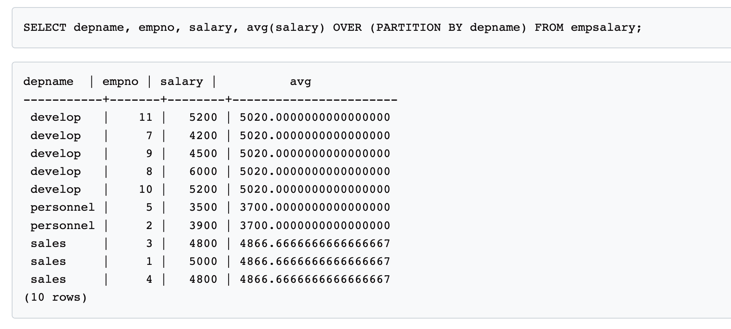
Window Functions
Similar to “Group By” – allows a calculation over “related” tuples
Unlike aggregates, does not “group” them – rather rows remain separate from each other
https://www.postgresql.org/docs/9.3/tutorial-window.html

Slide 94
Recursion in SQL
Example: find which courses are a prerequisite, whether directly or indirectly, for a specific course
with recursive rec_prereq(course_id, prereq_id) as ( select course_id, prereq_id from prereq union select rec_prereq.course_id, prereq.prereq_id, from rec_rereq, prereq where rec_prereq.prereq_id = prereq.course_id ) select ∗ from rec_prereq;
Makes SQL Turing Complete (i.e., you can write any program in SQL)
But: Just because you can, doesn’t mean you should

Slide 95
SQL Functions
Function to count number of instructors in a department
create function dept_count (dept_name varchar(20)) returns integer begin declare d_count integer; select count (* ) into d_count from instructor where instructor.dept_name = dept_name return d_count; end
Can use in queries
select dept_name, budget from department where dept_count (dept_name ) > 12

Slide 96
SQL Procedures
Same function as a procedure
create procedure dept_count_proc (in dept_name varchar(20), out d_count integer) begin
select count(*) into d_count from instructor where instructor.dept_name = dept_count_proc.dept_name
end
But use differently:
declare d_count integer; call dept_count_proc( ‘Physics’, d_count);
HOWEVER: Syntax can be wildly different across different systems
Was put in place by DBMS systems before standardization
Hard to change once customers are already using it

Slide 97
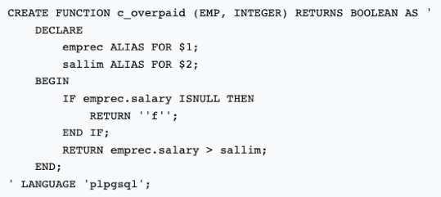
SQL Functions/Procedures
Stored procedures widely used in practice
Many benefits including reusability, better performance (reduce back and forth to the DB)
Most database systems support multiple langauges
Purely SQL → Fully procedural (e.g., C, etc)
PostgreSQL supports SQL, C, PL/pgSQL
Note PostgreSQL 10 (that we use) does not support PROCEDURE, only FUNCTION

Slide 98
Triggers
A trigger is a statement that is executed automatically by the system as a side effect of a modification to the database.
Suppose that instead of allowing negative account balances, the bank deals with overdrafts by
1. setting the account balance to zero
2. creating a loan in the amount of the overdraft
3. giving this loan a loan number identical to the account number of the overdrawn account
Notes:
To design a trigger mechanism, we must:
Specify the conditions under which the trigger is to be executed.
Specify the actions to be taken when the trigger executes.
Triggers introduced to SQL standard in SQL:1999, but supported even earlier using non-standard syntax by most databases.

Slide 99
Trigger Example in SQL:1999
create trigger overdraft-trigger after update on account referencing new row as nrow for each row when nrow.balance < 0 begin atomic actions to be taken
end

Slide 100
Trigger Example in SQL:1999
create trigger overdraft-trigger after update on account referencing new row as nrow for each row when nrow.balance < 0 begin atomic insert into borrower (select customer-name, account-number from depositor where nrow.account-number = depositor.account-number); insert into loan values (nrow.account-number, nrow.branch-name, nrow.balance); update account set balance = 0 where account.account-number = nrow.account-number end

Slide 101
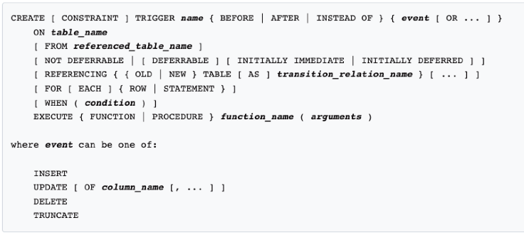
PostgreSQL Trigger Syntax
https://www.postgresql.org/docs/12/sql-createtrigger.html
NOTE: We use PostgreSQL 10, which does not support PROCEUDRE

Slide 102
Triggers…
External World Actions
How does the DB order something if the inventory is low ?
Syntax
Every system has its own syntax
Careful with triggers
Cascading triggers, Infinite Sequences…
More Info/Examples:
http://www.adp-gmbh.ch/ora/sql/create_trigger.html
Google: “create trigger” oracle download-uk
Notes:
Instead of executing a separate action for each affected row, a single action can be executed for all rows affected by a transaction
Use for each statement instead of for each row
Use referencing old table or referencing new table to refer to temporary tables (called transition tables) containing the affected rows
Can be more efficient when dealing with SQL statements that update a large number of rows
We sometimes require external world actions to be triggered on a database update
E.g. re-ordering an item whose quantity in a warehouse has become small, or turning on an alarm light,
Triggers cannot be used to directly implement external-world actions, BUT
Triggers can be used to record actions-to-be-taken in a separate table
Have an external process that repeatedly scans the table, carries out external-world actions and deletes action from table
E.g. Suppose a warehouse has the following tables
inventory(item, level): How much of each item is in the warehouse
minlevel(item, level) : What is the minimum desired level of each item
reorder(item, amount): What quantity should we re-order at a time
orders(item, amount) : Orders to be placed (read by external process)

Slide 103
Transactions
A transaction is a sequence of queries and update statements executed as a single unit
Transactions are started implicitly and terminated by one of
commit work: makes all updates of the transaction permanent in the database
rollback work: undoes all updates performed by the transaction.
Motivating example
Transfer of money from one account to another involves two steps:
deduct from one account and credit to another
If one steps succeeds and the other fails, database is in an inconsistent state
Therefore, either both steps should succeed or neither should
If any step of a transaction fails, all work done by the transaction can be undone by rollback work.
Rollback of incomplete transactions is done automatically, in case of system failures

Slide 104
Transactions (Cont.)
In most database systems, each SQL statement that executes successfully is automatically committed.
Each transaction would then consist of only a single statement
Automatic commit can usually be turned off, allowing multi-statement transactions, but how to do so depends on the database system
Another option in SQL:1999: enclose statements within begin atomic … end

Slide 105
CMSC424: Database Design Aside
Anatomy of a Web Application
Instructor: Amol Deshpande
amol@umd.edu

Slide 106
Anatomy of a Web Application
Book Chapters (6th Edition)
Sections 9.1, 9.2, 9.3.5, 9.3.6, 9.4.3
Much not covered in depth in the book, but lot of good tutorials on the web
Key Topics
How Web Applications Work
Some of the underlying technologies
REST

Slide 107
Application Architecture Evolution
Three distinct eras of application architecture
Mainframe (1960’s and 70’s)
Personal computer era (1980’s)
Web era (mid 1990’s onwards)
Web and Smartphone era (2010 onwards)

Slide 108
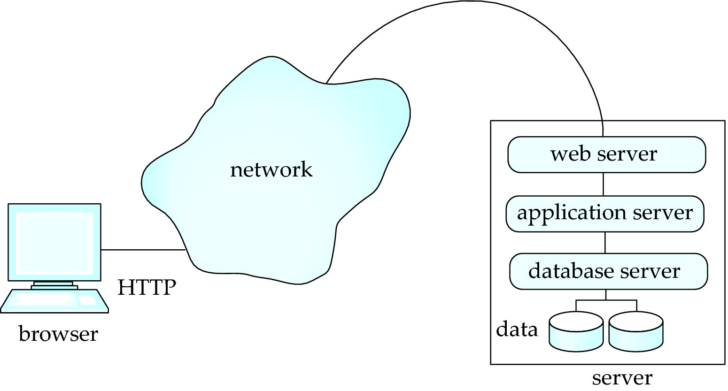
Web or Mobile Applications
Web browsers and mobile applications have become de facto standard user interface
Wide cross-platform accessibility
No need to download something
Three Tier or Two Tier Architectures

Slide 109
What runs where?
Flask, Django, Tomcat, Node.js, and others
Accept requests from the client and pass to the application server
Pass application server response back to the client
Support HTTP and HTTPS connections
Encapsulates business logic
Needs to support different user flows
Needs to handle all of the rendering and visualization
Ruby-on-rails, Django, Flask, Angular, React, PHP, and many others
Web Browser (Firefox, Chrome, Safari, Edge)
HTML to render webpages
Javascript for “client-side scripting” (running code in your browser without contacting the server)
Flash (not supported much – too much security risk)
Java “applets” – less common today
PostgreSQL, Oracle, SQL Server, Amazon RDS (Relational Databases)
MongoDB (Document/JSON databases)
SQLite --- not typically for production environments
Pretty much any database can be used…

Slide 110
Some Key Technologies
HTML
Controls display of content on webpages
HTTP/HTTPS, Sessions, Cookies
How “clients” connect to “servers”
Server-side vs client-side scripting
Some processing happens on the server, but increasingly on the client (though Javascript)
REST, SOAP, GraphQL
Protocols for “clients” to requests things from the “servers” (or for two web services to talk to each other)
Web APIs (typically REST or GraphQL)
Some services available on the Web

Slide 111
REST
Representation State Transfer: use standard HTTP requests to execute a request (against a web or application server) and return data
Technically REST is a software architectural style -- APIs that conform to it are called RESTful APIs
How REST uses the five standard HTTP request types:
POST: Invoke the method that corresponds to the URL, typically with data that is sent with the request
GET: Retrieve the data (no data sent with the request)
PUT: Reverse of GET
PATCH: Update some data
DELETE: Delete the data
Alternative: GraphQL -- uses HTTP POST calls, where the body of the call tells the web server what needs to be done
As someone on Stackoverflow put it: “REST is the way HTTP should be used."

Slide 112
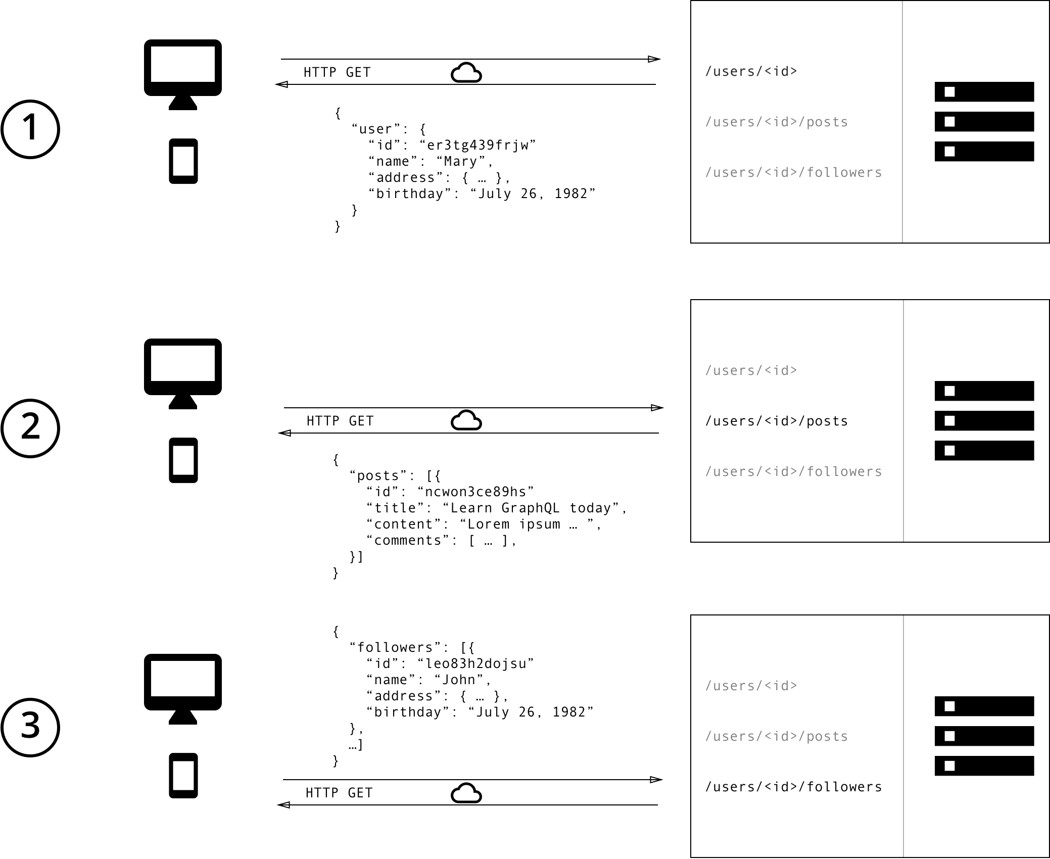
REST – GET Calls
https://www.howtographql.com/basics/1-graphql-is-the-better-rest/

Slide 113
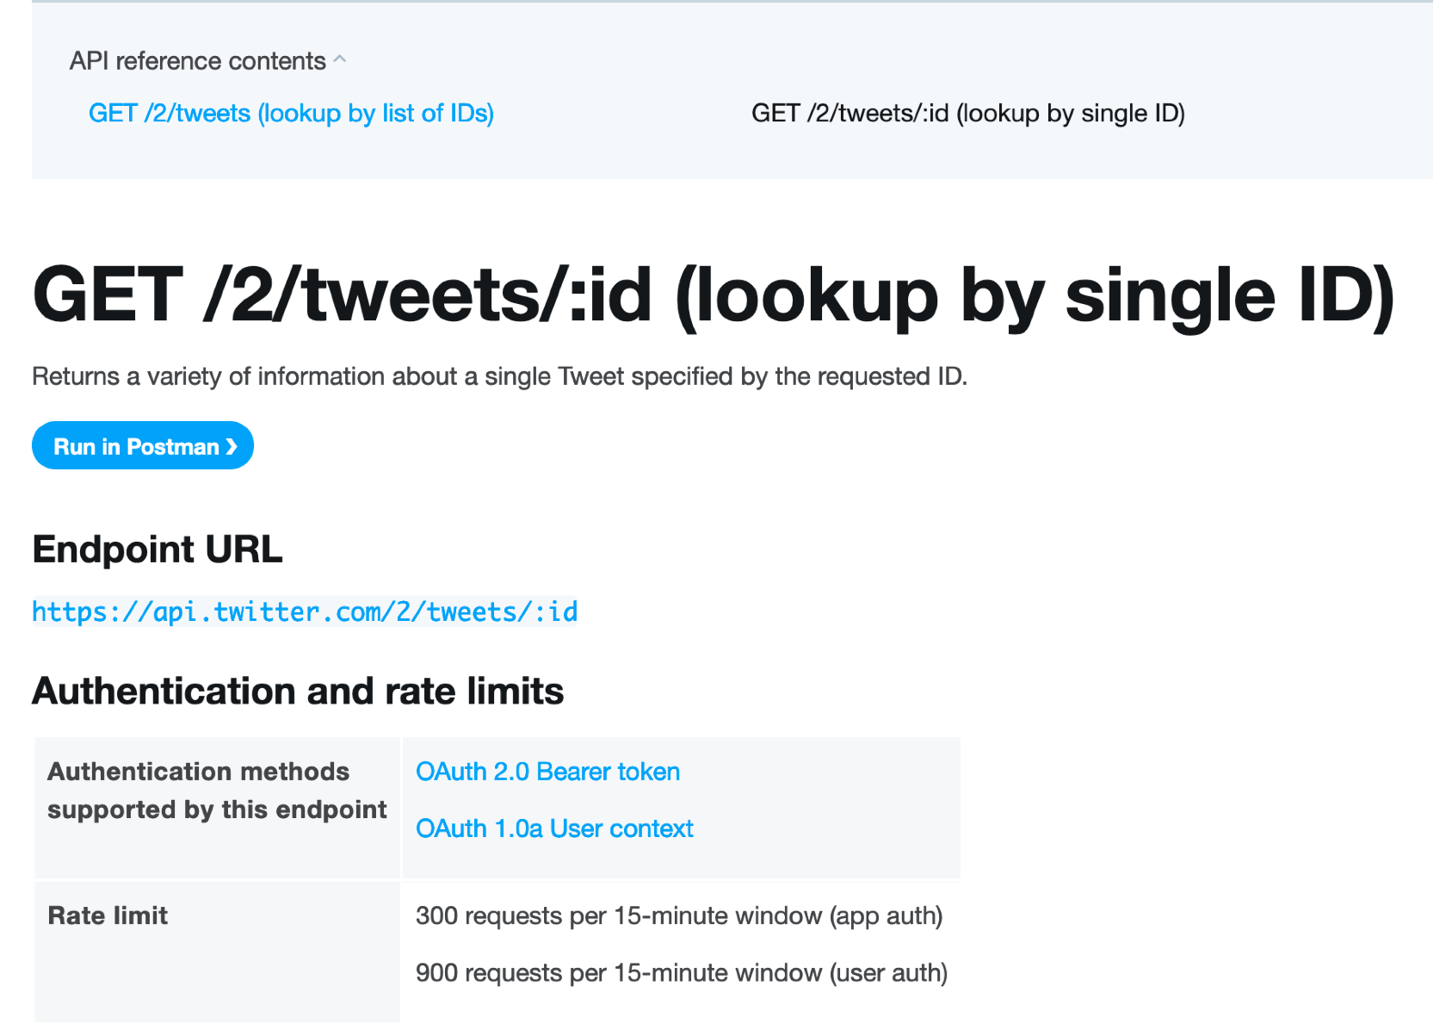
REST Example: Twitter

Slide 114
CMSC424: Database Design Module: Relational Model + SQL
SQL and Programming Languages
Instructor: Amol Deshpande
amol@umd.edu

Slide 115
SQL and Programming Languages
Book Chapters (6th Edition)
Sections 5.1, 9.4.2
Key Topics
Why use a programming language
Embedded SQL vs OBDC/JDBC
Object-relational impedance mismatch
Object-relational Mapping Frameworks

Slide 116
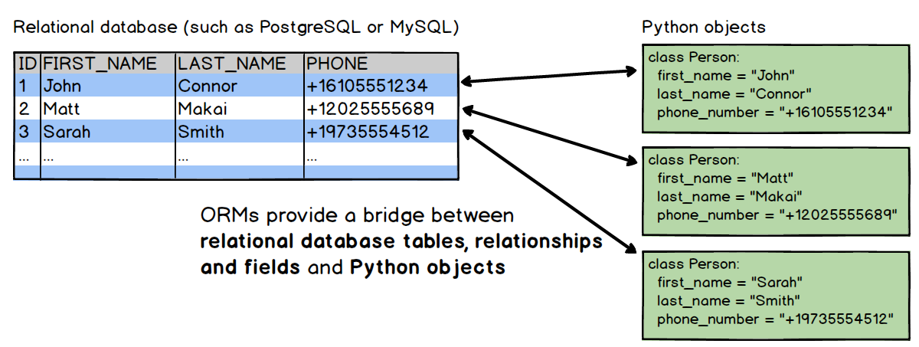
SQL and Programming Languages
Programmers/developers more comfortable using a programming language like Java, Python, etc.
SQL not natural for many things
Performance issues in going back and forth to the database
Need to deal with impedance mismatch between:
how data is represented in memory (typically as objects)
how it is stored (typically in a “normalized” relational schema)

Slide 117
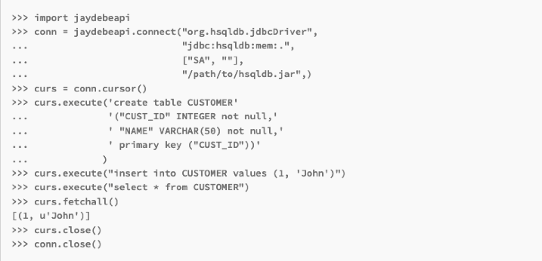
Option 1: JDBC/ODBC
Use a standard protocol like JDBC (Java Database Connectivity) to talk to the database from the programming language
Doesn’t solve impedance mismatch problem
Have to convert from the “result tuples” into “objects” and vice versa (when updating)

Slide 118
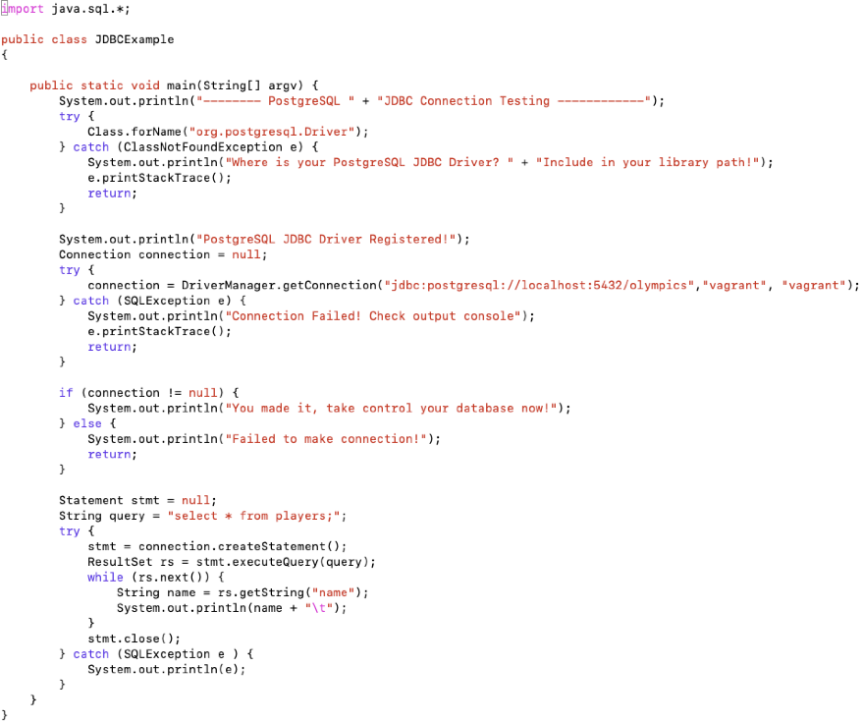

Slide 119
Option 1: JDBC/ODBC
WARNING: always use prepared statements when taking an input from the user and adding it to a query (Related to the issue of SQL Injection attacks)
NEVER create a query by concatenating strings
"insert into instructor values(' " + ID + " ', ' " + name + " ', " + " ' + dept name + " ', " ' balance + ')“
What if name is “D'Souza”?
PreparedStatement pStmt = conn.prepareStatement("insert into instructor values(?,?,?,?)"); pStmt.setString(1, "88877"); pStmt.setString(2, "Perry"); pStmt.setString(3, "Finance"); pStmt.setInt(4, 125000); pStmt.executeUpdate(); pStmt.setString(1, "88878"); pStmt.executeUpdate();
Python psycopg2 also has its own way of doing prepared statements
^{cur = conn.cursor()}
^{for i, j in parameters:}
cur.execute( "select * from tables where i = %s and j = %s", (i, j))
for record in cur: do_something_with(record)

Slide 120
Option 1: JDBC/ODBC
JDBC Features
Getting schemas, columns, primary keys
DatabaseMetaData dbmd = conn.getMetaData()
Transaction control
conn.commit(), conn.rollback()
Calling functions and procedures
ODBC: Open Database Connectivity Standard
Similar in many ways
Older – designed by Microsoft and typically used in C, C++, like languages
Java supports as well but slower

Slide 121
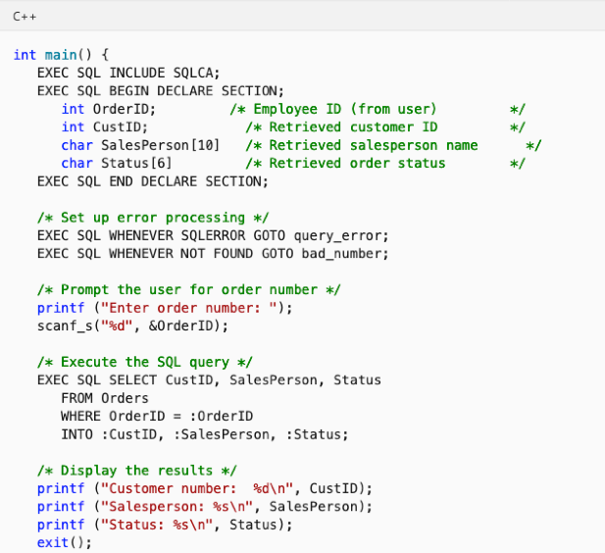
Option 2: Embedded SQL
SQL standard defines embeddings of SQL in a variety of programming languages such as C, C++, Java, Fortran, and PL/1
The language in which embedded is call “host” language

Slide 122
Option 2: Embedded SQL
SQL standard defines embeddings of SQL in a variety of programming languages such as C, C++, Java, Fortran, and PL/1
The language in which embedded is call “host” language
Needs compiler support for the host language
The compiler needs to know what to do with the EXEC SQL commands
Hard to port
Doesn’t solve impedance mismatch problem
Have to convert from the “result tuples” into “objects” and vice versa (when updating)
Not a preferred approach today

Slide 123
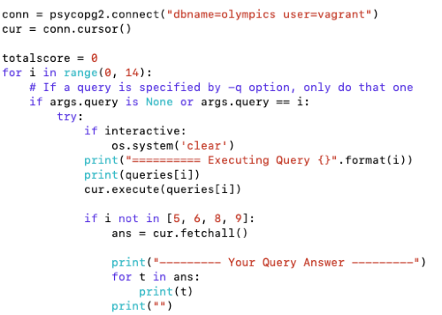
Option 3: Custom Libraries
Often there are vendor-specific libraries that sometimes use internal protocols (and not JDBC/ODBC)
e.g., python psycopg2 for PostgreSQL – although similar to JDBC calls, it uses the same proprietary protocol that ‘psql’ uses

Slide 124
Option 4: Object-relational Mappers
Aimed at solving the impedance mismatch
Primarily for Web Application Development
The ORM takes care of the mapping between objects and the database
Although largely designed around RDBMS, some ORMs support other databases as well
The programmer works with objects, and never directly sees the SQL
Has pros (easier to use) and cons (performance and correctness issues)
ORMs typically work with “Entities/Objects” and “Relationships”
Aligns well with the ER model that we will discuss next
We will cover Django constructs in more detail

Slide 125
Option 5: Other Mappers
Many other “wrappers” on top of relational databases that offer different functionalities
In some cases, operations written in a higher-level language mapped to SQL
like what we saw for ORMs
Microsoft LINQ is also similar
Allows intermixing of code mapped to SQL and other code
In some cases, used to provide alternate data models to users
e.g., a thin layer that provides a graph data model, but stores data in a relational database
Most “RDF” databases built on top of SQL databases
In today’s big data ecosystem, we see many many permutations how different tools (including databases) are combined together

Slide 126
CMSC424: Database Design Module: Relation Model + SQL
Relational Algebra
Instructor: Amol Deshpande
amol@umd.edu

Slide 127
Relational Operations
Book Chapters (6th Edition)
2.5, 2.6, 6.1.1-6.1.3 (expanded treatment of 2.5, 2.6)
Key Topics
Relational query languages and what purpose they serve
Basic unary and binary relational operations
Mapping between relational operations and SQL

Slide 128
Relational Query Languages
Example schema: R(A, B)
Practical languages
SQL
select A from R where B = 5;
Datalog (sort of practical)
q(A) :- R(A, 5)
Formal languages
Relational algebra
π_{A} ( σ_{B=5} (R) )
Tuple relational calculus
{ t : {A} | ∃ s : {A, B} ( R(A, B) ∧ s.B = 5) }
Domain relational calculus
Similar to tuple relational calculus

Slide 129
Relational Operations
Some of the languages are “procedural” and provide a set of operations
Each operation takes one or two relations as input, and produces a single relation as output
Examples: SQL, and Relational Algebra
The “non-procedural” (also called “declarative”) languages specify the output, but don’t specify the operations
Relational calculus
Datalog (used as an intermediate layer in quite a few systems today)

Slide 130
Relational Algebra
Procedural language
Six basic operators
select
project
union
set difference
Cartesian product
rename
The operators take one or more relations as inputs and give a new relation as a result.

Slide 131
Select Operation
^{Relation r}
^{A}
^{B}
^{C}
^{D}
^{σ}_{A=B ∧ D > 5} ^{(r)}
^{A}
^{B}
^{C}
^{D}
⍺
⍺
^{β}
^{β}
⍺
^{β}
^{β}
^{β}
¹
⁵
¹²
²³
⁷
⁷
³
¹⁰
⍺
^{β}
⍺
^{β}
¹
²³
⁷
¹⁰
SQL Equivalent:
select distinct *
from r
where A = B and D > 5
Unfortunate naming confusion

Slide 132
Project
^{Relation r}
^{A}
^{B}
^{C}
^{D}
^{π}_{A,D} ^{(r)}
^{A}
^{D}
^{A}
^{D}
⍺
⍺
^{β}
^{β}
⍺
^{β}
^{β}
^{β}
¹
⁵
¹²
²³
⁷
⁷
³
¹⁰
⍺
⍺
^{β}
^{β}
⁷
⁷
³
¹⁰
⍺
^{β}
^{β}
⁷
³
¹⁰
SQL Equivalent:
select distinct A, D
from r

Slide 133
Set Union, Difference
^{Relation r, s}
A
B
A
B
r ⋃ s:
A
B
r – s:
A
B
⍺
⍺
β
1
2
1
⍺
β
2
3
⍺
⍺
β
β
1
2
1
3
⍺
β
1
1
s
r
Must be compatible schemas
What about intersection ?
Can be derived
r ∩ s = r – ( r – s);
SQL Equivalent:
select * from r
union/except/intersect
select * from s;
This is one case where duplicates are removed.

Slide 134
Cartesian Product
^{Relation r, s}
A
B
C
D
E
r × s:
A
B
C
D
E
⍺
β
1
2
⍺
β
β
γ
10
10
20
10
a
a
b
b
⍺
⍺
⍺
⍺
β
β
β
β
1
1
1
1
2
2
2
2
⍺
β
β
γ
⍺
β
β
γ
10
10
20
10
10
10
20
10
a
a
b
b
a
a
b
b
r
s
SQL Equivalent:
select distinct *
from r, s
Does not remove duplicates.

Slide 135
Rename Operation
Allows us to name, and therefore to refer to, the results of relational-algebra expressions.
Allows us to refer to a relation by more than one name.
Example:
ρ _{x} (E)
returns the expression E under the name X
If a relational-algebra expression E has arity n, then
ρ_{x} _{(A1, A2, …, An)} (E)
returns the result of expression E under the name X,
and with the attributes renamed to A1, A2, …., An.

Slide 136
Relational Algebra
Those are the basic operations
What about SQL Joins ?
Compose multiple operators together
σ_{A=C}(r x s)
Additional Operations
Set intersection
Natural join
Division
Assignment

Slide 137
Additional Operators
Set intersection (∩ )
r ∩ s = r – ( r – s);
SQL Equivalent: intersect
Assignment (←)
A convenient way to right complex RA expressions
Essentially for creating “temporary” relations
temp1 ← ∏_{R-S} (r)
SQL Equivalent: “create table as…”

Slide 138
Additional Operators: Joins
Natural join (⋈)
A Cartesian product with equality condition on common attributes
Example:
if r has schema R(A, B, C, D), and if s has schema S(E, B, D)
Common attributes: B and D
Then:
r ⋈ s = ∏_{r.A, r.B, r.C, r.D, s.E} (σ_{r.B = s.B ∧ r.D = s.D} (r x s)
SQL Equivalent:
select r.A, r.B, r.C, r.D, s.E from r, s where r.B = s.B and r.D = s.D, OR
select * from r natural join s

Slide 139
Additional Operators: Joins
Equi-join
A join that only has equality conditions
Theta-join (⋈_{θ} )
r ⋈_{θ} s = σ_{θ}(r x s)
Left outer join (⟕)
Say r(A, B), s(B, C)
We need to somehow find the tuples in r that have no match in s
Consider: (r – π_{r.A, r.B}(r ⋈ s))
We are done:
(r ⋈ s) ⋃ ρ_{temp} _{(A, B, C)} ( (r – π_{r.A, r.B}(r ⋈ s)) × {(NULL)} )

Slide 140
Additional Operators: Join Variations
Tables: r(A, B), s(B, C)
name | Symbol | SQL Equivalent | RA expression
cross product | × | select * from r, s; | r × s
natural join | ⋈ | natural join | π_{r.A, r.B, s.C}σ_{r.B = s.B}(r x s)
theta join | ⋈_{θ} | from .. where θ; | σ_{θ}(r x s)
equi-join | ⋈_{θ} (theta must be equality)
left outer join | r ⟕ s | left outer join (with “on”) | (see previous slide)
full outer join | r ⟗ s | full outer join (with “on”) | -
(left) semijoin | r ⋉ s | none | π_{r.A, r.B}(r ⋈ s)
(left) antijoin | r ⊲ s | none | r - π_{r.A, r.B}(r ⋈ s)

Slide 141
Example Query
Find the largest salary in the university
Step 1: find instructor salaries that are less than some other instructor salary (i.e. not maximum)
using a copy of instructor under a new name d
∏_{instructor.salary} (σ _{instructor.salary < d,salary} (instructor x ρ_{d} (instructor)))
Step 2: Find the largest salary
∏_{salary} (instructor) – ∏_{instructor.salary} (σ _{instructor.salary < d,salary} (instructor x ρ_{d} (instructor)))

Slide 142
Example Queries
Find the names of all instructors in the Physics department, along with the course_id of all courses they have taught
Query 1 ∏_{instructor.ID,course_id} (σ_{dept_name=“Physics”} ( σ _{instructor.ID=teaches.ID} (instructor x teaches)))
Query 2 ∏_{instructor.ID,course_id} (σ_{instructor.ID=teaches.ID} ( σ _{dept_name=“Physics”} (instructor) x teaches))

Slide 143
CMSC424: Database Design Module: Relation Model + SQL
SQL “Multi-Set/Bag” Semantics
Instructor: Amol Deshpande
amol@umd.edu

Slide 144
Relational Operations
Book Chapters (6th Edition)
Multiset Relational Algebra Paragraph (Section 6.1, page 238)
Key Topics
SQL ”Bag”/”Multiset” Semantics
Operations on multisets

Slide 145
Duplicates
By definition, relations are sets
So → No duplicates allowed
Problem:
Not practical to remove duplicates after every operation
Why ?
So…
SQL by default does not remove duplicates
SQL follows bag semantics, not set semantics
Implicitly we keep count of number of copies of each tuple

Slide 146
Formal Semantics of SQL
RA can only express SELECT DISTINCT queries
To express SQL, must extend RA to a bag algebra
Bags (aka: multisets) like sets, but can have duplicates
e.g: {5, 3, 3}
e.g: homes =
cname | ccity
Johnson Smith Johnson Smith | Brighton Perry Brighton R.H.
Next: will define RA*: a bag version of RA

Slide 147
Formal Semantics of SQL: RA*
1. σ*_{p} (r): preserves copies in r
e.g: σ*_{city = Brighton} (homes) =
cname | ccity
Johnson Johnson | Brighton Brighton
π*_{A1, …, An} (r): no duplicate elimination
e.g: π *_{cname} (homes) =
cname
Johnson Smith Johnson Smith

Slide 148
Formal Semantics of SQL: RA*
3. r ∪* s : additive union
A | B
1 1 2 2 3 1 | α α β β α α
A | B
1 1 2 | α α β
A | B
2 3 1 | β α α
∪*
=
r
s
r -* s: bag difference
e.g: r -* s = s -* r =
A | B
3 | α
A | B
1 | α

Slide 149
Formal Semantics of SQL: RA*
5. r ×* s: cartesian product
A | B
1 1 2 | α α β
A | B | C
1 1 1 1 2 2 | α α α α β β | + - + - + -
C
+ -
×*
=

Slide 150
Formal Semantics of SQL
Query:
SELECT a₁, ….., a_{n}
FROM r₁, ….., r_{m}
WHERE p
Semantics:
π*_{A1, …, An} (σ*_{p} (r₁ × * … × * r_{m}) ) (1)
Query:
SELECT DISTINCT a₁, ….., a_{n}
FROM r₁, ….., r_{m}
WHERE p
Semantics:
What is the only operator to change in (1)?
π _{A1, …, An} (σ*_{p} (r₁ × * … × * r_{m}) ) (2)

Slide 151
Set/Bag Operations Revisited
Set Operations
UNION ≡ U
INTERSECT ≡ ∩
EXCEPT ≡ -
Bag Operations
UNION ALL ≡ U*
INTERSECT ALL ≡ ∩*
EXCEPT ALL ≡ -*
Duplicate Counting:
Given m copies of t in r, n copies of t in s, how many copies of t in:
r UNION ALL s?
A: m + n
r INTERSECT ALL s?
A: min (m, n)
r EXCEPT ALL s?
A: max (0, m-n)

Slide 152
CMSC424: Database Design Module: Relational Model + SQL
SQL: Views, Authorization
Instructor: Amol Deshpande
amol@umd.edu

Slide 153
SQL Views
Book Chapters (6th Edition)
3.8, 4.6
Key Topics
Defining Views and Use Cases
Difference between a view and a table
Updating a view
Authorization

Slide 154
Views
Provide a mechanism to hide certain data from the view of certain users. To create a view we use the command:
Can be used in any place a normal table can be used
For users, there is no distinction in terms of using it
create view v as <query expression>
where:
<query expression> is any legal expression
The view name is represented by v

Slide 155
Example Queries
A view consisting of courses and sections for Physics in Fall 2009
Find all physics fall 2009 courses in a building.

Slide 156
Views
Is it different from DBMS’s side ?
Yes; a view may or may not be materialized
Pros/Cons ?
Updates into views have to be treated differently
In most cases, disallowed.

Slide 157
Views vs Tables
Creating
Create view V
as (select *
from A, B
where …)
Create table T
as (select *
from A, B
where …)
Can be used
In any select query.
Only some update queries.
It’s a new table.
You can do what you want.
Maintained as
1. Evaluate the query and store it on disk as if a table.
2. Don’t store. Substitute in queries when referenced.
It’s a new table.
Stored on disk.
What if a tuple inserted in A ?
1. If stored on disk, the stored table is automatically updated to be accurate.
2. If we are just substituting, there is no need to do anything.
T is a separate table; there is no reason why DBMS should keep it updated. If you want that, you must define a trigger.

Slide 158
Views vs Tables
Views strictly supercede “create a table and define a trigger to keep it updated”
Two main reasons for using them:
Security/authorization
Can provide a user with ”read” access to only the view
Ease of writing queries
E.g. PresidentStateReturns , or a view listing who won which state
Perhaps the only reason to create a table is to force the DBMS to choose the option of “materializing”
That has efficiency advantages in some cases
Especially if the underlying tables don’t change

Slide 159
Update of a View
Create a view of all instructors while hiding the salary
Add a new tuple to the view
insert into faculty values (’30765’, ’Green’, ’Music’);
Options:
Reject because we don’t “salary” information, or
Insert into “instructors”: (’30765’, ’Green’, ’Music’, NULL);
Updates on more complex views are difficult or impossible to translate, and hence are disallowed.
Many SQL implementations allow updates only on simple views (without aggregates) defined on a single relation

Slide 160
Authorization/Security
GRANT and REVOKE keywords
grant select on instructor to U₁, U₂, U₃
revoke select on branch from U₁, U₂, U₃
Can provide select, insert, update, delete privileges
Can provide this for tables, schemas, “functions/procedures”, etc.
Some databases support doing this at the level of individual “tuples”
MS SQL Server: https://docs.microsoft.com/en-us/sql/relational-databases/security/row-level-security?view=sql-server-ver15
PostgreSQL: https://www.postgresql.org/docs/10/ddl-rowsecurity.html
Can also create “Roles” and do security at the level of roles
Notes:
¹⁶⁰

Slide 161
CMSC424: Database Design Module: Relation Model + SQL
SQL: Integrity Constraints
Instructor: Amol Deshpande
amol@umd.edu

Slide 162
SQL Integrity Constraints
Book Chapters (6th Edition)
4.4
Key Topics
Why Constraints
Different Types of Integrity Constraints
Referential Integrity
How to specify in SQL

Slide 163
IC’s
Goal: Avoid Semantic Inconsistencies in the Data
An IC is a predicate on the database
Must always be true (checked whenever DB gets updated)
There are the following 4 types of IC’s:
Key constraints (1 table)
e.g., 2 accts can’t share the same acct_no
Attribute constraints (1 table)
e.g., accts must have nonnegative balance
Referential Integrity constraints ( 2 tables)
E.g. bnames associated w/ loans must be names of real branches
Global Constraints (n tables)
E.g., all loans must be carried by at least 1 customer with a savings acct

Slide 164
Key Constraints
Idea: specifies that a relation is a set, not a bag
SQL examples:
1. Primary Key:
CREATE TABLE branch(
bname CHAR(15) PRIMARY KEY,
bcity CHAR(20),
assets INT);
or
CREATE TABLE depositor(
cname CHAR(15),
acct_no CHAR(5),
PRIMARY KEY(cname, acct_no));
2. Candidate Keys:
CREATE TABLE customer (
ssn CHAR(9) PRIMARY KEY,
cname CHAR(15),
address CHAR(30),
city CHAR(10),
UNIQUE (cname, address, city));

Slide 165
Key Constraints
Effect of SQL Key declarations
PRIMARY (A1, A2, .., An) or
UNIQUE (A1, A2, ..., An)
Insertions: check if any tuple has same values for A1, A2, .., An as any
inserted tuple. If found, reject insertion
Updates to any of A1, A2, ..., An: treat as insertion of entire tuple
Primary vs Unique (candidate)
1 primary key per table, several unique keys allowed.
Only primary key can be referenced by “foreign key” (ref integrity)
DBMS may treat primary key differently
(e.g.: create an index on PK)

Slide 166
Attribute Constraints
Idea:
Attach constraints to values of attributes
Enhances types system (e.g.: >= 0 rather than integer)
In SQL:
1. NOT NULL
e.g.: CREATE TABLE branch(
bname CHAR(15) NOT NULL,
....
)
Note: declaring bname as primary key also prevents null values
2. CHECK
e.g.: CREATE TABLE depositor(
....
balance int NOT NULL,
CHECK( balance >= 0),
....
)
affect insertions, update in affected columns

Slide 167
Attribute Constraints
Domains: can associate constraints with DOMAINS rather than attributes
e.g: instead of: CREATE TABLE depositor(
....
balance INT NOT NULL,
CHECK (balance >= 0)
)
One can write:
CREATE DOMAIN bank-balance INT (
CONSTRAINT not-overdrawn CHECK (value >= 0),
CONSTRAINT not-null-value CHECK( value NOT NULL));
CREATE TABLE depositor (
.....
balance bank-balance,
)
Advantages?

Slide 168
Attribute Constraints
Advantage of associating constraints with domains:
1. can avoid repeating specification of same constraint
for multiple columns
2. can name constraints
e.g.: CREATE DOMAIN bank-balance INT (
CONSTRAINT not-overdrawn
CHECK (value >= 0),
CONSTRAINT not-null-value
CHECK( value NOT NULL));
allows one to:
1. add or remove:
ALTER DOMAIN bank-balance
ADD CONSTRAINT capped
CHECK( value <= 10000)
2. report better errors (know which constraint violated)

Slide 169
Referential Integrity Constraints
Idea: prevent “dangling tuples” (e.g.: a loan with a bname, Kenmore, when no Kenmore tuple in branch)
Referencing
Relation
(e.g. loan)
Referenced
Relation
(e.g. branch)
“foreign key”
bname
primary key
bname
Ref Integrity:
ensure that:
foreign key value → primary key value
(note: don’t need to ensure ←, i.e., not all branches have to have loans)

Slide 170
Referential Integrity Constraints
bname
bname
Referencing
Relation
(e.g. loan)
x
Referenced
Relation
(e.g. branch)
x
x
In SQL:
CREATE TABLE branch(
bname CHAR(15) PRIMARY KEY
....)
CREATE TABLE loan (
.........
FOREIGN KEY bname REFERENCES branch);
Affects:
1) Insertions, updates of referencing relation
2) Deletions, updates of referenced relation

Slide 171
Referential Integrity Constraints
c
c
t_{i}
x
t_{j}
x
x
what happens when
we try to delete
this tuple?
A
B
Ans: 3 possibilities
1) reject deletion/ update
2) set t_{i} [c], t_{j}[c] = NULL
3) propagate deletion/update
DELETE: delete ti, tj
UPDATE: set ti[c], tj[c] to updated values

Slide 172
Referential Integrity Constraints
c
c
t_{i}
x
t_{j}
x
x
what happens when
we try to delete
this tuple?
A
B
CREATE TABLE A ( .....
FOREIGN KEY c REFERENCES B action
.......... )
Action: 1) left blank (deletion/update rejected)
2) ON DELETE SET NULL/ ON UPDATE SET NULL
sets ti[c] = NULL, tj[c] = NULL
3) ON DELETE CASCADE
deletes ti, tj
ON UPDATE CASCADE
sets ti[c], tj[c] to new key values
Notes:
Use board to give the interesting example.
Also talk about transactions, and delayed constraint checking.
How about we set the manager to the manager of that guy ? Well that requires triggers.

Slide 173
Global Constraints
Idea: two kinds
1) single relation (constraints spans multiple columns)
E.g.: CHECK (total = svngs + check) declared in the CREATE TABLE
2) multiple relations: CREATE ASSERTION
SQL examples:
1) single relation: All Bkln branches must have assets > 5M
CREATE TABLE branch (
..........
bcity CHAR(15),
assets INT,
CHECK (NOT(bcity = ‘Bkln’) OR assets > 5M))
Affects:
insertions into branch
updates of bcity or assets in branch

Slide 174
Global Constraints
SQL example:
2) Multiple relations: every loan has a borrower with a savings account
CHECK (NOT EXISTS (
SELECT *
FROM loan AS L
WHERE NOT EXISTS(
SELECT *
FROM borrower B, depositor D, account A
WHERE B.cname = D.cname AND
D.acct_no = A.acct_no AND
L.lno = B.lno)))
Problem: Where to put this constraint? At depositor? Loan? ....
Ans: None of the above:
CREATE ASSERTION loan-constraint
CHECK( ..... )
Checked with EVERY DB update!
very expensive.....

Slide 175
Summary: Integrity Constraints
Constraint Type | Where declared | Affects... | Expense
Key Constraints | CREATE TABLE (PRIMARY KEY, UNIQUE) | Insertions, Updates | Moderate
Attribute Constraints | CREATE TABLE CREATE DOMAIN (Not NULL, CHECK) | Insertions, Updates | Cheap
Referential Integrity | Table Tag (FOREIGN KEY .... REFERENCES ....) | 1.Insertions into referencing rel’n 2. Updates of referencing rel’n of relevant attrs 3. Deletions from referenced rel’n 4. Update of referenced rel’n | 1,2: like key constraints. Another reason to index/sort on the primary keys 3,4: depends on a. update/delete policy chosen b. existence of indexes on foreign key
Global Constraints | Table Tag (CHECK) or outside table (CREATE ASSERTION) | 1. For single rel’n constraint, with insertion, deletion of relevant attrs 2. For assesrtions w/ every db modification | 1. cheap 2. very expensive

Slide 176
CMSC424: Database Design NOT IN SYLLABUS
SQLMan: Wielding the Superpower of SQL
Instructor: Amol Deshpande
amol@umd.edu

Slide 177
Fun with SQL
https://blog.jooq.org/2016/04/25/10-sql-tricks-that-you-didnt-think-were-possible/
Long slide-deck linked off of this page
Complex SQL queries showing how to do things like: do Mandelbrot, solve subset sum problem etc.
The MADlib Analytics Library or MAD Skills, the SQL; https://arxiv.org/abs/1208.4165
https://www.red-gate.com/simple-talk/blogs/statistics-sql-simple-linear-regressions/

Slide 178
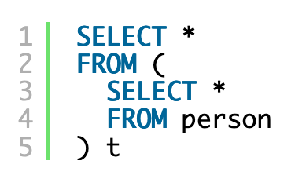
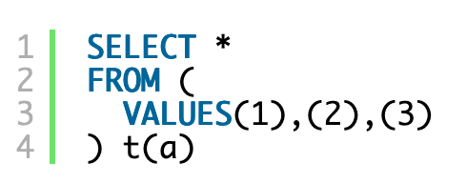
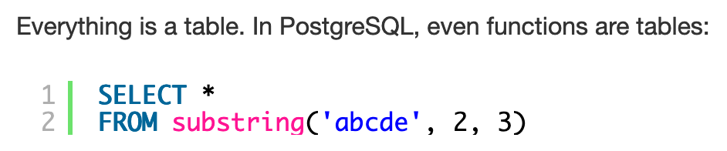
1. Everything is a Table
https://blog.jooq.org/2016/04/25/10-sql-tricks-that-you-didnt-think-were-possible/

Slide 179
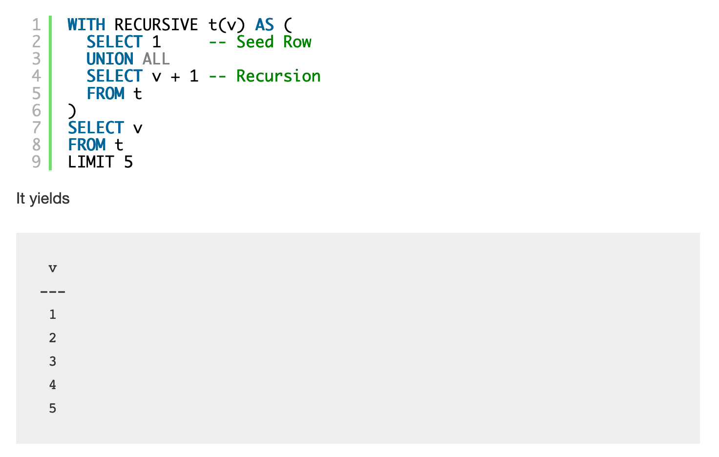
2. Recursion can be very powerful
Makes SQL Turing-Complete
https://blog.jooq.org/2016/04/25/10-sql-tricks-that-you-didnt-think-were-possible/

Slide 180
3. Window Functions
https://www.postgresql.org/docs/9.3/tutorial-window.html

Slide 181
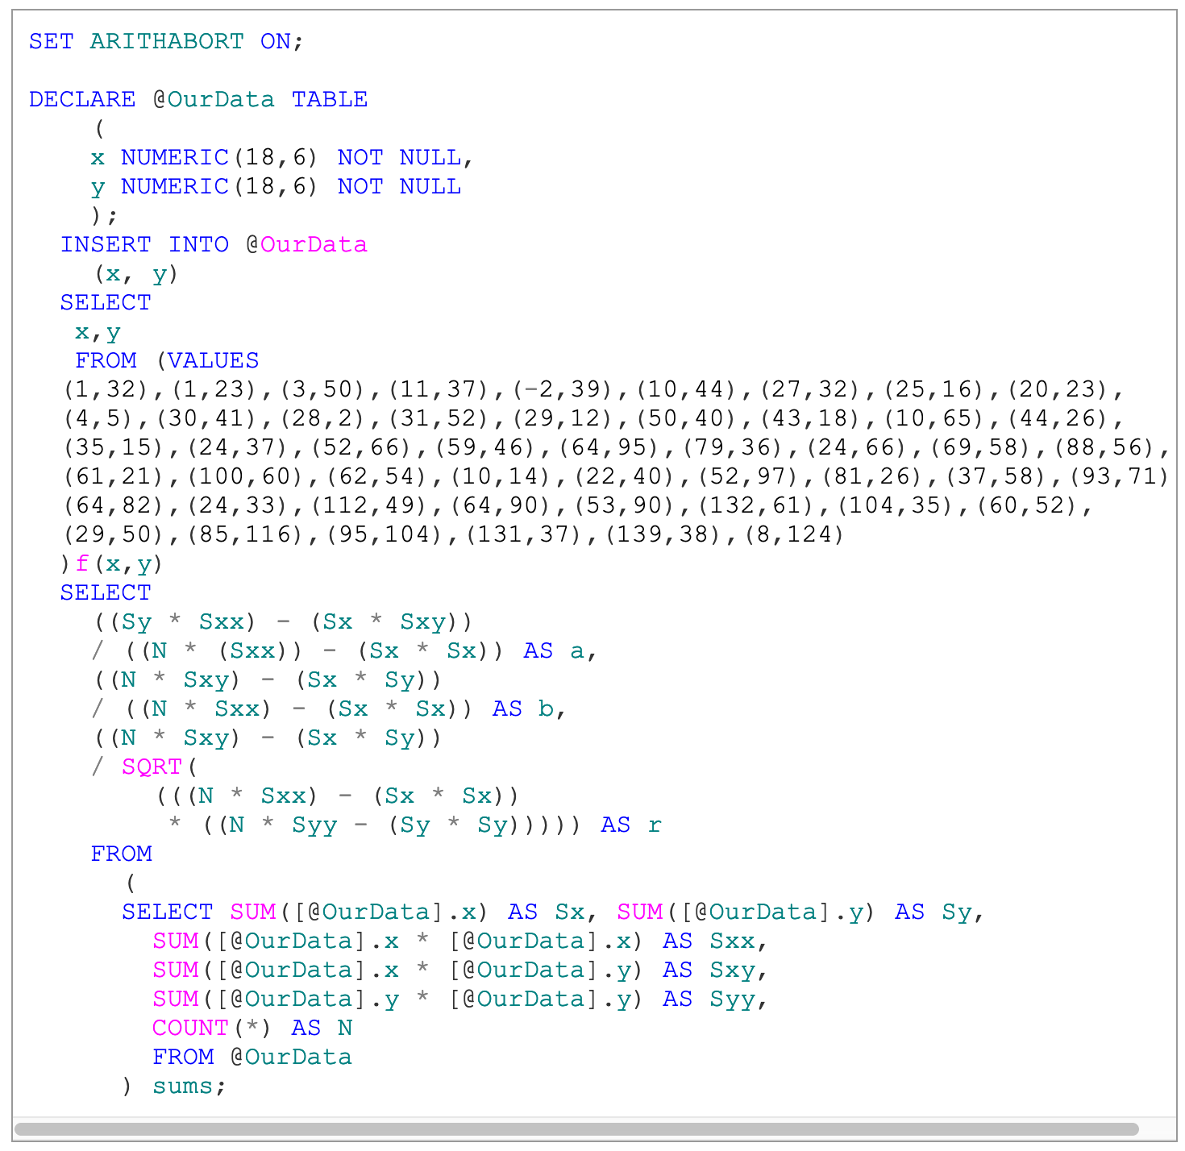
4. Correlation Coefficient
https://www.red-gate.com/simple-talk/blogs/statistics-sql-simple-linear-regressions/

Slide 182
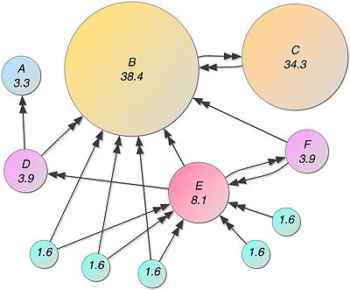
5. Page Rank
Recursive algorithm to assign weights to the nodes of a graph (Web Link Graph)
Weight for a node depends on the weights of the nodes that point to it
Typically done in iterations till “convergence”
Not obvious that you can do it in SQL, but:
Each iteration is just a LEFT OUTERJOIN
Stopping condition is trickier
Other ways to do it as well
https://devnambi.com/2013/pagerank.html

Slide 183
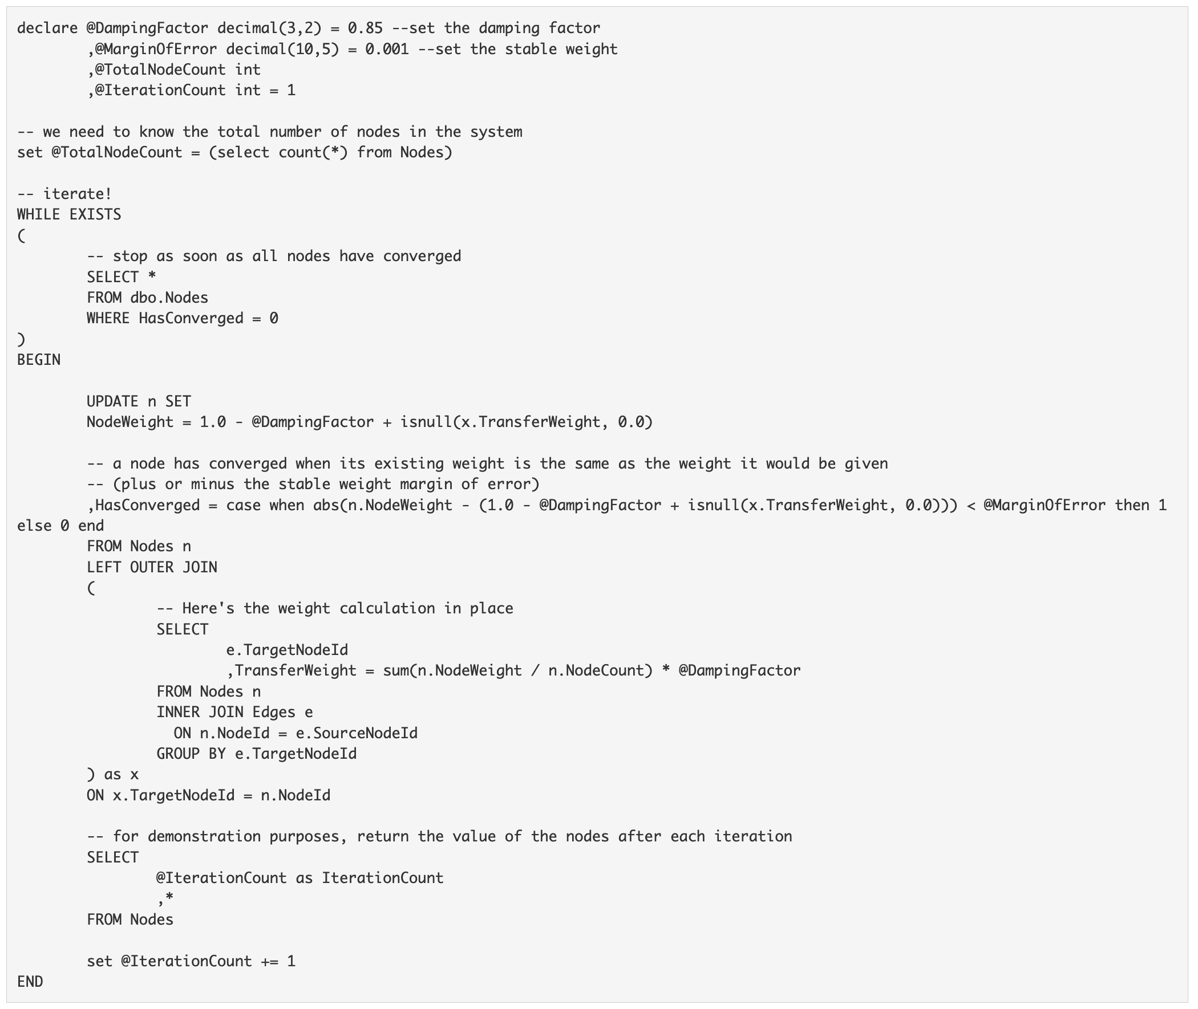

Slide 184
CMSC424: Database Design Module: Design: E/R Models and Normalization
Design Process;
Basics of E/R Modeling
Instructor: Amol Deshpande
amol@umd.edu

Slide 185
Design Process; E/R Basics
Book Chapters (6th Edition)
Sections 7.1, 7.2.1, 7.2.2
Key Topics
Steps in application and database design process
Two approaches to doing database design
Basics of E/R Modeling

Slide 186
Design Process
To create an end-to-end database-backed application, we must:
Design the database schema for hosting the data
Design the application programs for accessing and updating the data
Design security schemes to control access to the data
Typically an iterative process, involving many decision points and stakeholders
computing environments, where to deploy, how to host, languages to use, data model, database systems, application frameworks, etc. etc.
Need clear understanding of user requirements
Followed by conceptual designs → functional requirements → physical designs → implementation
Need to keep revisiting earlier decisions as requirements evolve

Slide 187
“Database” Design
Goal: design the logical database schema
Try to avoid redundancy (can lead to inconsistencies)
Ensure faithfulness to the requirements
Approach 1: Using a logical data model like the Entity-Relationship Model
Easier for humans to work with and visualize
Richer than relational model, but allows easy conversion to relational for implementation
Harder to keep up to date – requires a lot of discipline
Approach 2: Normalization Theory
Helps formalize the key design pitfalls and how to avoid them
The two approaches are complementary and important to know both of them

Slide 188
Entity-Relationship Model
Two key concepts
Entities:
An object that exists and is distinguishable from other objects
Examples: Bob Smith, BofA, CMSC424
Have attributes (people have names and addresses)
Form entity sets with other entities of the same type that share the same properties
Set of all people, set of all classes
Entity sets may overlap
Customers and Employees

Slide 189
Entity-Relationship Model
Two key concepts
Relationships:
Relate 2 or more entities
E.g. Bob Smith has account at College Park Branch
Form relationship sets with other relationships of the same type that share the same properties
Customers have accounts at Branches
Can have attributes:
has account at may have an attribute start-date
Can involve more than 2 entities
Employee works at Branch at Job

Slide 190
Entities and relationships
Two Entity Sets
Advisor Relationship, with and without attributes

Slide 191
ER Diagram
Alternative representation, used in the book in the past
access-date
cust-name
number
cust-id
Both notations used commonly
has
customer
account
cust-street
cust-city
balance

Slide 192
CMSC424: Database Design Module: Design: E/R Models and Normalization
Attributes; Relationship Cardinalities and Keys
Instructor: Amol Deshpande
amol@umd.edu

Slide 193
Attributes; Cardinality Constraints
Book Chapters (6th Edition)
Sections 7.2.3, 7.3.1, 7.3.3, 7.5.1-7.5.5
Key Topics
Different types of attributes
Cardinalities of relationships
How to identify ”keys” for relationships

Slide 194
Types of Attributes
Simple vs Composite
Single value per attribute ?
Single-valued vs Multi-valued
E.g. Phone numbers are multi-valued
Derived
If date-of-birth is present, age can be derived
Can help in avoiding redundancy, enforcing constraints etc…

Slide 195
Types of Attributes
Primary key underlined
Composite
Multi-valued
Derived

Slide 196
Relationship Cardinalities
We may know:
One customer can only open one account
OR
One customer can open multiple accounts
Representing this is important
Why ?
Better manipulation of data
If former, can store the account info in the customer table
Can enforce such a constraint
Application logic will have to do it; NOT GOOD
Remember: If not represented in conceptual model, the domain knowledge may be lost

Slide 197
Mapping Cardinalities
Express the number of entities to which another entity can be associated via a relationship set
Most useful in describing binary relationship sets

Slide 198
Mapping Cardinalities
One-to-One
One-to-Many
Many-to-One
Many-to-Many
advises
Instructor
Student
advises
Instructor
Student
advises
Instructor
Student
advises
Instructor
Student
Notes:
Should do some examples here.

Slide 199
Mapping Cardinalities
Express the number of entities to which another entity can be associated via a relationship set
Most useful in describing binary relationship sets
N-ary relationships ?
More complicated
Details in the book

Slide 200
Relationship Set Keys
What attributes are needed to represent a relationship completely and uniquely ?
Union of primary keys of the entities involved, and relationship attributes
{instructor.ID, date, student.ID} describes a relationship completely

Slide 201
Relationship Set Keys
Is {student_id, date, instructor_id} a candidate key ?
No. Attribute date can be removed from this set without losing key-ness
In fact, union of primary keys of associated entities is always a superkey

Slide 202
Relationship Set Keys
Is {student_id, instructor_id} a candidate key ?
Depends

Slide 203
Relationship Set Keys
Is {student_id, instructor_id} a candidate key ?
Depends
If one-to-one relationship, either {instructor_id} or {student_id} sufficient
Since a given instructor can only have one advisee, an instructor entity can only participate in one relationship
Ditto student

Slide 204
Relationship Set Keys
Is {student_id, instructor_id} a candidate key ?
Depends
If one-to-many relationship (as shown), {student_id} is a candidate key
A given instructor can have many advisees, but at most one advisor per student allowed

Slide 205
Relationship Set Keys
General rule for binary relationships
one-to-one: primary key of either entity set
one-to-many: primary key of the entity set on the many side
many-to-many: union of primary keys of the associate entity sets
n-ary relationships
More complicated rules

Slide 206
CMSC424: Database Design Module: Design: E/R Models and Normalization
More E/R Constructs
Instructor: Amol Deshpande
amol@umd.edu

Slide 207
More E/R Constructs
Book Chapters (6th Edition)
Sections 7.5.4, 7.5.6, 7.8
Key Topics
Recursive Relationships and Roles
Weak Entity Sets
Specialization/Generalization
Aggregation

Slide 208
Recursive Relationships
Sometimes a relationship associates an entity set to itself
Need “roles” to distinguish

Slide 209
Weak Entity Sets
An entity set without enough attributes to have a primary key
E.g. Section Entity
Still need to be able to distinguish between weak entities
Called “discriminator attributes”: dashed underline

Slide 210
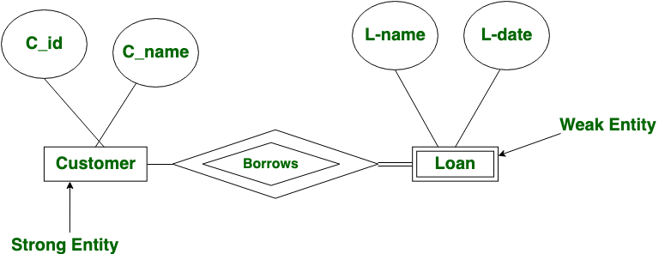
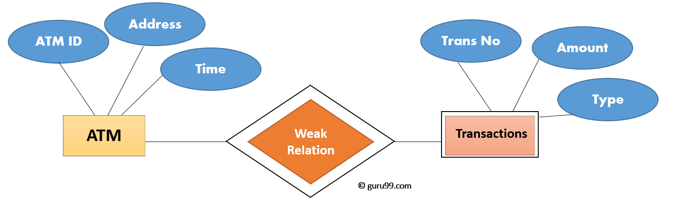
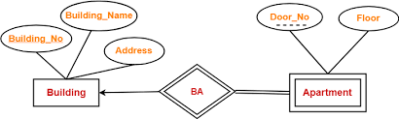
Examples of Weak Entity Sets
If transaction numbers are per ATM (i.e., first transaction from that ATM gets number 1, etc.), then Transactions is a weak entity
Loan may or may not have an extra unique identifier
Apartments don’t have a unique identifer (across all buildings) without the building information

Slide 211
Participation Constraints
Allow specifying full participation from an entity set in a relationship
i.e., every entity from that entity set ”must” participate in at least one relationship
Most common for Weak Entity Sets, but useful otherwise as well

Slide 212
Specialization/Generalization
Similar to object-oriented programming: allows inheritance etc.

Slide 213
Aggregation
No relationships allowed between relationships
Suppose we want to record evaluations of a student by a guide on a project

Slide 214
CMSC424: Database Design Module: Design: E/R Models and Normalization
Converting to Relational
Instructor: Amol Deshpande
amol@umd.edu

Slide 215
Converting E/R Models to Relations
Book Chapters (6th Edition)
Sections 7.6, 7.8.6
Key Topics
Creating Relational Schema from an E/R Model
Mapping Entities and Relationships to Relations
Weak Entity Sets to Relations
Other E/R Constructs

Slide 216
E/R Diagrams → Relations
Convert entity sets into a relational schema with the same set of attributes
Student (ID, name, tot_cred)
Instructor(ID, name, salary)

Slide 217
E/R Diagrams → Relations
Convert relationship sets also into a relational schema
Remember: A relationship is completely described by primary keys of associated entities and its own attributes
We can do better for many-to-one or one-to-one
Advisor (student_ID, instructor_ID, date)

Slide 218
E/R Diagrams → Relations
Foreign key into Instructor relation
Fold into Student:
Student(ID, name, tot_credits, advisor_ID, date)
Fold into Instructor:
Instructor(ID, name, salary, advisee_ID, date)

Slide 219
E/R Diagrams → Relations
Fold into Student:
Student(ID, name, tot_credits, advisor_ID)
OR
Fold into Instructor:
Instructor(ID, name, salary, advisee_ID)

Slide 220
Weak Entity Sets
Need to copy the primary key from the strong entity set:
Section(course_id, sec_id, semester, year)
Primary key for section = Primary key for course +
Discriminator Attributes

Slide 221
Multi-valued Attributes
BUT
Phone_number needs to be split out into a separate table
Instructor_Phone(Instructor_ID, phone_number)

Slide 222
Specialization and Generalization
A few different ways to handle it
Common table for common information and separate tables for additional information
Separate tables altogether – good idea if an employee can’t be a student also – querying becomes harder (have to do unions for queries across all “persons”)

Slide 223
CMSC424: Database Design Module: Design: E/R Models and Normalization
Design Issues;
Alternate Notations
Instructor: Amol Deshpande
amol@umd.edu

Slide 224
Design Issues; Alternate Notations
Book Chapters (6th Edition)
Sections 7.7, 7.9 (briefly)
Key Topics
Some Common Mistakes
Choosing between different ways to do the same thing
Alternate notations commonly used (including UML)
Recap

Slide 225
Some Common Mistakes

Slide 226
Some Common Mistakes

Slide 227
Design Issues
Entity sets vs attributes
Depends on the semantics of the application
Consider telephone

Slide 228
Design Issues
Entity sets vs Relationsihp sets
Consider takes

Slide 229
Design Issues
N-ary vs binary relationships
Possible to avoid n-ary relationships, but there are some cases where it is advantageous to use them

Slide 230
Alternate Notations

Slide 231
Unified Modeling Language (UML)
More comprehensive – covers use cases, flow of tasks between components, implementation diagrams, etc., in addition to data representation

Slide 232
Thoughts…
Nothing about actual data
How is it stored ?
No talk about the query languages
How do we access the data ?
Semantic vs Syntactic Data Models
Remember: E/R Model is used for conceptual modeling
Many conceptual models have the same properties
They are much more about representing the knowledge than about database storage/querying

Slide 233
Thoughts…
Basic design principles
Faithful
Must make sense
Satisfies the application requirements
Models the requisite domain knowledge
If not modeled, lost afterwards
Avoid redundancy
Potential for inconsistencies
Go for simplicity
Typically an iterative process that goes back and forth

Slide 234
CMSC424: Database Design Module: Design: E/R Models and Normalization
Normalization: Basics
Instructor: Amol Deshpande
amol@umd.edu

Slide 235
Relational Database Design
Where did we come up with the schema that we used ?
E.g. why not store the student course titles with their names ?
If from an E-R diagram, then:
Did we make the right decisions with the E-R diagram ?
Goals:
Formal definition of what it means to be a “good” schema.
How to achieve it.
More abstract and formal than most other topics we will study

Slide 236
Normalization
Book Chapters (6th Edition)
Section 8.1, 8.2
Key Topics
What makes a ”good” schema
Problems with small schemas
Problems with large schemas
Atomic domains and First Normal Form

Slide 237
Simplified University Database Schema
Student(student_id, name, tot_cred)
Student_Dept(student_id, dept_name)
Department(dept_name, building, budget)
Course(course_id, title, dept_name, credits)
Takes(course_id, student_id, semester, year)
Changed to:
Student_Dept(student_id, dept_name, name, tot_cred, building, budget)
<Student, Student_Dept, and Department Merged Together>
Course(course_id, title, dept_name, credits)
Takes(course_id, student_id, semester, year)
Is this a good schema ???

Slide 238
Student_Dept(student_id, dept_name, name, tot_cred, building, budget)
student_id | dept_name | name | tot_cred | building | budget
s1 | Comp. Sci. | John | 30 | Iribe Center | 10 M
s2 | Comp. Sci. | Alice | 20 | Iribe Center | 10 M
s2 | Math | Alice | 20 | Kirwan Hall | 10 M
s3 | Comp. Sci. | Mike | 30 | Iribe Center | 10 M
s3 | Math | Mike | 30 | Kirwan Hall | 10 M
Issues:
Redundancy ➔ higher storage, inconsistencies (“anomalies”)
update anomalies, insertion anamolies
Need nulls
Unable to represent some information without using nulls
How to store depts w/o students, or vice versa ?
Can’t have NULLs in primary keys

Slide 239
Student_Dept(student_ids, dept_name, names, tot_creds, building, budget)
student_ids | dept_name | names | tot_creds | building | budget
{s1, s2, s3} | Comp. Sci. | {John, Alice, Mike} | {30, 20, 30} | Iribe Center | 10 M
{s2, s3} | Math | {Alice, Mike} | {20, 30} | Kirwan Hall | 10 M
Issues:
3. Avoid sets
- Hard to represent
- Hard to query
- In this case, too many issues

Slide 240
Smaller schemas always good ????
Split Course(course_id, title, dept_name, credits) into:
Course1 (course_id, title, dept_name) Course2(course_id, credits)???
course_id | title | dept_name
c1 | “Intro to..” | Comp. Sci.
c2 | “Discrete Structures“ | Comp. Sci.
c3 | “Database Design” | Comp. Sci.
course_id | credits
c1 | 3
c2 | 3
c3 | 3
This process is also called “decomposition”
Issues:
4. Requires more joins (w/o any obvious benefits)
5. Hard to check for some dependencies
What if the “credits” depend on the “dept_name” (e.g., all CS courses must be 3 credits)?
No easy way to ensure that constraint (w/o a join)

Slide 241
Smaller schemas always good ????
Decompose Takes(course_id, student_id, semester, year) into:
Takes1(course_id, semester, year)
course_id | semester | year
c1 | Fall | 2020
c1 | Spring | 2020
c2 | Spring | 2020
course_id | student_id | semester | year
c1 | s1 | Fall | 2020
c1 | s2 | Spring | 2020
c2 | s1 | Spring | 2020
Takes2(course_id, student_id )
course_id | student_id
c1 | s1
c1 | s2
c2 | s1
Issues:
6. “joining” them back (on course_id) results in more tuples than what we started with
(c1, s1, Spring 2020) & (c1, s2, Fall 2020)
This is a “lossy” decomposition
We lost some constraints/information
The previous example was a “lossless” decomposition.

Slide 242
Desiderata
No sets
Correct and faithful to the original design
Must avoid lossy decompositions
As little redundancy as possible
To avoid potential anomalies
No “inability to represent information”
Nulls shouldn’t be required to store information
Dependency preservation
Should be possible to check for constraints
Not always possible.
We sometimes relax these for:
simpler schemas, and fewer joins during queries.

Slide 243
Overall Approach
1. We will encode and list all our knowledge about the schema
e.g., Functional dependencies (FDs)
SSN → name (means: SSN “implies” length)
If two tuples have the same “SSN”, they must have the same “name”
movietitle → length ???? Not true.
But, (movietitle, movieYear) → length --- True.
2. We will define a set of rules that the schema must follow to be considered good
“Normal forms”: 1NF, 2NF, 3NF, BCNF, 4NF, …
A normal form specifies constraints on the schemas and FDs
3. If not in a “normal form”, we modify the schema

Slide 244
Atomic Domains and 1st Normal Form
A domain is called “atomic” if the elements can be considered indivisible
i.e., not composite or sets
Somewhat subjective and depends on how it is being used
What about CMSC424?
A natural split into “CMSC” and “424”.
Technically not atomic since programs/analysis often split it
Often treated as atomic, but better to keep as separate columns
As long as all attributes are atomic → 1st Normal Form

Slide 245
CMSC424: Database Design Module: Design: E/R Models and Normalization
Functional Dependencies
Instructor: Amol Deshpande
amol@cs.umd.edu

Slide 246
Functional Dependencies
Book Chapters (6th Edition)
Section 8.3.1
Key Topics
Definition of a FD
Examples
Holding on an instance vs on all “legal” instances
FDs and Redundancies

Slide 247
Functional Dependencies
On a relational schema: R(A, B, C, …)
A → B (A “implies” B)
means that if two tuples have the same value for A, they
have the same value for B
A way to reason about duplication in a relational schema

Slide 248
FDs: Example 1
student_id | dept_name | name | tot_cred | building | budget
s1 | Comp. Sci. | John | 30 | Iribe Center | 10 M
s2 | Comp. Sci. | Alice | 20 | Iribe Center | 10 M
s2 | Math | Alice | 20 | Kirwan Hall | 10 M
s3 | Comp. Sci. | Mike | 30 | Iribe Center | 10 M
s3 | Math | Mike | 30 | Kirwan Hall | 10 M
student_id → name
student_id → name, tot_cred
dept_name → building
dept_name → building, budget

Slide 249
FDs: Example 2
State Name | State Code | State Population | County Name | County Population | Senator Name | Senator Elected | Senator Born | Senator Affiliation
Alabama | AL | 4779736 | Autauga | 54571 | Jeff Sessions | 1997 | 1946 | ‘R’
Alabama | AL | 4779736 | Baldwin | 182265 | Jeff Sessions | 1997 | 1946 | ‘R’
Alabama | AL | 4779736 | Barbour | 27457 | Jeff Sessions | 1997 | 1946 | ‘R’
Alabama | AL | 4779736 | Autauga | 54571 | Richard Shelby | 1987 | 1934 | ‘R’
Alabama | AL | 4779736 | Baldwin | 182265 | Richard Shelby | 1987 | 1934 | ‘R’
Alabama | AL | 4779736 | Barbour | 27457 | Richard Shelby | 1987 | 1934 | ‘R’
State Name → State Code
State Code → State Name
Senator Name → Senator Born

Slide 250
FDs: Example 3
Course ID | Course Name | Dept Name | Credits | Section ID | Semester | Year | Building | Room No. | Capacity | Time Slot ID
Functional dependencies
course_id → title, dept_name, credits
building, room_number → capacity
course_id, section_id, semester, year → building, room_number, time_slot_id

Slide 251
Examples from Quiz
advisor(s_id, i_id, s_name, s_dept_name, i_name, i_dept_name)
friends(userid1, userid2, name1, name2, birthdate1, birthdate2)

Slide 252
Functional Dependencies
Let R be a relation schema and
α ⊆ R and β ⊆ R
The functional dependency
α → β holds on R iff for any legal relations r(R), whenever two tuples t₁ and t₂ of r have same values for α, they have same values for β.
t₁[α] = t₂ [α] ⇒ t₁[β ] = t₂ [β ]
Example:
On this instance, A → B does NOT hold, but B → A does hold.
A B
4
1 5
3 7

Slide 253
Functional Dependencies
Difference between holding on an instance and holding on all legal relation
Name → Tot_Cred holds on this instance
Is this a true functional dependency ? No.
Two students with the same name can have the different credits.
Can’t draw conclusions based on a single instance
Need to use domain knowledge to decide which FDs hold
student_id | dept_name | name | tot_cred | building | budget
s1 | Comp. Sci. | John | 30 | Iribe Center | 10 M
s2 | Comp. Sci. | Alice | 20 | Iribe Center | 10 M
s2 | Math | Alice | 20 | Kirwan Hall | 10 M
s3 | Comp. Sci. | Mike | 30 | Iribe Center | 10 M
s3 | Math | Mike | 30 | Kirwan Hall | 10 M

Slide 254
FDs and Redundancy
Consider a table: R(A, B, C):
With FDs: B → C, and A → BC
So “A” is a Key, but “B” is not
So: there is a FD whose left hand side is not a key
Leads to redundancy
A | B | C
a1 | b1 | c1
a2 | b1 | c1
a3 | b1 | c1
a4 | b2 | c2
a5 | b2 | c2
a6 | b3 | c3
a7 | b4 | c1
Since B is not unique, it may be duplicated
Every time B is duplicated, so is C
Not a problem with A → BC
A can never be duplicated
Not a duplication → Two different tuples just happen to have the same value for C

Slide 255
FDs and Redundancy
Better to split it up
A | B
a1 | b1
a2 | b1
a3 | b1
a4 | b2
a5 | b2
a6 | b3
a7 | b4
B | C
b1 | c1
b2 | c2
b3 | c3
b4 | c1
Not a duplication → Two different tuples just happen to have the same value for C

Slide 256
Functional Dependencies
Functional dependencies and keys
A key constraint is a specific form of a FD.
E.g. if A is a superkey for R, then:
A → R
Similarly for candidate keys and primary keys.
Deriving FDs
A set of FDs may imply other FDs
e.g. If A → B, and B → C, then clearly A → C
We will see a formal method for inferring this later

Slide 257
Definitions
1. A relation instance r satisfies a set of functional dependencies, F, if the FDs hold on the relation
2. F holds on a relation schema R if no legal (allowable) relation instance of R violates it
3. A functional dependency, A → B, is called trivial if:
B is a subset of A
e.g. Movieyear, length → length
4. Given a set of functional dependencies, F, its closure,
F⁺ , is all the FDs that are implied by FDs in F.

Slide 258
CMSC424: Database Design Module: Design: E/R Models and Normalization
FDs: Armstrong Axioms, etc.
Instructor: Amol Deshpande
amol@umd.edu

Slide 259
Working with Functional Dependencies
Book Chapters (6th Edition)
Section 8.4.1, 8.4.2, 8.4.3
Key Topics
Closure of an attribute and attribute set
Armstrong Axioms
Extraneous Attributes
Canonical Cover
Sufficient to get a high-level idea of these – don’t need to understand the entire theory to follow rest of this

Slide 260
1. Closure
Given a set of functional dependencies, F, its closure, F⁺ , is all FDs that are implied by FDs in F.
e.g. If A → B, and B → C, then clearly A → C
We can find F+ by applying Armstrong’s Axioms:
if β ⊆ α, then α → β (reflexivity)
if α → β, then γ α → γ β (augmentation)
if α → β, and β → γ, then α → γ (transitivity)
These rules are
sound (generate only functional dependencies that actually hold)
complete (generate all functional dependencies that hold)

Slide 261
Additional rules
If α → β and α → γ, then α → β γ (union)
If α → β γ, then α → β and α → γ (decomposition)
If α → β and γ β → δ, then α γ → δ (pseudotransitivity)
The above rules can be inferred from Armstrong’s axioms.

Slide 262
Example
R = (A, B, C, G, H, I) F = { A → B A → C CG → H CG → I B → H}
Some members of F⁺
A → H
by transitivity from A → B and B → H
AG → I
by augmenting A → C with G, to get AG → CG and then transitivity with CG → I
CG → HI
by augmenting CG → I to infer CG → CGI,
and augmenting of CG → H to infer CGI → HI,
and then transitivity

Slide 263
2. Closure of an attribute set
Given a set of attributes A and a set of FDs F, closure of A under F is the set of all attributes implied by A
In other words, the largest B such that: A → B
Redefining super keys:
The closure of a super key is the entire relation schema
Redefining candidate keys:
1. It is a super key
2. No subset of it is a super key

Slide 264
Computing the closure for A
Simple algorithm
1. Start with B = A.
2. Go over all functional dependencies, β → γ , in F⁺
3. If β ⊆ B, then
Add γ to B
4. Repeat till B changes

Slide 265
Example
R = (A, B, C, G, H, I) F = { A → B A → C CG → H CG → I B → H}
(AG) ⁺ ?
1. result = AG
2. result = ABCG (A → C and A → B)
3. result = ABCGH (CG → H and CG ⊆ AGBC)
4. result = ABCGHI (CG → I and CG ⊆ AGBCH
Is (AG) a candidate key ?
1. It is a super key.
2. (A+) = ABCH, (G+) = G.
YES.

Slide 266
Uses of attribute set closures
Determining superkeys and candidate keys
Determining if A → B is a valid FD
Check if A+ contains B
Can be used to compute F+

Slide 267
3. Extraneous Attributes
Consider F, and a functional dependency, A → B.
“Extraneous”: Are there any attributes in A or B that can be safely removed ?
Without changing the constraints implied by F
Example: Given F = {A → C, AB → CD}
C is extraneous in AB → CD since AB → C can be inferred even after deleting C
ie., given: A → C, and AB → D, we can use Armstrong Axioms to infer AB → CD

Slide 268
4. Canonical Cover
A canonical cover for F is a set of dependencies F_{c} such that
F logically implies all dependencies in F_{c,} and
F_{c} logically implies all dependencies in F, and
No functional dependency in F_{c} contains an extraneous attribute, and
Each left side of functional dependency in F_{c} is unique
In some (vague) sense, it is a minimal version of F
Read up algorithms to compute F_{c}

Slide 269
CMSC424: Database Design Module: Design: E/R Models and Normalization
Decompositions
Instructor: Amol Deshpande
amol@cs.umd.edu

Slide 270
Lossless and Lossy Decompositions
Book Chapters (6th Edition)
Section 8.4.4
Key Topics
How to decompose a schema in a lossless manner
Dependency preserving decompositions

Slide 271
Decompositions
Splitting a relational schema R into two relations R1, R2, typically for normalization
e.g., R(A, B, C, D, E) can be decomposed into:
R1(A, B, C), R2(D, E)
R1(A, B, C, D), R2(D, E)
…
When is this okay to do?
The two resulting relations must be equivalent to the original relation… always
Otherwise, it is a “lossy” decomposition, and not allowed

Slide 272
Loss-less Decompositions
Definition: A decomposition of R into (R1, R2) is called lossless if, for all legal instances of r(R):
r = ∏_{R1} (r ) ∏_{R2} (r )
In other words, projecting on R1 and R2, and joining back, results in the relation you started with
Rule: A decomposition of R into (R1, R2) is lossless, iff:
R1 ∩ R2 → R1 or R1 ∩ R2 → R2
in F+.
Why? The join attributes then form a key for one of the relations
Each tuple from the other relation joins with exactly one from that relation

Slide 273
Loss-less Decompositions
Example: R(A, B, C), FDs: A → B
Decomposition into R1(A, B) and R2(A, C) is lossless
(R1 ∩ R2 =) A → (R1 =) AB
Decomposition into R1(A, B) and R2(B, C) is not lossless
A | B | C
a1 | b1 | c1
a1 | b1 | c2
a2 | b1 | c3
a3 | b1 | c4
A | B
a1 | b1
a2 | b1
a3 | b1
B | C
b1 | c1
b1 | c2
b1 | c3
b1 | c4
A | B | C
a1 | b1 | c1
a1 | b1 | c2
a1 | b1 | c3
a1 | b1 | c4
a2 | b1 | c1
a2 | b1 | c2
a2 | b1 | c3
a2 | b1 | c4
a3 | b1 | c1
a3 | b1 | c2
a3 | b1 | c3
a3 | b1 | c4
=

Slide 274
Dependency-preserving Decompositions
Is it easy to check if the dependencies in F hold ?
Okay as long as the dependencies can be checked in the same table.
Consider R = (A, B, C), and F ={A → B, B → C}
1. Decompose into R1 = (A, B), and R2 = (A, C)
Lossless ? Yes.
But, makes it hard to check for B → C
The data is in multiple tables.
2. On the other hand, R1 = (A, B), and R2 = (B, C),
is both lossless and dependency-preserving
Really ? What about A → C ?
If we can check A → B, and B → C, A → C is implied.

Slide 275
Dependency-preserving Decompositions
Definition:
Consider decomposition of R into R1, …, Rn.
Let F_{i} be the set of dependencies F ⁺ that include only attributes in R_{i}.
The decomposition is dependency preserving, if
(F₁ ∪ F₂ ∪ … ∪ F_{n} )⁺ = F ⁺

Slide 276
CMSC424: Database Design Module: Design: E/R Models and Normalization
Boyce-Codd Normal Form
Instructor: Amol Deshpande
amol@umd.edu

Slide 277
Boyce Codd Normal Form
Book Chapters (6th Edition)
Section 8.3.2
Key Topics
Definition
How BCNF helps avoid redundancy
How to decompose a schema into BCNF

Slide 278
Approach
1. We will encode and list all our knowledge about the schema
Functional dependencies (FDs)
Also:
Multi-valued dependencies (briefly discuss later)
Join dependencies etc…
2. We will define a set of rules that the schema must follow to be considered good
“Normal forms”: 1NF, 2NF, 3NF, BCNF, 4NF, …
A normal form specifies constraints on the schemas and FDs
3. If not in a “normal form”, we modify the schema

Slide 279
BCNF: Boyce-Codd Normal Form
A relation schema R is “in BCNF” if:
Every functional dependency A → B that holds on it is EITHER:
1. Trivial OR
2. A is a superkey of R
Why is BCNF good ?
Guarantees that there can be no redundancy because of a functional dependency
Consider a relation r(A, B, C, D) with functional dependency
A → B and two tuples: (a1, b1, c1, d1), and (a1, b1, c2, d2)
b1 is repeated because of the functional dependency
BUT this relation is not in BCNF
A → B is neither trivial nor is A a superkey for the relation

Slide 280
BCNF and Redundancy
Why does redundancy arise ?
Given a FD, A → B, if A is repeated (B – A) has to be repeated
If rule 1 is satisfied, (B – A) is empty, so not a problem.
If rule 2 is satisfied, then A can’t be repeated, so this doesn’t happen either
Hence no redundancy because of FDs
Redundancy may exist because of other types of dependencies
Higher normal forms used for that (specifically, 4NF)
Data may naturally have duplicated/redundant data
We can’t control that unless a FD or some other dependency is defined

Slide 281
BCNF
What if the schema is not in BCNF ?
Decompose (split) the schema into two pieces.
From the previous example: split the schema into:
r1(A, B), r2(A, C, D)
The first schema is in BCNF, the second one may not be (and may require further decomposition)
No repetition now: r1 contains (a1, b1), but b1 will not be repeated
Careful: you want the decomposition to be lossless
No information should be lost
The above decomposition is lossless

Slide 282
Achieving BCNF Schemas
For all dependencies A → B in F+, check if A is a superkey
By using attribute closure
If not, then
Choose a dependency in F+ that breaks the BCNF rules, say A → B
Create R1 = A B
Create R2 = A (R – B – A)
Note that: R1 ∩ R2 = A and A → AB (= R1), so this is lossless decomposition
Repeat for R1, and R2
By defining F1+ to be all dependencies in F that contain only attributes in R1
Similarly F2+

Slide 283
Example 1
R = (A, B, C)
F = {A → B, B → C}
Candidate keys = {A}
BCNF = No. B → C violates.
^{B → C}
R1 = (B, C)
F1 = {B → C}
Candidate keys = {B}
BCNF = true
R2 = (A, B)
F2 = {A → B}
Candidate keys = {A}
BCNF = true

Slide 284
Example 2-1
R = (A, B, C, D, E)
F = {A → B, BC → D}
Candidate keys = {ACE}
BCNF = Violated by {A → B, BC → D} etc…
From A → B and BC → D by pseudo-transitivity
^{A → B}
R1 = (A, B)
F1 = {A → B}
Candidate keys = {A}
BCNF = true
R2 = (A, C, D, E)
F2 = {AC → D}
Candidate keys = {ACE}
BCNF = false (AC → D)
Dependency preservation ???
We can check:
A → B (R1), AC → D (R3),
but we lost BC → D
So this is not a dependency
-preserving decomposition
^{AC → D}
R3 = (A, C, D)
F3 = {AC → D}
Candidate keys = {AC}
BCNF = true
R4 = (A, C, E)
F4 = {} [[ only trivial ]]
Candidate keys = {ACE}
BCNF = true

Slide 285
Example 2-2
R = (A, B, C, D, E)
F = {A → B, BC → D}
Candidate keys = {ACE}
BCNF = Violated by {A → B, BC → D} etc…
^{BC → D}
R1 = (B, C, D)
F1 = {BC → D}
Candidate keys = {BC}
BCNF = true
R2 = (B, C, A, E)
F2 = {A → B}
Candidate keys = {ACE}
BCNF = false (A → B)
Dependency preservation ???
We can check:
BC → D (R1), A → B (R3),
Dependency-preserving
decomposition
^{A → B}
R3 = (A, B)
F3 = {A → B}
Candidate keys = {A}
BCNF = true
R4 = (A, C, E)
F4 = {} [[ only trivial ]]
Candidate keys = {ACE}
BCNF = true

Slide 286
Example 3
R = (A, B, C, D, E, H)
F = {A → BC, E → HA}
Candidate keys = {DE}
BCNF = Violated by {A → BC} etc…
^{A → BC}
R1 = (A, B, C)
F1 = {A → BC}
Candidate keys = {A}
BCNF = true
R2 = (A, D, E, H)
F2 = {E → HA}
Candidate keys = {DE}
BCNF = false (E → HA)
^{E → HA}
Dependency preservation ???
We can check:
A → BC (R1), E → HA (R3),
Dependency-preserving
decomposition
R3 = (E, H, A)
F3 = {E → HA}
Candidate keys = {E}
BCNF = true
R4 = (ED)
F4 = {} [[ only trivial ]]
Candidate keys = {DE}
BCNF = true

Slide 287
CMSC424: Database Design Module: Design: E/R Models and Normalization
3NF, 4NF, and Other Issues
Instructor: Amol Deshpande
amol@umd.edu

Slide 288
3rd and 4th Normal Forms
Book Chapters (6th Edition)
Section 8.3.4, 8.3.5, 8.5.2, 8.6 (at a high level)
Key Topics
BCNF can’t always preserve dependencies
How 3NF fixes that
BCNF causes redundancy because of “multi-valued dependencies”
How 4NF fixes that

Slide 289
Issue 1: BCNF may not preserve dependencies
R = (J, K, L}
F = {JK → L, L → K }
Two candidate keys = JK and JL
R is not in BCNF
Any decomposition of R will fail to preserve
JK → L
This implies that testing for JK → L requires a join

Slide 290
Issue 1: BCNF may not preserve dependencies
Not always possible to find a dependency-preserving decomposition that is in BCNF.
PTIME to determine if there exists a dependency-preserving decomposition in BCNF
in size of F
NP-Hard to find one if it exists
Better results exist if F satisfies certain properties

Slide 291
3NF (3rd Normal Form)
Definition: Prime attributes
An attribute that is contained in a candidate key for R
Example 1:
R = (A, B, C, D, E, H}, F = {A → BC, E → HA},
Candidate keys = {ED}
Prime attributes: D, E
Example 2:
R = (J, K, L), F = {JK → L, L → K},
Candidate keys = {JL, JK}
Prime attributes: J, K, L
Observation/Intuition:
1. A key has no redundancy (is not repeated in a relation)
2. A prime attribute has limited redundancy

Slide 292
3NF (3rd Normal Form)
Given a relation schema R, and a set of functional dependencies F, if every FD, A → B, is either:
1. Trivial, or
2. A is a superkey of R, or
3. All attributes in (B – A) are prime
Then, R is in 3NF (3rd Normal Form)
Why is 3NF good ?

Slide 293
3NF and Redundancy
Why does redundancy arise ?
Given a FD, A → B, if A is repeated (B – A) has to be repeated
If rule 1 is satisfied, (B – A) is empty, so not a problem.
If rule 2 is satisfied, then A can’t be repeated, so this doesn’t happen either
If not, rule 3 says (B – A) must contain only prime attributes
This limits the redundancy somewhat.
So 3NF relaxes BCNF somewhat by allowing for some (hopefully limited) redundancy
Why ?
There always exists a dependency-preserving lossless decomposition in 3NF.

Slide 294
Decomposing into 3NF
A synthesis algorithm
Start with the canonical cover, and construct the 3NF schema directly
Homework assignment.

Slide 295
Issue 2: BCNF and redundancy
MovieTitle | MovieYear | StarName | Address
Star wars | 1977 | Harrison Ford | Address 1, LA
Star wars | 1977 | Harrison Ford | Address 2, FL
Indiana Jones | 198x | Harrison Ford | Address 1, LA
Indiana Jones | 198x | Harrison Ford | Address 2, FL
Witness | 19xx | Harrison Ford | Address 1, LA
Witness | 19xx | Harrison Ford | Address 2, FL
… | … | … | …
Lot of redundancy
FDs ? No non-trivial FDs.
So the schema is trivially in BCNF (and 3NF)
What went wrong ?

Slide 296
Multi-valued Dependencies
The redundancy is because of multi-valued dependencies
Denoted:
starname →→ address
starname →→ movietitle, movieyear
Should not happen if the schema is constructed from an E/R diagram
Functional dependencies are a special case of multi-valued dependencies

Slide 297
4NF
Similar to BCNF, except with MVDs instead of FDs.
Given a relation schema R, and a set of multi-valued dependencies F, if every MVD, A →→ B, is either:
1. Trivial, or
2. A is a superkey of R
Then, R is in 4NF (4th Normal Form)
4NF → BCNF → 3NF → 2NF → 1NF:
If a schema is in 4NF, it is in BCNF.
If a schema is in BCNF, it is in 3NF.
Other way round is untrue.

Slide 298
Comparing the normal forms
 | 3NF | BCNF | 4NF
Eliminates redundancy because of FD’s | Mostly | Yes | Yes
Eliminates redundancy because of MVD’s | No | No | Yes
Preserves FDs | Yes. | Maybe | Maybe
Preserves MVDs | Maybe | Maybe | Maybe
4NF is typically desired and achieved.
A good E/R diagram won’t generate non-4NF relations at all
Choice between 3NF and BCNF is up to the designer

Slide 299
CMSC424: Database Design Module: Design: E/R Models and Normalization
Recap and Other Issues
Instructor: Amol Deshpande
amol@umd.edu

Slide 300
Recap and Other Issues
Book Chapters (6th Edition)
Section 8.8
Key Topics
Database design process
Denormalization
Other normal forms
Recap

Slide 301
Database design process
Three ways to come up with a schema
1. Using E/R diagram
If good, then little normalization is needed
Tends to generate 4NF designs
2. A universal relation R that contains all attributes.
Called universal relation approach
Note that MVDs will be needed in this case
3. An ad hoc schema that is then normalized
MVDs may be needed in this case

Slide 302
Recap
What about 1st and 2nd normal forms ?
1NF:
Essentially says that no set-valued attributes allowed
Formally, a domain is called atomic if the elements of the domain are considered indivisible
A schema is in 1NF if the domains of all attributes are atomic
We assumed 1NF throughout the discussion
Non 1NF is just not a good idea
2NF:
Mainly historic interest
See Exercise 7.15 in the book

Slide 303
Recap
We would like our relation schemas to:
Not allow potential redundancy because of FDs or MVDs
Be dependency-preserving:
Make it easy to check for dependencies
Since they are a form of integrity constraints
Functional Dependencies/Multi-valued Dependencies
Domain knowledge about the data properties
Normal forms
Defines the rules that schemas must follow
4NF is preferred, but 3NF is sometimes used instead

Slide 304
Recap
Denormalization
After doing the normalization, we may have too many tables
We may denormalize for performance reasons
Too many tables → too many joins during queries
A better option is to use views instead
So if a specific set of tables is joined often, create a view on the join
More advanced normal forms
project-join normal form (PJNF or 5NF)
domain-key normal form
Rarely used in practice

Slide 305
CMSC424: Database Design Module: Database Implementation
Instructor: Amol Deshpande
amol@cs.umd.edu

Slide 306
Database Implementation
Shifting into discussing the internals of a DBMS
How data stored? How queries/transactions executed?
Topics:
Storage: How is data stored? Important features of the storage devices (RAM, Disks, SSDs, etc)
File Organization: How are tuples mapped to blocks
Indexes: How to quickly find specific tuples of interest (e.g., all ‘friends’ of ‘user0’)
Query processing: How to execute different relational operations? How to combine them to execute an SQL query?
Query optimization: How to choose the best way to execute a query?

Slide 307
Query Processing/Storage
user query
results
Given an input user query, decide how to “execute” it
Specify sequence of pages to be brought in memory
Operate upon the tuples to produce results
Query Processing Engine
page requests
pointers
to pages
Bringing pages from disk to memory
Managing the limited memory
Buffer Management
block requests
data
Space Management on Persistent Storage (e.g., Disks)
Storage hierarchy
How are relations mapped to files?
How are tuples mapped to disk blocks?

Slide 308
CMSC424: Database Design Module: Database Implementation
Storage: Storage Hierarchy
Instructor: Amol Deshpande
amol@cs.umd.edu

Slide 309
Storage Hierarchy
Book Chapters
10.1 (and some other online resources)
Key topics:
Differences between storage media
Storage hierarchy
Caches

Slide 310
Storage Options
At various points, data stored in different storage hardware
Memory, Disks, SSDs, Tapes, Cache
Tradeoffs between speed and cost of access
CPU needs the data in memory and cache to operate on it
Volatile vs nonvolatile
Volatile: Loses contents when power switched off
Sequential vs random access
Sequential: read the data contiguously
select * from employee
Random: read the data from anywhere at any time
select * from employee where name like ‘__a__b’

Slide 311
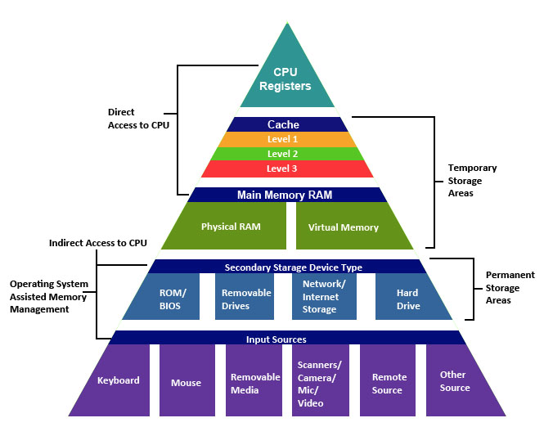
Storage Hierarchy
source: http://cse1.net/recaps/4-memory.html

Slide 312
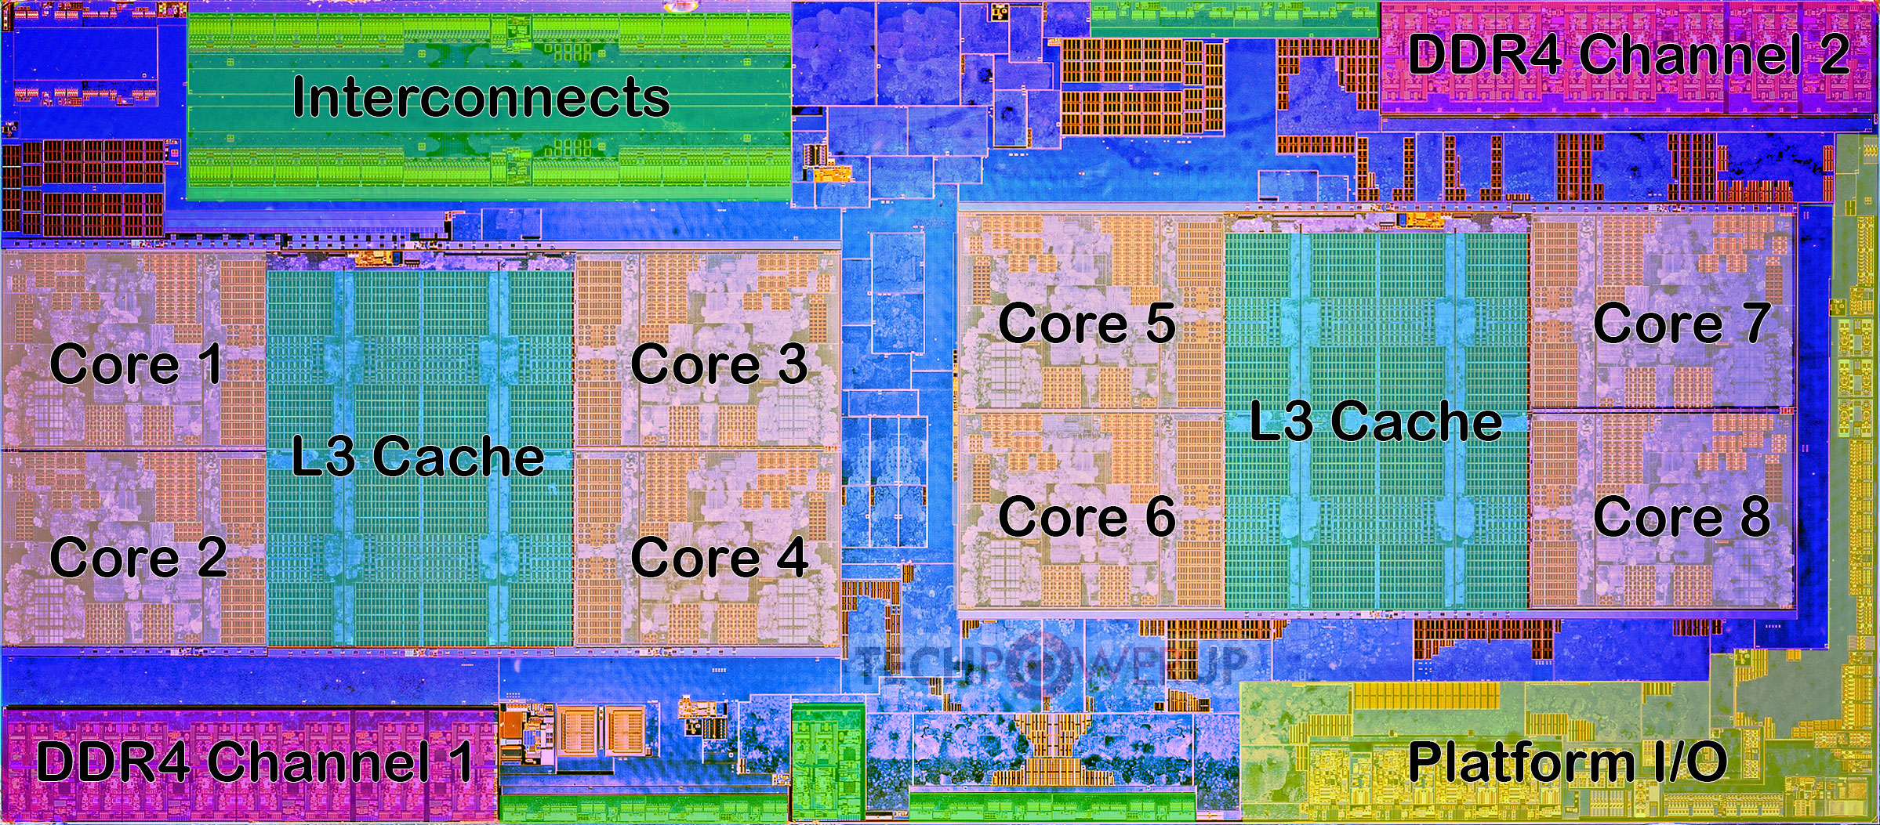
AMD Ryzen CPU Architecture
Die shot overlaid with functional units
https://www.techpowerup.com/review/amd-ryzen-5-1600/3.html

Slide 313
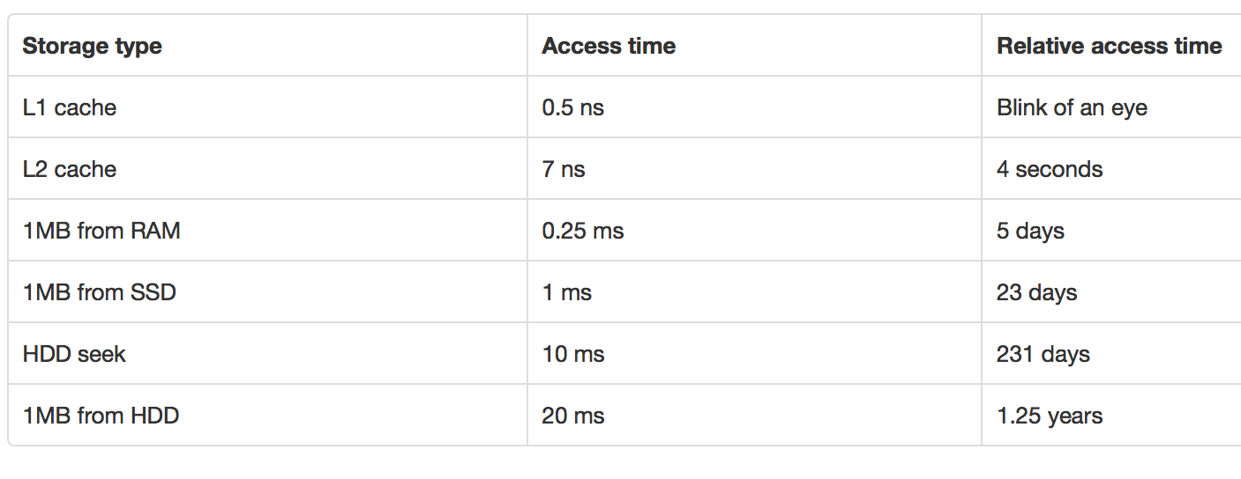
Storage Hierarchy
source: http://cse1.net/recaps/4-memory.html

Slide 314
Storage Options
Primary
e.g. Main memory, cache; typically volatile, fast
Secondary
e.g. Disks; Solid State Drives (SSD); non-volatile
Tertiary
e.g. Tapes; Non-volatile, super cheap, slow
Each storage media has different performance characteristics
Important to understand in order to write systems or optimize queries or tasks

Slide 315
Storage Hierarchy: Cache
Cache
Super fast; volatile; Typically on chip
L1 vs L2 vs L3 caches ???
L1 about 64KB or so; L2 about 1MB; L3 8MB (on chip) to 256MB (off chip)
Huge L3 caches available now-a-days
Becoming more and more important to care about this
Cache misses are expensive
Similar tradeoffs as were seen between main memory and disks

Slide 316
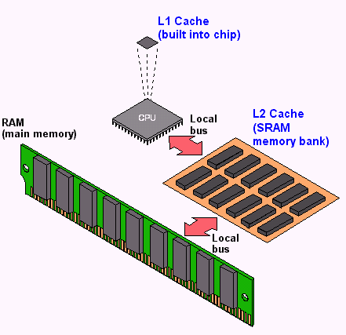
Storage Hierarchy: Cache
source: http://cse1.net/recaps/4-memory.html

Slide 317
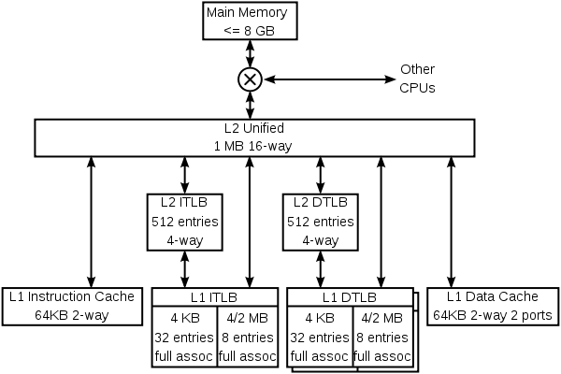
Storage Hierarchy: Cache
K8 core in the AMD Athlon 64 CPU

Slide 318
Storage Hierarchy: Main Memory
Data must be brought from disks/SSDs into Memory (and then into Caches) for the CPU to access it
CPU has no “direct” connection to the disks
10s or 100s of ns; Volatile (so will not survive a power failure)
Pretty cheap and dropping: 1GByte < $10 today
Main memory databases very common now-a-days
Dramatically changes the tradeoffs
Don’t need to worry about the disks or SSDs as much

Slide 319
Storage Hierarchy
Magnetic Disk (Hard Drive)
Non-volatile
Sequential access much much faster than random access
Discuss in more detail later
Optical Storage - CDs/DVDs; Jukeboxes
Used more as backups… Why ?
Very slow to write (if possible at all)
Tape storage
Backups; super-cheap; painful to access
IBM just released a secure tape drive storage solution

Slide 320
How important is this today?
Trade-offs shifted drastically over last 10-15 years
Especially with fast network, SSDs, and high memories
However, the volume of data is also growing quite rapidly
Some observations:
Cheaper to access another computer’s memory than accessing your own disk
Cache is playing more and more important role
Enough memory around that data often fits in memory of a single machine, or a cluster of machines
“Disk” considerations less important
Still: Disks are where most of the data lives today
Similar reasoning/algorithms required though

Slide 321
CMSC424: Database Design Module: Database Implementation
Storage: Disks and SSDs
Instructor: Amol Deshpande
amol@cs.umd.edu

Slide 322
Disks and SSDs
Book Chapters
10.2
Key topics:
Key components
Characteristics
Solid State Drives

Slide 323
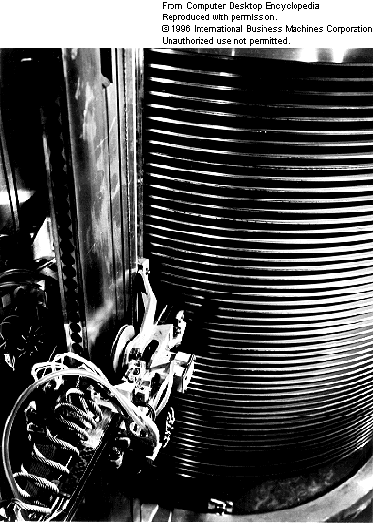
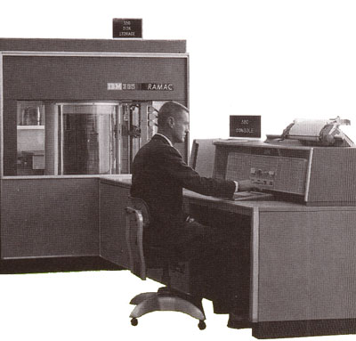
1956
IBM RAMAC
24” platters
100,000 characters each
5 million characters

Slide 324
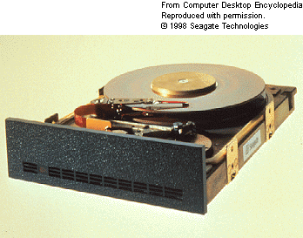


1979
SEAGATE
5MB
1998
SEAGATE
47GB
2006
Western Digital
500GB
Weight (max. g): 600g

Slide 326
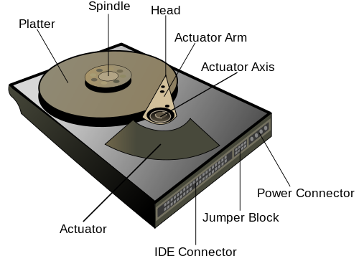

Slide 327

https://www.youtube.com/watch?v=9eMWG3fwiEU

Slide 328
“Typical” Values
Diameter: 1 inch → 15 inches
Cylinders: 100 → 2000
Surfaces: 1 or 2
(Tracks/cyl) 2 (floppies) → 30
Sector Size: 512B → 50K
Capacity → 360 KB to 2TB (as of Feb 2010)
Rotations per minute (rpm) → 5400 to 15000

Slide 329
Accessing Data
Accessing a sector
Time to seek to the track (seek time)
average 4 to 10ms
+ Waiting for the sector to get under the head (rotational latency)
average 4 to 11ms
+ Time to transfer the data (transfer time)
very low
About 10ms per access
So if randomly accessed blocks, can only do 100 block transfers
100 x 512bytes = 50 KB/s
Data transfer rates
Rate at which data can be transferred (w/o any seeks)
30-50MB/s to up to 200MB/s (Compare to above)
Seeks are bad !

Slide 330
Reliability
Mean time to/between failure (MTTF/MTBF):
57 to 136 years
Consider:
1000 new disks
1,200,000 hours of MTTF each
On average, one will fail 1200 hours = 50 days !
Need to assume disk failures are common
Handled today through keeping data in duplicate, or triplicate
If a disk fails, replace with a new disk and copy data over

Slide 331
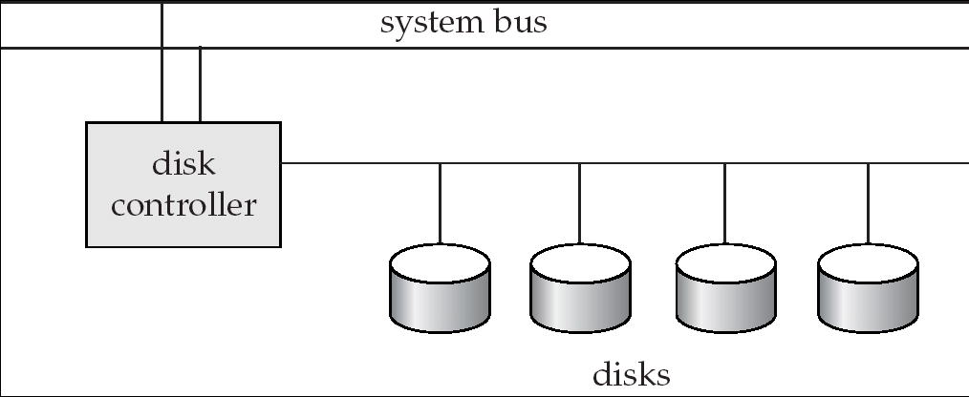
Disk Controller
Interface between the disk and the CPU
Accepts the commands
checksums to verify correctness
Remaps bad sectors

Slide 332
Optimizing block accesses
Typically sectors too small
Block: A contiguous sequence of sectors
512 bytes to several Kbytes
All data transfers done in units of blocks
Scheduling of block access requests ?
Considerations: performance and fairness
Elevator algorithm

Slide 333

Solid State Drives
Essentially flash that emulates hard disk interfaces
https://blogs.umass.edu/Techbytes/2018/02/23/types-of-ssds-and-which-ones-to-buy/

Slide 334
Solid State Drives
Still support the same “block-oriented” interface
So reads/writes happen in units of blocks
No seeks → Much better random reads performance
Writes are more complicated
Must write an entire block at a time, after first “erasing” it
Limit on how many times you can erase a block
Wear leveling
Distributes writes across the SSD for uniform wearing out
Flash Translation Layer (FTL) takes care of these issues
About a factor of 5-10 more expensive right now

Slide 335
CMSC424: Database Design Module: Database Implementation
Virtual Memory and Buffer Manager
Instructor: Amol Deshpande
amol@umd.edu

Slide 336
Virtual memory and buffer manager
Book Chapters
10.7 and other resources (VM not covered in book)
Key topics:
Role of a Buffer Manager
Buffer Manager Replacement Policies
Key requirements and definitions for Buffer Manager
Brief recap of Virtual Memory and Why it matters in practice

Slide 337
Query Processing/Storage
user query
results
Given an input user query, decide how to “execute” it
Specify sequence of pages to be brought in memory
Operate upon the tuples to produce results
Query Processing Engine
page requests
pointers
to pages
Bringing pages from disk to memory
Managing the limited memory
Buffer Management
block requests
data
Space Management on Persistent Storage (e.g., Disks)
Storage hierarchy
How are relations mapped to files?
How are tuples mapped to disk blocks?

Slide 338
Buffer Manager
When the QP wants a block, it asks the “buffer manager”
The block must be in memory to operate upon
Buffer manager:
If block already in memory: return a pointer to it
If not:
Evict a current page
Either write it to temporary storage,
or write it back to its original location,
or just throw it away (if it was read from disk, and not modified)
and make a request to the storage subsystem to fetch it

Slide 339
Buffer Manager
Page Requests from Higher Levels
BUFFER POOL
disk page
free frame
MAIN MEMORY
DISK
choice of frame dictated
by replacement policy
DB

Slide 340
Buffer Manager
Similar to virtual memory manager
Buffer replacement policies
What page to evict ?
LRU: Least Recently Used
Throw out the page that was not used in a long time
MRU: Most Recently Used
The opposite
Why ? Works better for database “scan” operations
LRU-k
Look at the penultimate access rather than the last access
Does as well as MRU for scans

Slide 341
Replacement Policy: Example
Say Buffer can hold 3 pages, and pages are: A, B, C, D, E, F
For LRU-2: we look at the second-last access
If no second-last access, then treat it as: - ∞
Break ties based on last access
Once a page goes to disk, the accesses reset
Page Request | LRU State | MRU State | LRU-2 State
A | A | A | A
B | A, B | B, A | A, B
C | A, B, C | C, B, A | A, B, C
D | B, C, D | D, B, A | B, C, D
A | C, D, A | A, D, B | C, D, A
C | D, A, C | C, D, B | D, A, C
B | A, C, B | B, C, D | A, B, C
Order of eviction
i.e., A will be evicted first
Different from LRU – B will be evicted earlier
Penultimate access for C is earlier than B (- infinity for B)

Slide 342
Buffer Manager
Pinning a block
Not allowed to write back to the disk
Force-output (force-write)
Force the contents of a block to be written to disk
Order the writes
This block must be written to disk before this block
Critical for fault tolerant guarantees
Otherwise the database has no control over whats on disk and whats not on disk

Slide 343
Reality Check…
Most operating systems don’t provide user programs with direct access to memory
Some DBs built their own OSs because of this in the early days
Most databases today run on top of your OSes
Including our PostgreSQL
Causes several problems
OS Buffer Manager doesn’t provide the required functionality
No real control over when pages are written back
Can’t “pin” pages, or “force-write”

Slide 344
Reality Check…
Memory-mapped files help with many of these issues
Allow mapping a disk file directly to virtual memory
More efficient than going through the OS
With increasing memory sizes, most databases now-a-days fit in memory
Many newer database systems redesigned to exploit this
Issues of cache/memory, how memory is managed, etc. becoming increasingly important
Distributed/parallel architectures also add more complexity to this

Slide 345
CMSC424: Database Design Module: File Organization and Indexes
File Organization
Instructor: Amol Deshpande
amol@umd.edu

Slide 346
File Organization & Indexes Overview
Book Chapters
10.5, 10.6
Key topics:
Different ways the tuples mapped to disk blocks
Pros and cons of the different approaches

Slide 347
Review: Query Processing/Storage
user query
results
Given a input user query, decide how to “execute” it
Specify sequence of pages to be brought in memory
Operate upon the tuples to produce results
Query Processing Engine
page requests
pointers
to pages
Bringing pages from disk to memory
Managing the limited memory
Buffer Management
block requests
data
Space Management on Persistent Storage (e.g., Disks)
Storage hierarchy
How are relations mapped to files?
How are tuples mapped to disk blocks?

Slide 348
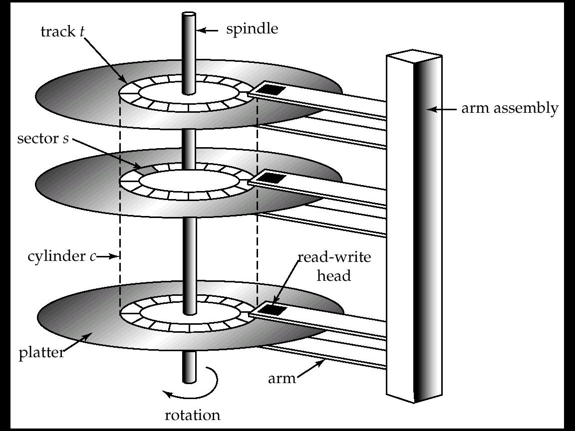
Mapping Tuples to Disk Blocks
Very important implications on performance
Quite a few different ways to do this
Similar issues even if not using disks as the primary storage
?

Slide 349
File Organization
Requirements and Performance Goals:
Allow insertion/deletions of tuples/records in relations
Fetch a particular record (specified by record id)
Find all tuples that match a condition (say SSN = 123) ?
Fetch all tuples from a specific relation (scans)
Faster if they are all sequential/in contiguous blocks
Allow building of “indexes”
Auxiliary data structures maintained on disks and in memory for faster retrieval
And so on…

Slide 350
File System or Not
Option 1: Use OS File System
File systems are a standard abstraction provided by Operating Systems (OS) for managing data
Major Con: Databases don’t have as much control over the physical placement anymore --- OS controls that
E.g., Say DBMS maps a relation to a “file”
No guarantee that the file will be “contiguous” on the disk
OS may spread it across the disk, and won’t even tell the DBMS
Option 2: DBMS directly works with the disk or uses a lightweight/custom OS
Increasingly uncommon – most DBMSs today run on top of OSes (e.g., PostgreSQL on your laptop, or on linux VMs in the cloud, or on a distributed HDFS)

Slide 351
Through a File System
Option 1: Allocate a single “file” on the disk, and treat it as a contiguous sequence of blocks
This is what PostgreSQL does
The blocks may not actually be contiguous on disk
Option 2: A different file per relation
Some of the simpler DBMS use this approach
Either way: we have a set of relations mapped to a set of blocks on disk

Slide 352
Assumptions for Now
Each relation stored separately on a separate set of blocks
Assumed to be contiguous
Each “index” maintained in a separate set of blocks
Assumed to be contiguous
Disk block
instructor
student
B+-tree index for instructor
Some extra space for new tuples

Slide 353
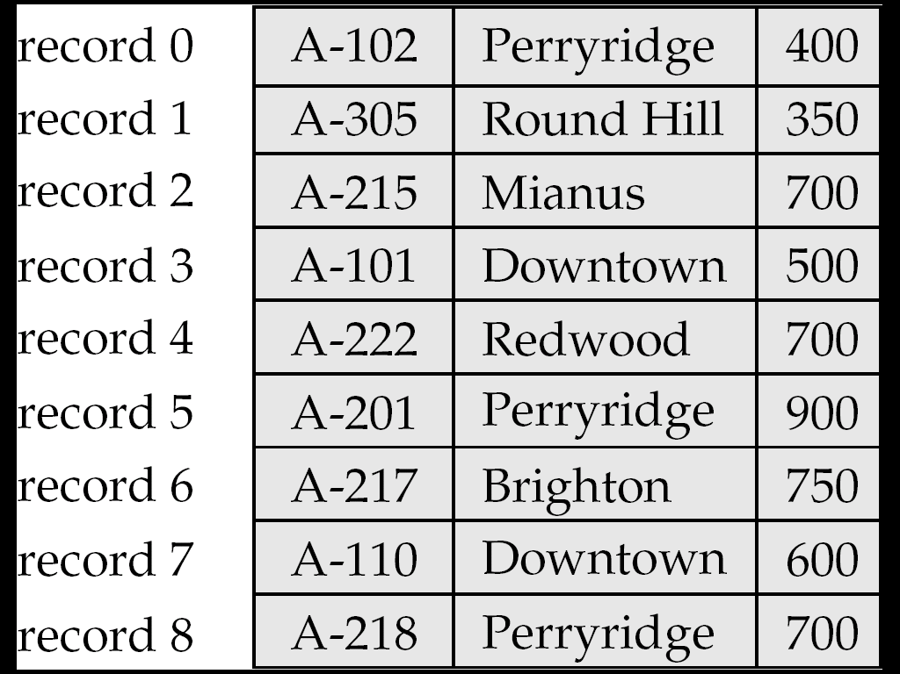
Within block: Fixed Length Records
n = number of bytes per record
Store record i at position:
n * (i – 1)
Records may cross blocks
Not desirable
Stagger so that that doesn’t happen
Inserting a tuple ?
Depends on the policy used
One option: Simply append at the end of the record
Deletions ?
Option 1: Rearrange
Option 2: Keep a free list and use for next insert

Slide 354
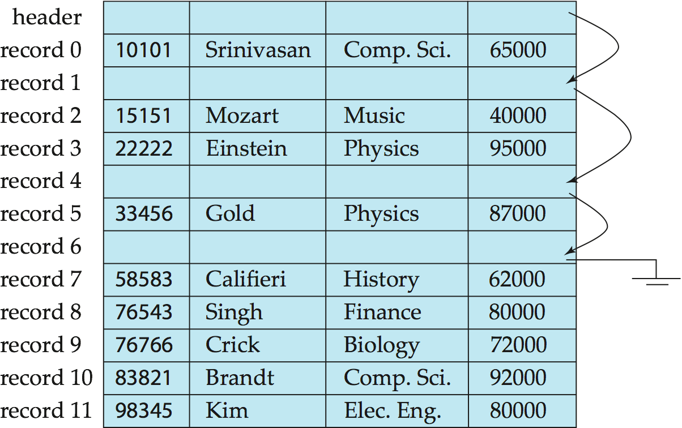
Within block: Fixed Length Records
Deleting: using “free lists”

Slide 355
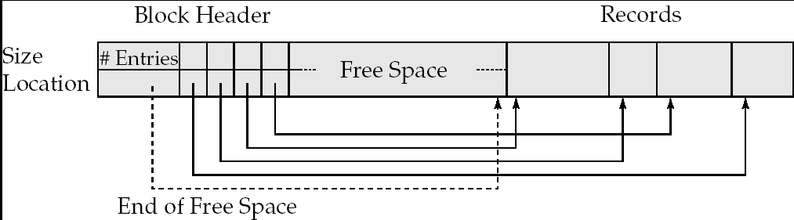
Within block: Variable-length Records
Slotted page/block structure
Indirection:
The records may move inside the page, but the outside world is oblivious to it
Why ?
The headers are used as a indirection mechanism
Record ID 1000 is the 5th entry in the page number X

Slide 356
Across Blocks of a Relation
Which block should a record go to ?
Anywhere ?
How to search for “SSN = 123” ?
Called “heap” organization
Sorted by SSN ?
Called “sequential” organization
Keeping it sorted would be painful
How would you search ?
Based on a “hash” key
Called “hashing” organization
Store the record with SSN = x in the block number x%1000
Why ?

Slide 357
Across Blocks: Sequential File Organization
Keep sorted by some search key
Insertion
Find the block in which the tuple should be
If there is free space, insert it
Otherwise, must create overflow pages
Deletions
Delete and keep the free space
Databases tend to be insert heavy, so free space gets used fast
Can become fragmented
Must reorganize once in a while

Slide 358
Across Blocks: Sequential File Organization
What if I want to find a particular record by value ?
Account info for SSN = 123
Binary search
Takes log(n) number of disk accesses
Random accesses
Too much
n = 1,000,000,000 -- log(n) = 30
Recall each random access approx 10 ms
300 ms to find just one account information
< 4 requests satisfied per second
Indexes – next topic

Slide 359
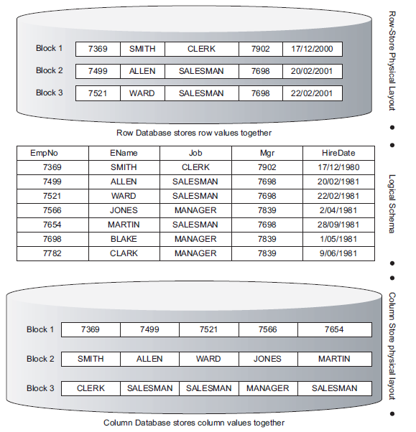
Advanced Topics
Row vs columnar representation:
We are largely focused on row representation
Column-based organization much more efficient for queries
But are not as efficient to update
Used by most modern warehouses

Slide 360
Advanced Topics
Data Storage Formats used in ”big data” world
Parquet, Avro, and many others
Sophisticated on-disk and in-memory representations for maintaining very large volumes of data as ”files”
That can be emailed, shared, interpreted by many different programs
Typically tend to be ”column-oriented”
Are not designed to be easy to update (by and large)
Lot of work in recent years on this

Slide 361
CMSC424: Database Design Module: File Organization and Indexes
Indexes Overview
Instructor: Amol Deshpande
amol@cs.umd.edu

Slide 362
File Organization & Indexes Overview
Book Chapters
11.1, 11.2
Key topics:
How an “index” helps efficiently find tuples that satisfy a condition?
What are key characteristics of indexes?

Slide 363
Index
A data structure for efficient search through large databaess
Two key ideas:
The records are mapped to the disk blocks in specific ways
Sorted, or hash-based
Auxiliary data structures are maintained that allow quick search
Search key:
Attribute or set of attributes used to look up records
E.g. SSN for a persons table
Two types of indexes
Ordered indexes
Hash-based indexes
Think library index/catalogue

Slide 364


Slide 365
Ordered Indexes
Primary index
The relation is sorted on the search key of the index
Secondary index
It is not
Can have only one primary index on a relation
^{Index}
^{Relation}

Slide 366
Primary Sparse Index
Every key doesn’t have to appear in the index
Allows for very small indexes
Better chance of fitting in memory
Tradeoff: Must access the relation file even if the record is not present

Slide 367
Primary Dense Index
Every key must appear in the index
Index becomes pretty large, but can often avoid having to go to the relation
E.g., select * from instructor where ID = 10000
Not found in the index, so can return immediately

Slide 368
Secondary Index
Relation sorted on ID
But we want an index on salary
Must be dense
Every search key must appear in the index

Slide 369
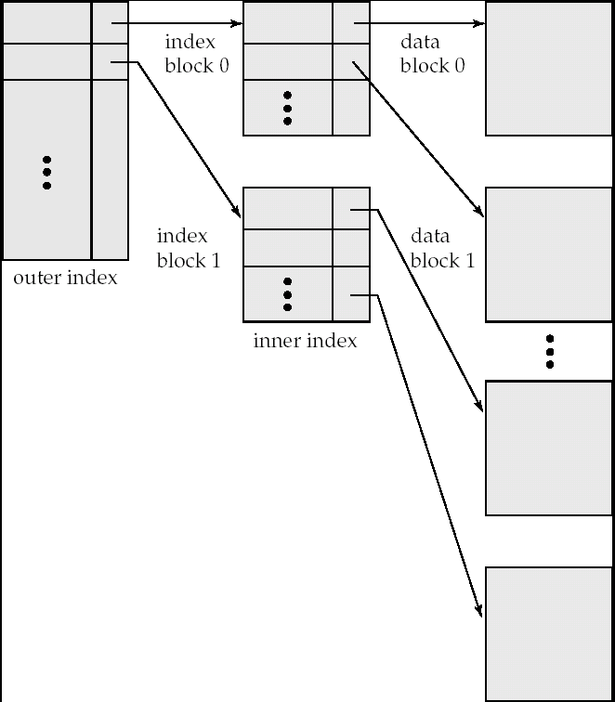
Multi-level Indexes
What if the index itself is too big for memory ?
Relation size = n = 1,000,000,000
Block size = 100 tuples per block
So, number of pages = 10,000,000
Keeping one entry per page takes too much space
Solution
Build an index on the index itself

Slide 370
Multi-level Indexes
How do you search through a multi-level index ?
What about keeping the index up-to-date ?
Tuple insertions and deletions
This is a static structure
Need overflow pages to deal with insertions
Works well if no inserts/deletes
Not so good when inserts and deletes are common

Slide 371
CMSC424: Database Design Module: File Organization and Indexes
B+-Trees: Basics
Instructor: Amol Deshpande
amol@cs.umd.edu

Slide 372
B+-Trees
Book Chapters
11.3
Key topics:
B+-Trees as a multi-level index, and basic properties
How to search in a B+-Tree?

Slide 373
Example B+-Tree Index
Index Disk Blocks

Slide 374
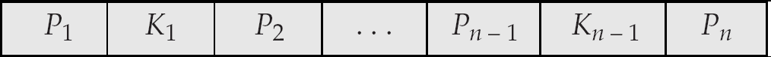
B⁺-Tree Node Structure
Typical node
K_{i} are the search-key values
P_{i} are pointers to children (for non-leaf nodes) or pointers to records or buckets of records (for leaf nodes).
The search-keys in a node are ordered
K₁ < K₂ < K₃ < . . . < K_{n–1}

Slide 375
Properties of B+-Trees
It is balanced
Every path from the root to a leaf is same length
Leaf nodes (at the bottom)
P1 contains the pointers to tuple(s) with key K1
…
Pn is a pointer to the next leaf node
Must contain at least n/2 entries

Slide 376
Properties
Interior nodes
All tuples in the subtree pointed to by P1, have search key < K1
To find a tuple with key K1’ < K1, follow P1
…
Finally, search keys in the tuples contained in the subtree pointed to by Pn, are all larger than Kn-1
Must contain at least n/2 entries (unless root)

Slide 377
B+-Trees - Searching
How to search ?
Follow the pointers
Logarithmic
log_{B/2}(N), where B = Number of entries per block
B is also called the order of the B+-Tree Index
Typically 100 or so
If a relation contains1,000,000,000 entries, takes only 4 random accesses
The top levels are typically in memory
So only requires 1 or 2 random accesses per request

Slide 378
Example B+-Tree Index

Slide 379
Example B+-Tree Index
If this were a “primary” index, then not all ”keys” are present in the index

Slide 380
B+ Trees in Practice
Typical order: 100. Typical fill-factor: 67%.
average fanout = 133
Typical capacities:
Height 3: 133³ = 2,352,637 entries
Height 4: 133⁴ = 312,900,700 entries
Can often hold top levels in buffer pool:
Level 1 = 1 page = 8 Kbytes
Level 2 = 133 pages = 1 Mbyte
Level 3 = 17,689 pages = 133 MBytes

Slide 381
CMSC424: Database Design Module: File Organization and Indexes
B+-Trees: Inserts
Instructor: Amol Deshpande
amol@cs.umd.edu

Slide 382
B+-Trees: Inserts
Book Chapters
11.3.3.1
Key topics:
How to insert a new entry in the index while keeping it balanced and satisfying half-full guarantees

Slide 383
Tuple Insertion
Find the leaf node where the search key should go
If already present
Insert record in the file. Update the bucket if necessary
This would be needed for secondary indexes
If not present
Insert the record in the file
Adjust the index
Add a new (Ki, Pi) pair to the leaf node
Recall the keys in the nodes are sorted
What if there is no space ?

Slide 384
B⁺-Trees: Insertion

Slide 385
Tuple Insertion
Splitting a node
Node has too many key-pointer pairs
Needs to store n, only has space for n-1
Split the node into two nodes
Put about half in each
Recursively go up the tree
May result in splitting all the way to the root
In fact, may end up adding a level to the tree
Pseudocode in the book !!

Slide 386
B⁺-Trees: Insertion

Slide 387
B⁺-Trees: Insertion

Slide 388
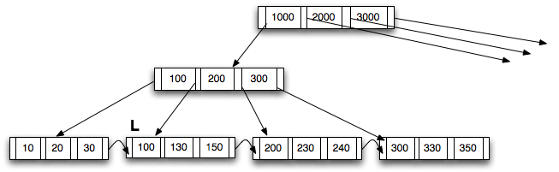
Another B+Tree Insertion Example
INITIAL TREE
Next slides show the insertion of (125) into this tree
According to the Algorithm in Figure 12.13, Page 495
Notes:
Parent of leaf containing Perryridge became underfull, and borrowed a pointer from its left sibling
Search-key value in the parent’s parent changes as a result

Slide 389
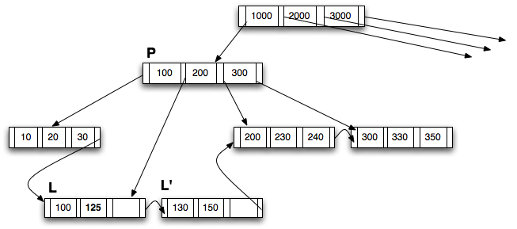
Another Example: INSERT (125)
Step 1: Split L to create L’
Insert the lowest value in L’ (130) upward into the parent P
Notes:
Parent of leaf containing Perryridge became underfull, and borrowed a pointer from its left sibling
Search-key value in the parent’s parent changes as a result

Slide 390
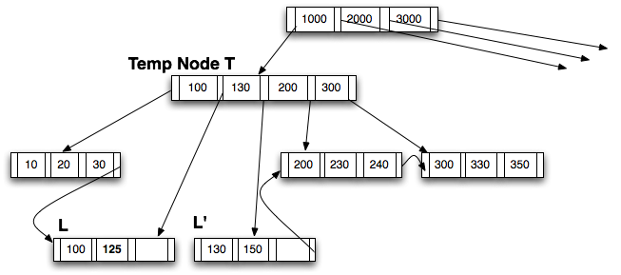
Another Example: INSERT (125)
Step 2: Insert (130) into P by creating a temp node T
Notes:
Parent of leaf containing Perryridge became underfull, and borrowed a pointer from its left sibling
Search-key value in the parent’s parent changes as a result

Slide 391
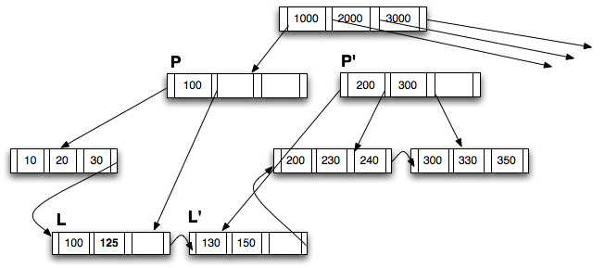
Another Example: INSERT (125)
Step 3: Create P’; distribute from T into P and P’
New P has only 1 key, but two pointers so it is OKAY.
This follows the last 4 lines of Figure 12.13 (note that “n” = 4)
K’’ = 130. Insert upward into the root
Notes:
Parent of leaf containing Perryridge became underfull, and borrowed a pointer from its left sibling
Search-key value in the parent’s parent changes as a result

Slide 392
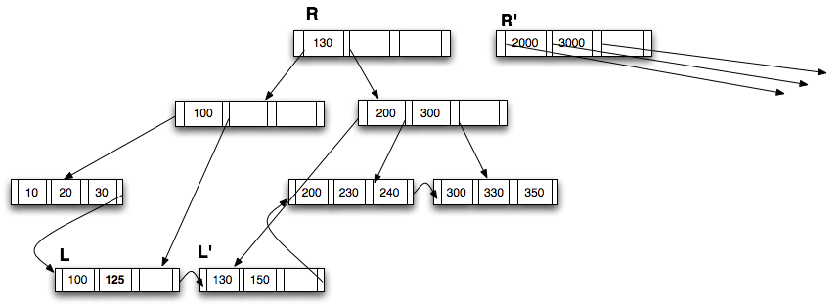
Another Example: INSERT (125)
Step 4: Insert (130) into the parent (R); create R’
Once again following the insert_in_parent() procedure, K’’ = 1000
Notes:
Parent of leaf containing Perryridge became underfull, and borrowed a pointer from its left sibling
Search-key value in the parent’s parent changes as a result

Slide 393
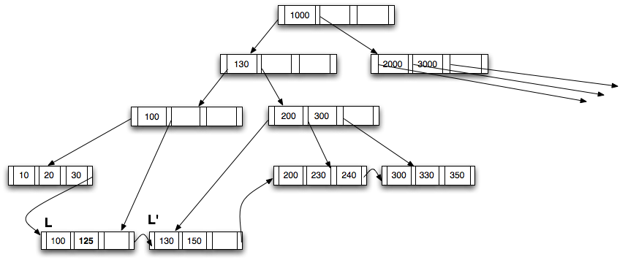
Another Example: INSERT (125)
Step 5: Create a new root
Notes:
Parent of leaf containing Perryridge became underfull, and borrowed a pointer from its left sibling
Search-key value in the parent’s parent changes as a result

Slide 394
CMSC424: Database Design Module: File Organization and Indexes
B+-Trees: Deletions
Instructor: Amol Deshpande
amol@cs.umd.edu

Slide 395
B+-Trees: Deletions
Book Chapters
11.3.3.2
Key topics:
How to delete an existing entry in the index while keeping it balanced and satisfying half-full guarantees

Slide 396
Updates on B⁺-Trees: Deletion
Find the record, delete it.
Remove the corresponding (search-key, pointer) pair from a leaf node
Note that there might be another tuple with the same search-key
In that case, this is not needed
Issue:
The leaf node now may contain too few entries
Why do we care ?
Solution:
See if you can borrow some entries from a sibling
If all the siblings are also just barely full, then merge (opposite of split)
May end up merging all the way to the root
In fact, may reduce the height of the tree by one

Slide 397
Examples of B⁺-Tree Deletion
Deleting “Katz” – No issues
Deleting “Gold” – Just delete from the leaf
Gold can stay in the “interior” node – no need to delete it
The purpose of the search keys in the interior nodes is to “direct” searches

Slide 398
Examples of B⁺-Tree Deletion
Deleting “Brandt”
The first leaf node becomes underful
Merge with the next node, and modify Parent appropriately.
Merged leaf node: Adams, Califieri, Crick
Updated parent node: Einstein, Gold (one fewer entry)

Slide 399
Examples of B⁺-Tree Deletion
Before and after deleting “Singh” and “Wu”

Slide 400
Examples of B⁺-Tree Deletion

Slide 401
Examples of B⁺-Tree Deletion
Deletion of “Gold”
Rightmost two leaves merged into a single one: (Katz, Kim, Mozart)
Need to remove a pointer from parent node (Kim), which also becomes underful and merged with its sibling (Califieri, Einstein) ➔ New root

Slide 402
CMSC424: Database Design Module: File Organization and Indexes
Hash Indexes
Instructor: Amol Deshpande
amol@cs.umd.edu

Slide 403
Hash Indexes
Book Chapters
11.6, 11.7 (at a high level)
Key topics:
Hash-based file organization
Static hashing-based indexes
Handling of bucket overflows
Extendable hashing and benefits
Comparing ordered and hashing indexes

Slide 404
Hash-based File Organization
Store record with search key k
in block number h(k)
e.g. for a person file,
h(SSN) = SSN % 4
Blocks called “buckets”
What if the block becomes full ?
Overflow pages
Uniformity property:
Don’t want all tuples to map to
the same bucket
h(SSN) = SSN % 2 would be bad
Hash functions should also be random
Should handle different real datasets
(1000, “A”,…)
(200, “B”,…)
(4044, “C”, …)
Block 0
(401, “Ax”,…)
(21, “Bx”,…)
Block 1
Buckets
(1002, “Ay”,…)
(10, “By”,…)
Block 2
(1003, “Az”,…)
(35, “Bz”,…)
Block 3

Slide 405
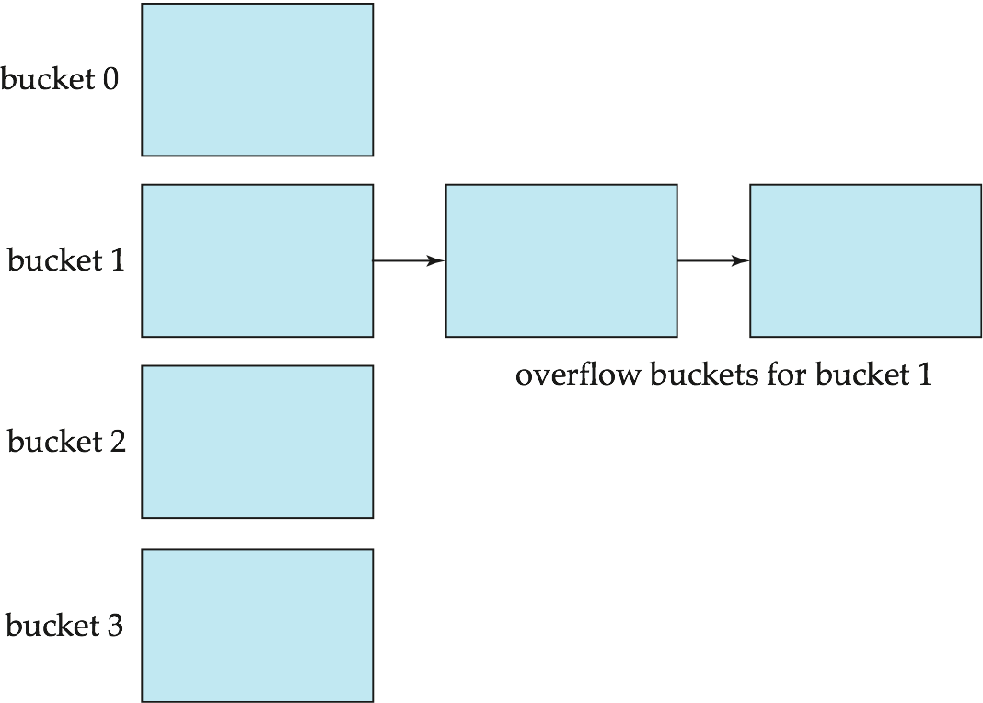
Overflow Pages
Overflow chaining – the overflow buckets of a given bucket are chained together in a linked list.
Above scheme is called closed hashing.
An alternative, called open hashing, which does not use overflow buckets, is not suitable for database applications.

Slide 406
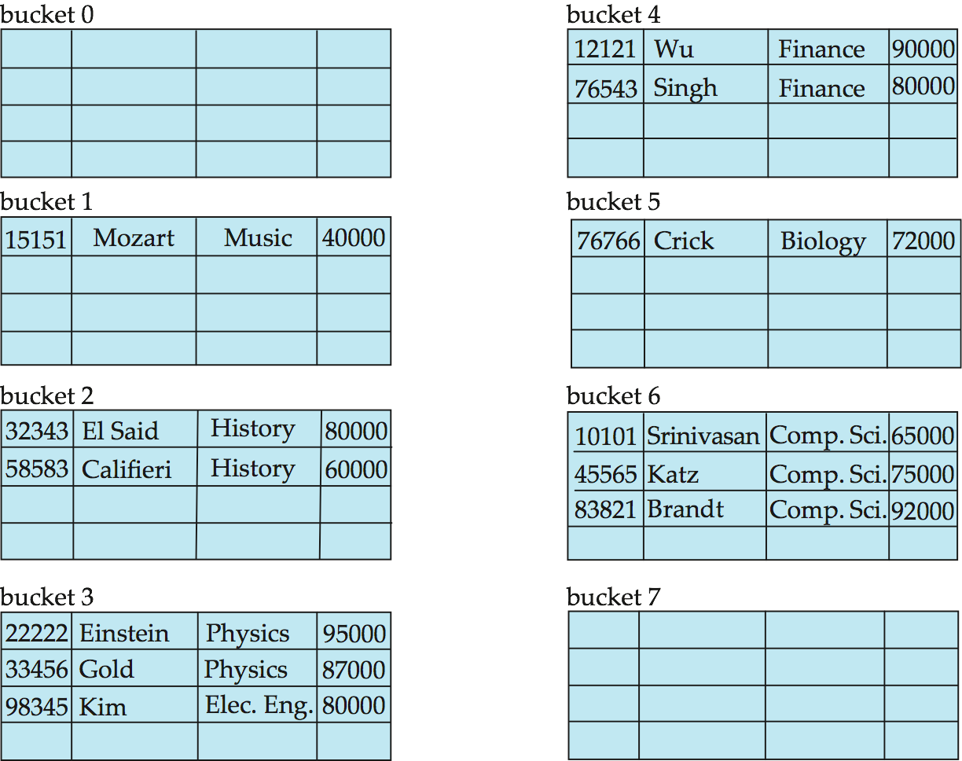
Hash-based File Organization
Hashed on “branch-name”
Hash function:
a = 1, b = 2, .., z = 26
h(abz)
= (1 + 2 + 26) % 10
= 9

Slide 407

Hash Indexes
Extends the basic idea
Search:
Find the block with
search key
Follow the pointer
Range search ?
a < X < b ?
hash index on instructor, on attribute ID

Slide 408
Hash Indexes
Very fast search on equality
Can’t search for “ranges” at all
Must scan the file
Inserts/Deletes
Overflow pages can degrade the performance
Can do periodic reorganization (by modifying hash functions)
A better approach is to use “dynamic hashing”
Allow use of a hash function that can be modified
We discuss one such technique: Extendable Hashing

Slide 409
Extendable Hashing
Use a hash function that outputs a large number of bits, e.g., 32 bits or 64 bits
However, only use a “prefix” of that hash function based on the size of the database
Different parts of the database may use different length prefix
When “inserting”, if the bucket becomes too big, split it and use an extra bit

Slide 410

General Extendable Hash Structure

Slide 411


Example
Using only first bit so far

Slide 412

Example
Using first two bits now, but both 00 and 01 point to first bucket

Slide 413

Example
Using first three bits now, but 0xx point to the first bucket

Slide 414
Extendable Hashing vs. Other Schemes
Benefits of extendable hashing:
Hash performance does not degrade with growth of file
Minimal space overhead
Disadvantages of extendable hashing
Extra level of indirection to find desired record
Bucket address table may itself become very big (larger than memory)
Changing size of bucket address table is an expensive operation
Linear hashing is an alternative mechanism
Allows incremental growth of its directory (equivalent to bucket address table)
At the cost of more bucket overflows

Slide 415
Comparison of Ordered Indexing and Hashing
Cost of periodic re-organization
Relative frequency of insertions and deletions
Is it desirable to optimize average access time at the expense of worst-case access time?
Expected type of queries:
Hashing is generally better at retrieving records having a specified value of the key.
If range queries are common, ordered indices are to be preferred
Hashing very common in distributed settings (e.g., in key-value stores)

Slide 416
CMSC424: Database Design Module: File Organization and Indexes
Indexes: Miscellaneous
Instructor: Amol Deshpande
amol@umd.edu

Slide 417
Indexes: Miscellaneous
Book Chapters
11.4.1, 11.4.5, 11.5, 11.9 (briefly)
Key topics:
B-Tree Indexes
B+-Tree File Organization
Multi-key indexes
Bitmap indexes
R-Trees

Slide 418


B-Tree Index Example
B-tree (above) and B+-tree (below) on same data – B-Trees have ”record pointers” at interior nodes

Slide 419
B-Tree Index Files (Cont.)
Advantages of B-Tree indices:
May use less tree nodes than a corresponding B⁺-Tree.
Sometimes possible to find search-key value before reaching leaf node.
Disadvantages of B-Tree indices:
Only small fraction of all search-key values are found early
Non-leaf nodes are larger, so fan-out is reduced. Thus, B-Trees typically have greater depth than corresponding B⁺-Tree
Insertion and deletion more complicated than in B⁺-Trees
Implementation is harder than B⁺-Trees.
Typically, advantages of B-Trees do not outweigh disadvantages.

Slide 420

B+-Tree File Organization
Store the records at the leaves
Sorted order etc..

Slide 421
Multiple-Key Access
select ID
from instructor
where dept_name = “Finance” and salary = 80000
Possible strategies for processing query using indices on single attributes:
Use index on dept_name to find instructors with department name Finance; test salary = 80000
Use index on salary to find instructors with a salary of $80000; test dept_name = “Finance”.
Use dept_name index to find pointers to all records pertaining to the “Finance” department. Similarly use index on salary. Take intersection of both sets of pointers obtained.
Called “INDEX-ANDING”

Slide 422
Indices on Multiple Keys
Composite search keys are search keys containing more than one attribute
E.g. (dept_name, salary)
Lexicographic ordering: (a₁, a₂) < (b₁, b₂) if either
a₁ < b₁, or
a₁=b₁ and a₂ < b₂
Ideal for something like:
where dept_name = “Finance” and salary = 80000
Can also efficiently handle where dept_name = “Finance” and salary < 80000
But cannot efficiently handle where dept_name < “Finance” and balance = 80000

Slide 423
Bitmap Indices
Specialized indexes used in data warehouses
Assume records numbered sequentially from 0
Given a number n it must be easy to retrieve record n
Particularly easy if records are of fixed size
Best for attributes that with a small domain
E.g., gender, country, state, …
E.g., income-level (income broken up into a small number of levels such as 0-9999, 10000-19999, 20000-50000, 50000- infinity)
A bitmap is simply an array of bits

Slide 424
Bitmap Indices (Cont.)
Bitmap index on an attribute has one bitmap for each value of the attribute
Bitmap has as many bits as records
Keeps track of whether a record has that value for the attr

Slide 425
Bitmap Indices (Cont.)
Not particularly useful for single attribute queries
But consider a query: gender = m and income_level = L1
Retrieve individual bitmaps for those two
Do an AND to find all records that satisfy both conditions
Retrieve only those records
Can also be used for gender = m or income_level = L1
Really useful when queries have many predicates, and relations are large (i.e., a data warehouse)
Updating bitmap indexes is very expensive

Slide 426

R-Trees
For spatial data (e.g. maps, rectangles, GPS data etc)

Slide 427
Conclusions
Indexing Goal: “Quickly find the tuples that match certain conditions”
Equality and range queries most common
Hence B+-Trees the predominant structure for on-disk representation
Hashing is used more commonly for in-memory operations
Many many more types of indexing structures exist
For different types of data
For different types of queries
E.g. “nearest-neighbor” queries

Slide 428
CMSC424: Database Design Module: Database Implementation
Instructor: Amol Deshpande
amol@cs.umd.edu

Slide 429
Database Implementation
Shifting into discussing the internals of a DBMS
How data stored? How queries/transactions executed?
Topics:
Storage: How is data stored? Important features of the storage devices (RAM, Disks, SSDs, etc)
File Organization: How are tuples mapped to blocks
Indexes: How to quickly find specific tuples of interest (e.g., all ‘friends’ of ‘user0’)
Query processing: How to execute different relational operations? How to combine them to execute an SQL query?
Query optimization: How to choose the best way to execute a query?

Slide 430
Other Stuff
Midterm 2 will also be online
Final will be in person
Similar format as Midterm 1
We will finish up remaining Indexing stuff next week
Today’s focus:
Query processing basics
Discussion of the Iterator Model (Assignment 4)

Slide 431
Query Processing/Storage
user query
results
Given an input user query, decide how to “execute” it
Specify sequence of pages to be brought in memory
Operate upon the tuples to produce results
Query Processing Engine
page requests
pointers
to pages
Bringing pages from disk to memory
Managing the limited memory
Buffer Management
block requests
data
Space Management on Persistent Storage (e.g., Disks)
Storage hierarchy
How are relations mapped to files?
How are tuples mapped to disk blocks?

Slide 432
CMSC424: Database Design Module: Database Implementation
Query Processing: Overview, and Cost Measures
Instructor: Amol Deshpande
amol@umd.edu

Slide 433
Overview and Cost Measures
Book Chapters
12.1, 12.2
Key topics:
Main steps in Query Processing
How to measure the ”cost” of an operation so we can compare alternatives?

Slide 434
Getting Deeper into Query Processing
User
select *
from R, S
where …
Resolve the references,
Syntax errors etc.
Converts the query to an
internal format
relational algebra like
Query Parser
Query Optimizer
Results
Find the best way to evaluate
the query
Which index to use ?
What join method to use ?
…
Query Processor
Read the data from the files
Do the query processing
joins, selections, aggregates
…
R, B+Tree on R.a
S, Hash Index on S.a
…

Slide 435
Getting Deeper into Query Processing

Slide 436
“Cost”
Complicated to compute, but very important to decide early on
Need to know what you are “optimizing” for
Many competing factors in today’s computing environment
CPU Instructions
Disk I/Os
Network Usage – either peak or average (for distributed settings)
Memory Usage
Cache Misses
… and so on
Want to pick the one (or combination) that’s actually a bottleneck
No sense in optimizing for “memory usage” if you have a TB of memory and a single disk
Can do combinations by doing a weighted sum: e.g., 10 * Memory + 50 * Disk I/Os

Slide 437
“Cost”
We will focus on disk for simplicity:
Number of I/Os ?
Not sufficient
Number of seeks matters a lot… why ?
t_{T} – time to transfer one block
t_{S} – time for one seek
Cost for b block transfers plus S seeks b * t_{T} + S * t_{S}
Measured in seconds
Real systems do take CPU cost into account

Slide 438
“Cost” Example
t_{S} = 10 ms (seek time)
t_{T} = ?
Typical block size = 4kB
Say transfer rate = 200MB/s → 200kB/ms → 0.02ms per 4kB
If a plan makes 100 seeks, and transfer 100 blocks:
Cost = 100 * 10 + 0.02 * 100 = 1002ms
If a plan makes 1 seek, and transfer 5000 blocks:
Cost = 10 + 0.02 * 5000 = 110ms
Transfer rates keep going up (through better hardware and parallelization), but seek times are constant
The gap keeps increasing

Slide 439
Next…
For each relational operation, we will discuss different techniques for doing them
The basic technique usually straightforward, adaptations more complex
For each technique, we will try to figure out roughly the number of seeks and I/Os
Try to focus on the abstract principles involved, and not the details
Very similar techniques used in data processing in other systems like Apache Spark, Hadoop, Python Pandas, etc.

Slide 440
CMSC424: Database Design Module: Query Processing
Selection Operation
Instructor: Amol Deshpande
amol@umd.edu

Slide 441
Selections
Book Chapters
12.3
Key topics:
Different ways to do a ”selection” operation (“where” clause) based on the properties of the predicates and the availability of indexes

Slide 442
Selection Operation
select * from person where SSN = “123”
Option 1: Sequential Scan
Read the relation start to end and look for “123”
Can always be used (not true for the other options)
Cost ?
Let b_{r} = Number of relation blocks
Then:
1 seek and b_{r} block transfers
So:
t_{S} + b_{r} * t_{T} sec
Improvements:
If SSN is a key, then can stop when found
So on average, b_{r}/2 blocks accessed

Slide 443
Selection Operation
select * from person where SSN = “123”
Option 2 : Use Index
Pre-condition:
An appropriate index must exist
Use the index
Find the first leaf page that contains the search key
Retrieve all the tuples that match by following the pointers
If primary index, the relation is sorted by the search key
Go to the relation and read blocks sequentially
If secondary index, must follow all pointers using the index

Slide 444
Selection w/ B+-Tree Indexes
cost of finding the first leaf
cost of retrieving the tuples
primary index, candidate key, equality
h_{i} * (t_{T} + t_{S})
1 * (t_{T} + t_{S})
primary index, not a key, equality
h_{i} * (t_{T} + t_{S})
1 * (t_{T} + t_{S}) + (b – 1) * t_{T}
Note: primary == sorted
b = number of pages that contain the matches
secondary index, candidate key, equality
h_{i} * (t_{T} + t_{S})
1 * (t_{T} + t_{S})
secondary index, not a key, equality
h_{i} * (t_{T} + t_{S})
n * (t_{T} + t_{S})
n = number of records that match
This can be bad
h_{i} = height of the index

Slide 445
Selection Operation
Selections involving ranges
select * from accounts where balance > 100000
select * from matches where matchdate between ’10/20/06’ and ’10/30/06’
Option 1: Sequential scan
Option 2: Using an appropriate index
Can’t use hash indexes for this purpose
Cost formulas:
Range queries == “equality” on “non-key” attributes
So rows 3 and 5 in the preceding page

Slide 446
Selection Operation
Complex selections
Conjunctive: select * from accounts where balance > 100000 and SSN = “123”
Disjunctive: select * from accounts where balance > 100000 or SSN = “123”
Option 1: Sequential scan
Option 2 (Conjunctive only): Using an appropriate index on one of the conditions
E.g. Use SSN index to evaluate SSN = “123”. Apply the second condtion to the tuples that match
Or do the other way around (if index on balance exists)
Which is better ?
Option 3 (Conjunctive only) : Choose a multi-key index
Not commonly available

Slide 447
Selection Operation
Complex selections
Conjunctive: select * from accounts where balance > 100000 and SSN = “123”
Disjunctive: select * from accounts where balance > 100000 or SSN = “123”
Option 4: Conjunction or disjunction of record identifiers
Use indexes to find all RIDs that match each of the conditions
Do an intersection (for conjunction) or a union (for disjunction)
Sort the records and fetch them in one shot
Called “Index-ANDing” or “Index-ORing”
Heavily used in commercial systems

Slide 448
CMSC424: Database Design Module: Query Processing
Joins
Instructor: Amol Deshpande
amol@umd.edu

Slide 449
Joins
Book Chapters
12.5.1, 12.5.2, 12.5.3, 12.5.5
Key topics:
Simplest way to do a join as a nested for loop
Block Nested Loops Joins
Using “indexes” for more efficient joins
Hash Joins
Sort-merge Joins

Slide 450
Join
select * from R, S where R.a = S.a
Called an “equi-join”
select * from R, S where |R.a – S.a | < 0.5
Not an “equi-join”
Goal: For each tuple r in R, find all “matching” tuples in S (or vice versa)
Simplest Algorithm (“nested loops” join)
for each tuple r in R
for each tuple s in S
check if r.a = s.a (or whether |r.a – s.a| < 0.5)
Complexity too high– also not disk efficient
e.g., imagine if |R| and |S| both in millions of tuples

Slide 451
Block Nested-loops Join
Simple modification to the basic “nested-loops join” that is disk efficient
Read a chunk of blocks of R from disk at a time; go through S for each chunk
for each k blocks of R
for each block B_{s} of S
for each tuple r in those k blocks of R
for each tuple s in Bs
check if r.a = s.a (or whether |r.a – s.a| < 0.5)
Cost?
Blocks Read of R: |Br| (every block read exactly once)
Blocks Read of S: |Bs| * |Br|/k (every block of S read |Br|/k times)
Seeks: 2 * |Br|/k
Choose k to be as large as possible (but can’t be more than M)
However: We are still comparing every R tuple with every S tuple → high CPU cost

Slide 452
Index Nested-loops Join
select * from R, S where R.a = S.a
Called an “equi-join”
Let’s say there is an “index” on S.a
for each tuple r in R
use the index to find S tuples with S.a = r.a
Blocks read of R: Br
Blocks read of S: depends on the index (see previous formulas)
Seeks: Br for R, but seeks for S depend on the index

Slide 453
Index Nested-loops Join
Restricted applicability
An appropriate index must exist
What about |R.a – S.a| < 5 ?
Great for queries with joins and selections
select *
from accounts, customers
where accounts.customer-SSN = customers.customer-SSN and
accounts.acct-number = “A-101”
Only need to access one SSN from the other relation

Slide 454
Hash Join
Case 1: Smaller relation (S) fits in memory
read S in memory and build a hash index on it
for each tuple r in R
use the hash index on S to find tuples such that S.a = r.a
Cost: b_{r} + b_{s} transfers, 2 seeks
Why good ?
CPU cost is much better (even though we technically don’t care about it in our cost function, in reality, it matters a lot)
Performs much better than nested-loops join when S doesn’t fit in memory (next)

Slide 455
Hash Join
Case 2: Smaller relation (S) doesn’t fit in memory
Two “phases”
Phase 1:
Read the relation R block by block and partition it using a hash function, h1(a)
Create one partition for each possible value of h1(a)
Write the partitions to disk
R gets partitioned into R1, R2, …, Rk
Similarly, read and partition S, and write partitions S1, S2, …, Sk to disk
Only requirement:
Each S partition fits in memory
Requires SQRT(Bs) Memory
Can do “recursive” partitioning if not enough memory – rarely the case today

Slide 456
Hash Join
Case 2: Smaller relation (S) doesn’t fit in memory
Two “phases”
Phase 2:
Read S1 into memory, and bulid a hash index on it (S1 fits in memory)
Using a different hash function, h₂(a)
Read R1 block by block, and use the hash index to find matches.
Repeat for S2, R2, and so on.

Slide 457
Hash Join
Case 2: Smaller relation (S) doesn’t fit in memory
Two “phases”:
Phase 1:
Partition the relations using one hash function, h₁(a)
Phase 2:
Read S_{i} into memory, and bulid a hash index on it (S_{i} fits in memory)
Read R_{i} block by block, and use the hash index to find matches.
Cost ?
3(b_{r} + b_{s}) +4 ∗ n_{h} block transfers + 2( ⎡b_{r} / b_{b}⎤ + ⎡b_{s} / b_{b}⎤) seeks
Where b_{b} is the size of each output buffer
Much better than Nested-loops join under the same conditions

Slide 458

Hash Join

Slide 459
Hash Join: Issues
How to guarantee that the partitions of S all fit in memory ?
Say S = 10000 blocks, Memory = M = 100 blocks
Use a hash function that hashes to 100 different values ?
Eg. h1(a) = a % 100 ?
Problem: Impossible to guarantee uniform split
Some partitions will be larger than 100 blocks, some will be smaller
Use a hash function that hashes to 100*f different values
f is called fudge factor, typically around 1.2
So we may consider h1(a) = a % 120.
This is okay IF a is uniformly distributed
What if the hash function turns out to be bad ?
Repartition using a different hash function (at run time)

Slide 460
CMSC424: Database Design Module: Query Processing
Aggregates
Instructor: Amol Deshpande
amol@umd.edu

Slide 461
Group By and Aggregation
select a, count(b)
from R
group by a;
Hash-based algorithm
Steps:
Create a hash table on a, and keep the count(b) so far
Read R tuples one by one
For a new R tuple, “r”
Check if r.a exists in the hash table
If yes, increment the count
If not, insert a new value

Slide 462
Group By and Aggregation
select a, count(b)
from R
group by a;
Sort-based algorithm
Steps:
Sort R on a
Now all tuples in a single group are contigous
Read tuples of R (sorted) one by one and compute the aggregates

Slide 463
Group By and Aggregation
select a, AGGR(b) from R group by a;
sum(), count(), min(), max(): only need to maintain one value per group
Called “distributive”
average() : need to maintain the “sum” and “count” per group
Called “algebraic”
stddev(): algebraic, but need to maintain some more state
median(): can do efficiently with sort, but need two passes (called “holistic”)
First to find the number of tuples in each group, and then to find the median tuple in each group
count(distinct b): must do duplicate elimination before the count

Slide 464
CMSC424: Database Design Module: Query Processing
Sorting and Merge Joins; Some Other Operators
Instructor: Amol Deshpande
amol@umd.edu

Slide 465
Sorting; Merge Joins
Book Chapters
12.4, 12.5.4, 12.6
Key topics:
How to sort when data doesn’t fit in memory
Using sorting for joins
Duplicate elimination
Set operations
Outerjoins

Slide 466
Sorting
Commonly required for many operations
Duplicate elimination, group by’s, sort-merge join
Queries may have ASC or DSC in the query
One option:
Read the lowest level of the index
May be enough in many cases
But if relation not sorted, this leads to too many random accesses
If relation small enough…
Read in memory, use quick sort (qsort() in C)
What if relation too large to fit in memory ?
External sort-merge

Slide 467
External sort-merge
Divide and Conquer !!
Let M denote the memory size (in blocks)
Phase 1:
Read first M blocks of relation, sort, and write it to disk
Read the next M blocks, sort, and write to disk …
Say we have to do this “N” times
Result: N sorted runs of size M blocks each
Phase 2:
Merge the N runs (N-way merge)
Can do it in one shot if N < M

Slide 468
External sort-merge
Phase 1:
Create sorted runs of size M each
Result: N sorted runs of size M blocks each
Phase 2:
Merge the N runs (N-way merge)
Can do it in one shot if N < M
What if N > M ?
Do it recursively
Not expected to happen
If M = 1000 blocks = 4MB (assuming blocks of 4KB each)
Can sort: 4000MB = 4GB of data

Slide 469

Example: External Sorting Using Sort-Merge

Slide 470
External Merge Sort (Cont.)
Cost analysis:
Total number of merge passes required: ⎡log_{M–1}(b_{r}/M)⎤.
Disk accesses for initial run creation as well as in each pass is 2b_{r}
for final pass, we don’t count write cost
we ignore final write cost for all operations since the output of an operation may be sent to the parent operation without being written to disk
Thus total number of disk accesses for external sorting:
b_{r} ( 2 ⎡log_{M–1}(b_{r} / M)⎤ + 1)
What about seeks?
More complicated

Slide 471

Merge-Join (Sort-merge join)
Pre-condition:
The relations must be sorted by the join attribute
If not sorted, can sort first, and then use this algorithms
Called “sort-merge join” sometimes
select *
from r, s
where r.a1 = s.a1
Step:
1. Compare the tuples at pr and ps
2. Move pointers down the list
- Depending on the join condition
3. Repeat

Slide 472
Merge-Join (Sort-merge join)
Cost:
If the relations sorted, then just
b_{r} + b_{s} block transfers, some seeks depending on memory size
What if not sorted ?
Then sort the relations first
In many cases, still very good performance
Typically comparable to hash join
Observation:
The final join result will also be sorted on a1
This might make further operations easier to do
E.g. duplicate elimination

Slide 473
Joins: Summary
Block Nested-loops join
Can always be applied irrespective of the join condition
Index Nested-loops join
Only applies if an appropriate index exists
Hash joins – only for equi-joins
Join algorithm of choice when the relations are large
Hybrid hash join
An optimization on hash join that is always implemented
Sort-merge join
Very commonly used – especially since relations are typically sorted
Sorted results commonly desired at the output
To answer group by queries, for duplicate elimination, because of ASC/DSC

Slide 474
Duplicate Elimination
select distinct a
from R ;
Best done using sorting – Can also be done using hashing
Steps:
Sort the relation R
Read tuples of R in sorted order
prev = null;
for each tuple r in R (sorted)
if r != prev then
Output r
prev = r
else
Skip r

Slide 475
Set operations
(select * from R) union (select * from S) ;
(select * from R) intersect (select * from S) ;
(select * from R) union all (select * from S) ;
(select * from R) intersect all (select * from S) ;
Remember the rules about duplicates
“union all”: just append the tuples of R and S
“union”: append the tuples of R and S, and do duplicate elimination
“intersection”: similar to joins
Find tuples of R and S that are identical on all attributes
Can use hash-based or sort-based algorithm

Slide 476
Outer Joins
Say: R FULL OUTER JOIN S, on R.a = S.a
Need to keep track of which tuples of R “do not match” any tuples from S, and vice versa
Hash-based, with a hash index on S:
For a tuple r in R, if the probe returns NULL, output r padded with NULLs
For each tuple s in S, maintain a Boolean variable (in the hash table) to track whether s was returned for any probes
At the end, go through the hash table, and look for S tuples that did not match anything
Merge join can also be adapted in a similar way

Slide 477
CMSC424: Database Design Module: Query Processing
Putting it All Together
Instructor: Amol Deshpande
amol@cs.umd.edu

Slide 478
Putting it all together
Book Chapters
12.7
Key topics:
How to put it all together in a query plan
Pipelining vs Materialization
Iterator Interface

Slide 479

Evaluation of Expressions
select customer-name
from account a, customer c
where a.SSN = c.SSN and
a.balance < 2500
Two options:
Materialization
Pipelining

Slide 480
Evaluation of Expressions
Materialization
Evaluate each expression separately
Store its result on disk in temporary relations
Read it for next operation
Pipelining
Evaluate multiple operators simultaneously
Skip the step of going to disk
Usually faster, but requires more memory
Also not always possible..
E.g. Sort-Merge Join
Harder to reason about

Slide 481
Materialization
Materialized evaluation is always applicable
Cost of writing results to disk and reading them back can be quite high
Our cost formulas for operations ignore cost of writing results to disk, so
Overall cost = Sum of costs of individual operations + cost of writing intermediate results to disk
Double buffering: use two output buffers for each operation, when one is full write it to disk, while the other is getting filled
Allows overlap of disk writes with computation and reduces execution time

Slide 482
Pipelining
Evaluate several operations simultaneously, passing the results of one operation on to the next.
E.g., in previous expression tree, don’t store result of
instead, pass tuples directly to the join.. Similarly, don’t store result of join, pass tuples directly to projection.
Much cheaper: no need to store a temporary relation to disk.
Requires higher amount of memory
All operations are executing at the same time (say as processes)
Somewhat limited applicability
A “blocking” operation: An operation that has to consume entire input before it starts producing output tuples

Slide 483
Pipelining
Need operators that generate output tuples while receiving tuples from their inputs
Selection: Usually yes.
Sort: NO. The sort operation is blocking
Sort-merge join: The final (merge) phase can be pipelined
Hash join: The partitioning phase is blocking; the second phase can be pipelined
Aggregates: Typically no. Need to wait for the entire input before producing output
However, there are tricks you can play here
Duplicate elimination: Since it requires sort, the final merge phase could be pipelined
Set operations: see duplicate elimination

Slide 484
Pipelining: Demand-driven
Iterator Interface
Each operator implements:
init(): Initialize the state (sometimes called open())
get_next(): get the next tuple from the operator
close(): Finish and clean up
Sequential Scan:
init(): open the file
get_next(): get the next tuple from file
close(): close the file
Execute by repeatadly calling get_next() at the root
root calls get_next() on its children, the children call get_next() on their children etc…
The operators need to maintain internal state so they know what to do when the parent calls get_next()

Slide 485
Hash-Join Iterator Interface
open():
Call open() on the left and the right children
Decide if partitioning is needed (if size of smaller relation > allotted memory)
Create a hash table
get_next(): ((( assuming no partitioning needed )))
First call:
Get all tuples from the right child one by one (using get_next()), and insert them into the hash table
Read the first tuple from the left child (using get_next())
All calls:
Probe into the hash table using the “current” tuple from the left child
Read a new tuple from left child if needed
Return exactly “one result”
Must keep track if more results need to be returned for that tuple

Slide 486
Hash-Join Iterator Interface
close():
Call close() on the left and the right children
Delete the hash table, other intermediate state etc…
get_next(): (((partitioning needed )))
First call:
Get all tuples from both children and create the partitions on disk
Read the first partition for the right child and populate the hash table
Read the first tuple from the left child from appropriate partition
All calls:
Once a partition is finished, clear the hash table, read in a new partition from the right child, and re-populate the hash table
Not that much more complicated
Take a look at the postgreSQL codebase

Slide 487
Pipelining (Cont.)
In produce-driven or eager pipelining
Operators produce tuples eagerly and pass them up to their parents
Buffer maintained between operators, child puts tuples in buffer, parent removes tuples from buffer
if buffer is full, child waits till there is space in the buffer, and then generates more tuples
System schedules operations that have space in output buffer and can process more input tuples

Slide 488
Recap: Query Processing
Many, many ways to implement the relational operations
Numerous more used in practice
Especially in data warehouses which handles TBs (even PBs) of data
However, consider how complex SQL is and how much you can do
Compared to that, this isn’t much
Most of it is very nicely modular
Especially through use of the iterator() interface
Can plug in new operators quite easily
PostgreSQL query processing codebase very easy to read and modify
Having so many operators does complicate the codebase and the query optimizer though
But needed for performance

Slide 489
CMSC424: Database Design Module: Query Processing
Query Optimization
Instructor: Amol Deshpande
amol@umd.edu

Slide 490
Query Optimization: Overview
Key topics:
Why query optimization is so important?
Key steps in query optimization
High-level concepts

Slide 491
Getting Deeper into Query Processing
User
select *
from R, S
where …
Resolve the references,
Syntax errors etc.
Converts the query to an
internal format
relational algebra like
Query Parser
Query Optimizer
Results
Find the best way to evaluate
the query
Which index to use ?
What join method to use ?
…
Query Processor
Read the data from the files
Do the query processing
joins, selections, aggregates
…
R, B+Tree on R.a
S, Hash Index on S.a
…

Slide 492
Query Optimization
Why ?
Many different ways of executing a given query
Huge differences in cost
Example:
select * from person where ssn = “123”
Size of person = 1GB
Sequential Scan:
Takes 1GB / (20MB/s) = 50s
Use an index on SSN (assuming one exists):
Approx 4 Random I/Os = 40ms

Slide 493
Query Optimization
Many choices
Using indexes or not, which join method (hash, vs merge, vs NL)
What join order ?
Given a join query on R, S, T, should I join R with S first, or S with T first ?
This is an optimization problem
Similar to say traveling salesman problem
Number of different choices is very very large
Step 1: Figuring out the solution space
Step 2: Finding algorithms/heuristics to search through the solution space

Slide 494
Query Optimization: Goal
Find the best (or a good enough) execution plan
Execution plans = Evaluation expressions annotated with the methods used

Slide 495
Query Optimization
Steps:
Generate all possible execution plans for the query
Figure out the cost for each of them
Choose the best
Not done exactly as listed above
Too many different execution plans for that
Typically interleave all of these into a single efficient search algorithm

Slide 496
Equivalence of Expressions
Equivalent relational expressions
Drawn as a tree
List the operations and the order

Slide 497
Equivalence of Expressions
Two relational expressions equivalent iff:
Their result is identical on all legal databases
Equivalence rules:
Allow replacing one expression with another
Examples:
1.
2. Selections are commutative

Slide 498
Equivalence Rules
Examples:
3.
5. E_{1 θ} E₂ = E₂ _{θ} E₁
7(a). If θ₀ only involves attributes from E₁
σ_{θ0}(E₁ _{θ} E₂) = (σ_{θ0}(E₁)) _{θ} E₂
And so on…
Many rules of this type

Slide 499

Pictorial Depiction

Slide 500
Equivalence of Expressions
The rules give us a way to enumerate all equivalent expressions
Note that the expressions don’t contain physical access methods, join methods etc…
Simple Algorithm:
Start with the original expression
Apply all possible applicable rules to get a new set of expressions
Repeat with this new set of expressions
Till no new expressions are generated

Slide 501
Equivalence of Expressions
Works, but is not feasible
Consider a simple case:
R1 (R2 (R3 (… Rn)))….)
Just join commutativity and associativity will give us:
At least:
n^2 * 2^n
At worst:
n! * 2^n
Typically the process of enumeration is combined with the search process

Slide 502
Evaluation Plans
We still need to choose the join methods etc..
Option 1: Choose for each operation separately
Usually okay, but sometimes the operators interact
Consider joining three relations on the same attribute:
R1 _{a} (R2 _{a} R3)
Best option for R2 join R3 might be hash-join
But if R1 is sorted on a, then sort-merge join is preferable
Because it produces the result in sorted order by a
Also, we need to decide whether to use pipelining or materialization
Such issues are typically taken into account when doing the optimization

Slide 503
Query Optimization
Steps:
Generate all possible execution plans for the query
First generate all equivalent expressions
Then consider all annotations for the operations
Figure out the cost for each of them
Compute cost for each operation
Using the formulas discussed before
One problem: How do we know the number of result tuples for, say,
Add them !
Choose the best

Slide 504
Cost estimation
Computing operator costs requires information like:
Primary key ?
Sorted or not, which attribute
So we can decide whether need to sort again
How many tuples in the relation, how many blocks ?
RAID ?? Which one ?
Read/write costs are quite different
How many tuples match a predicate like “age > 40” ?
E.g. Need to know how many index pages need to be read
Intermediate result sizes
E.g. (R JOIN S) is input to another join operation – need to know if it fits in memory
And so on…

Slide 505
Cost estimation
Some information is static and is maintained in the metadata
Primary key ?
Sorted or not, which attribute
So we can decide whether need to sort again
How many tuples in the relation, how many blocks ?
RAID ?? Which one ?
Read/write costs are quite different
Typically kept in some tables in the database
“all_tab_columns” in Oracle
Most systems have commands for updating them

Slide 506
Cost estimation
However, others need to be estimated somehow
How many tuples match a predicate like “age > 40” ?
E.g. Need to know how many index pages need to be read
Intermediate result sizes
The problem variously called:
“intermediate result size estimation”
“selectivity estimation”
Very important to estimate reasonably well
e.g. consider “select * from R where zipcode = 20742”
We estimate that there are 10 matches, and choose to use a secondary index (remember: random I/Os)
Turns out there are 10000 matches
Using a secondary index very bad idea
Optimizer also often choose Nested-loop joins if one relation very small… underestimation can result in very bad

Slide 507
Selectivity Estimation
Basic idea:
Maintain some information about the tables
More information → more accurate estimation
More information → higher storage cost, higher update cost
Make uniformity and randomness assumptions to fill in the gaps
Example:
For a relation “people”, we keep:
Total number of tuples = 100,000
Distinct “zipcode” values that appear in it = 100
Given a query: “zipcode = 20742”
We estimated the number of matching tuples as: 100,000/100 = 1000
What if I wanted more accurate information ?
Keep better statistics/summaries…

Slide 508
Examples
Consider a range query: x < R.a < y
Let Max(a, R) = maximum value of a in R
Let Min(a, R) = minimum value of a in R
Then: fraction of tuples that satisfy = (y – x) / (Max – Min)
Assuming all tuples are distributed uniformly and randomly
If y > Max or x < Min → adjust accordingly
Better summary statistics (like histograms) can help with refining these estimates

Slide 509
Example: Joins
R JOIN S: R.a = S.a
|R| = 10,000; |S| = 5000
CASE 1: a is key for S
Each tuple of R joins with exactly one tuple of S
So: |R JOIN S| = |R| = 10,000
Assumption: Referential integrity holds
What if there is a selection on R or S
Adjust accordingly
Say: S.b = 100, with selectivity 0.1
THEN: |R JOIN S| = |R| * 0.1 = 100
CASE 2: a is key for R
Similar

Slide 510
Joins
R JOIN S: R.a = S.a
|R| = 10,000; |S| = 5000
CASE 3: a is not a key for either
Reason with the distributions on a
Say: the domain of a: V(A, R) = 100 (the number of distinct values a can take)
THEN, assuming uniformity
For each value of a
We have 10,000/100 = 100 tuples of R with that value of a
We have 5000/100 = 50 tuples of S with that value of a
All of these will join with each other, and produce 100 *50 = 5000
So total number of results in the join:
5000 * 100 = 500000
We can improve the accuracy if we know the distributions on a better
Say using a histogram

Slide 511
Query Optimization
Steps:
Generate all possible execution plans for the query
First generate all equivalent expressions
Then consider all annotations for the operations
Figure out the cost for each of them
Compute cost for each operation
Using the formulas discussed before
One problem: How do we know the number of result tuples for, say,
Add them !
Choose the best

Slide 512
Optimization Algorithms
Two types:
Exhaustive: That attempt to find the best plan
Heuristical: That are simpler, but are not guaranteed to find the optimal plan
Consider a simple case
Join of the relations R1, …, Rn
No selections, no projections
Still very large plan space

Slide 513
Searching for the best plan
Option 1:
Enumerate all equivalent expressions for the original query expression
Using the rules outlined earlier
Estimate cost for each and choose the lowest
Too expensive !
Consider finding the best join-order for r₁ r₂ . . . r_{n}.
There are (2(n – 1))!/(n – 1)! different join orders for above expression. With n = 7, the number is 665280, with n = 10, the number is greater than 176 billion!

Slide 514
Searching for the best plan
Option 2:
Dynamic programming
There is too much commonality between the plans
Also, costs are additive
Caveat: Sort orders (also called “interesting orders”)
Reduces the cost down to O(n3^n) or O(n2^n) in most cases
Interesting orders increase this a little bit
Considered acceptable
Typically n < 10.
Switch to heuristic if not acceptable

Slide 515
Heuristic Optimization
Dynamic programming is expensive
Use heuristics to reduce the number of choices
Typically rule-based:
Perform selection early (reduces the number of tuples)
Perform projection early (reduces the number of attributes)
Perform most restrictive selection and join operations before other similar operations.
Some systems use only heuristics, others combine heuristics with partial cost-based optimization.

Slide 516
Summary
Integral component of query processing
Why ?
One of the most complex pieces of code in a database system
Active area of research
E.g. XML Query Optimization ?
What if you don’t know anything about the statistics
Better statistics
Etc …

Slide 517
CMSC424: Database Design Module: NoSQL; Big Data Systems
Overview; Parallel/Distributed Architectures
Instructor: Amol Deshpande
amol@umd.edu

Slide 518
NoSQL and Big Data Systems: Motivation
Book Chapters
10.1, 10.2 (7TH EDITION)
Key topics:
Big data motivating scenarios
Why systems so far (relational databases, data warehouses, parallel databases) don’t work

Slide 519
RDBMS: Application Scenarios
Online Transaction Processing (OLTP)
E-commerce, Airline Reservations, Class registrations, etc.
Simple queries (get all orders for a customer)
Many updates (inserts, updates, deletes)
Need ACID properties (consistency, etc.)
Online Analytical Processing (OLAP)
Decision-support, data mining, ML (today), etc.
Huge volumes of data, but not updated
Complex, but read-only queries (many joins, group-by’s)

Slide 520
RDBMS Evolution
Original database systems aimed to support both use cases
Slowly, specialized systems were built, starting late 80’s-early 90’s, especially for decision support (Data Warehouses)
Today, different RDBMSs systems for different use cases, e.g.,:
VoltDB for OLTP – fully in-memory, very fast transactions, but no complex queries
Teradata, Aster Data, Snowflake, AWS Redshift – handle PBs of data, but batch updates only – many indexes and summary structures (cubes) for queries – typically “parallel” (i.e., use many machines)
Fundamental and wide differences in the technology
But both still support SQL as the primary interface (with visualizations, exploration, and other tools on top)

Slide 521
NoSQL + Big Data Systems: Motivation
Very large volumes of data being collected
Driven by growth of web, social media, and more recently internet-of-things
Web logs were an early source of data
Analytics on web logs has great value for advertisements, web site structuring, what posts to show to a user, etc
Big Data: differentiated from data handled by earlier generation databases
Volume: much larger amounts of data stored
Velocity: much higher rates of insertions
Variety: many types of data, beyond relational data

Slide 522


Slide 523
Some motivating scenarios
Deciding what to show a user in a social network, or news aggregator
Advertising on the Web or Mobile
Analyzing user behavior on web sites to optimize or increase engagement
Analyzing large numbers of images and building search indexes on them
Text analytics for topic modelling, summarization, …
Internet of things…
And many many others…

Slide 524
Two Primary Use Cases
OLTP-like
Simple queries, but lots of updates
Need to support distributed users
Need to support non-relational data (e.g., graphs, JSONs)
Need to scale fast (10 users to 10s of Millions of Users)
Need to work well in 3-tier Web Apps
Need to support fast schema changes
OLAP-like
Complex analysis on large volumes of data
Often no “real-time” component, and no updates
Mostly non-relational data (images, webpages, text, etc)
Tasks often procedural in nature (analyse webpages for searching, data cleaning, ML)

Slide 525
Why (Parallel) Databases Don’t Work
The data is often not relational in nature
E.g., images, text, graphs
The analysis/queries are not relational in nature
E.g., Image Analysis, Text Analytics, Natural Language Processing, Web Analytics, Social Network Analysis, Machine Learning, etc.
Databases don’t really have constructs to support this
User-defined functions can help to some extent
Need to interleave relational-like operations with non-relational (e.g., data cleaning, etc.)
Domain users are more used to procedural languages
The operations are often one-time
Only need to analyse images once in a while to create a “deep learning” model
Databases are really better suited for repeated analysis of the data
Much of the analysis not time-sensitive
Parallel databases too expensive given the data volumes
Were designed for large enterprises, with typically big budgets

Slide 526
Parallel and Distributed Architectures
Ability to scale “up” a computer is limited ➔ Use many computers together
Called cluster or network of computers (and today, just a “data center”)
Also need to ”meet” where the users are
To minimize interactive latencies (e.g., social networks)
Has made parallel and distributed architectures very common today

Slide 527

Parallel Architectures
Shared-nothing vs. shared-memory vs. shared-disk

Slide 528
Parallel Architectures

Slide 529
Parallel Architectures
Shared Memory
Shared Disk
Shared Nothing
Communication between processors
Extremely fast
Disk interconnect is very fast
Over a LAN, so slowest
Scalability ?
Not beyond 32 or 64 or so (memory bus is the bottleneck)
Not very scalable (disk interconnect is the bottleneck)
Very very scalable
Notes
Cache-coherency an issue
Transactions complicated; natural fault-tolerance.
Distributed transactions are complicated (deadlock detection etc);
Main use
Low degrees of parallelism
Not used very often
Everywhere

Slide 530
Parallel Systems
A coarse-grain parallel machine → a small number of powerful processors
A massively parallel or fine grain parallel machine → thousands of smaller processors.
We see a variety of mixes of these today, especially with the rise of multi-core machines
Two main performance measures:
throughput --- the number of tasks that can be completed in a given time interval
response time --- the amount of time it takes to complete a single task from the time it is submitted

Slide 531
Speed-Up and Scale-Up
Speedup: a fixed-sized problem executing on a small system is given to a system which is N-times larger.
Measured by:
speedup = small system elapsed time
large system elapsed time
Speedup is linear if equation equals N.
Scaleup: increase the size of both the problem and the system
N-times larger system used to perform N-times larger job
Measured by:
scaleup = small system small problem elapsed time
big system big problem elapsed time
Scale up is linear if equation equals 1.

Slide 532
Factors Limiting Speedup and Scaleup
Sequential computation: Some parts may not be parallalelizable
Amdahl’s Law: If “p” is the fraction of the task that can be parallelized, then the best speedup you can get is:
If ”p” is 0.9, the best speedup is 10
Startup costs: Cost of starting up multiple processes may dominate computation time, if the degree of parallelism is high.
Interference: Processes accessing shared resources (e.g., system bus, disks, or locks) compete with each other, thus spending time waiting on other processes, rather than performing useful work.
Skew: Increasing the degree of parallelism increases the variance in service times of parallely executing tasks. Overall execution time determined by slowest of parallely executing tasks.

Slide 533

What about “Distributed” Systems?
Over a wide area network
Typically not done for performance reasons
For that, use a parallel system
Done because of necessity
Imagine a large corporation with offices all over the world
Or users distributed across the globe
Also, for redundancy and for disaster recovery reasons

Slide 534
CMSC424: Database Design Module: NoSQL; Big Data Systems
Data Replication; Sharding; Failures
Instructor: Amol Deshpande
amol@umd.edu

Slide 535
Parallel or Distributed Systems
Key Questions from Data Management Perspective:
How to partition (or “shard”) data across a collection of storage devices/machines
How to execute an “operation” across a group of computers
In different configurations (shared-memory vs shared-disk vs shared-nothing vs NUMA)
Trade-offs and bottlenecks can be vastly different
How to execute an “update” across a group of computers
Need to ensure consistency
How to deal with “failures”

Slide 536
Data Partitioning
Partition a relation or a dataset across machines
Typically through “hashing”
Advantages:
In-memory computation: data fits in memory across machines
Parallelism: simple read/write queries can be distributed across machines
Disadvantages:
Complex queries: require combining data across all partitions, especially “joins” are tricky
R1, S1
Machine 1
Machine 1 can directly read R1, S1
If it wants R2, Machine 2 must read it and send it to Machine 1
Partitions of R (Not different relations)
R2, S2
Machine 2
R3, S3
Machine 3

Slide 537
Data Replication
A data item (file, relation, relation fragment, object, tuple) is replicated if it is stored redundantly in two or more sites
Advantages:
Availability: failures can be handled through replicas
Parallelism: queries can be run on any replica
Reduced data transfer: queries can go to the “closest” replica
Disadvantages:
Increased cost of updates: both computation as well as latency
Increased complexity of concurrency control: need to update all copies of a data item/tuple
R
Machine 1
Read queries can go to any machine
Write queries must go to “all” machines (if we want consistency)
e.g., what if Application 1 writes to Machine 1, and Application 2 sends its write to Machine 3
-- May result in an inconsistent state
R
Machine 2
R
Machine 3

Slide 538
Data Sharding + Replication
Many data management systems today combine both
Partition a dataset/file/relation into smaller pieces and distributed it across machines
Replicate each of the pieces multiple times
This may be done:
In a data center with very fast networks, or
In a wide-area setting with slower networks and higher latencies
So need to worry about:
Efficient execution of complex queries
Consistency for updates
Recovery from failures

Slide 539
Failures
Need to consider:
Disk failures: one of the disks (hard drives or SSDs) fails
Not uncommon with 10’s of thousands of disks
Network failures: machines may not be able to talk to each other
Machine failure: a machine crashes during the execution of a query or a transaction
Required guarantees:
Shouldn’t lose any data if a disk fails
Consistency (when making updates) shouldn’t be affected if one of the involved machines fails
Or if machines are not able to talk to each other
Shouldn’t have to restart a complex analytics task entirely if one of the involved machines fails

Slide 540
CMSC424: Database Design Module: NoSQL; Big Data Systems
Overview (Cntd)
Instructor: Amol Deshpande
amol@umd.edu

Slide 541
Two Primary Use Cases
OLTP-like
Simple queries, but lots of updates
Need to support distributed users
Need to support non-relational data (e.g., graphs, JSONs)
Need to scale fast (10 users to 10s of Millions of Users)
Need to work well in 3-tier Web Apps
Need to support fast schema changes
OLAP-like
Complex analysis on large volumes of data
Often no “real-time” component, and no updates
Mostly non-relational data (images, webpages, text, etc)
Tasks often procedural in nature (analyse webpages for searching, data cleaning, ML)
NoSQL Storage Systems: HDFS, Cassandra, MongoDB, Neo4j, AWS DynamoDB, and many many others
Big data frameworks:
Hadoop MapReduce, Flink, Spark, and many others

Slide 542
Examples of Systems
Too much variety in the systems out there today
different types of data models supported
Files/Objects (HDFS, AWS S3), Document (MongoDB), Graph (Neo4j), Wide-table (Cassandra, DynamoDB), Multi-Model (Azure CosmosDB)
different types of query languages or frameworks or workloads
SQL (Snowflake, Redshift, …), MongoQL, Cassandra QL, DataFrames (Spark), MapReduce (Hadoop), TensorFlow for ML, …
different environmental assumptions
Distributed vs parallel, disks or in-memory only, single-machine or not, streaming or static, etc.
different performance focus and/or guarantees
e.g., consistency guarantees in a distributed setting differ quite a bit
Many of these systems work with each
e.g., Spark can read data from most of the storage systems
Interoperability increasing a requirement

Slide 543
What We Will Cover
Apache Spark
Current leader in big data (OLAP-style) frameworks
Supports many query/analysis models, including a light version of SQL
MongoDB
Perhaps the most popular NoSQL system, uses a ”document” (JSON) data model
Focus primarily on OLTP
Doesn’t really support joins (some limited ability today) – have to do that in the app
How to “Parallelize” Operations
Useful to understand how Spark and other systems actually work
Often times you have to build these in the application layer
The original MapReduce framework
Led to development of much work on large-scale data analysis (OLAP-style)
Basically a way to execute a group-by at scale on non-relational data
Hadoop Distributed File System (briefly)
A key infrastructure piece, with no real alternative
Basic file system interface, with replication and redundancy built in for failures
Quick overview of other NoSQL data models

Slide 544
CMSC424: Database Design Module: NoSQL; Big Data Systems
Apache Spark
Instructor: Amol Deshpande
amol@umd.edu

Slide 545
Apache Spark
Book Chapters
10.4 (7TH EDITION) covers this topic, but Spark programming guide is a better resource
Assignments will refer to the programming guide
Key topics:
A Resilient Distributed Dataset (RDD)
Operations on RDDs

Slide 546

Spark
Open-source, distributed cluster computing framework
Much better performance than Hadoop MapReduce through in-memory caching and pipelining
Originally provided a low-level RDD-centric API, but today, most of the use is through the “Dataframes” (i.e., relations) API
Dataframes support relational operations like Joins, Aggregates, etc.

Slide 547
Resilient Distributed Dataset (RDD)
RDD = Collection of records stored across multiple machines in-memory
Drivers
Come and go
Not fault-tolerant
In-memory partitions of RDD 1
RDD Manipulation Commands
Worker Nodes
- Always running
Results – typically at the end
In-memory partitions of RDD 2
In-memory partitions of RDD 3

Slide 548

Spark
Why “Resilient”?
Can survive the failure of a worker node
Spark maintains a “lineage graph” of how each RDD partition was created
If a worker node fails, the partitions are recreated from its inputs
Only a small set of well-defined operations are permitted on the RDDs
But the operations usually take in arbitrary ”map” and “reduce” functions
Fault tolerance for the “driver” is trickier
Drivers have arbitrary logic (cf., the programs you are writing)
In some cases (e.g., Spark Streaming), you can do fault tolerance
But in general, driver failure requires a restart

Slide 549
Example Spark Program
Driver
Initialize RDD by reading the textFile and partitioning
If textFile stored on HDFS, it is already partitioned – just read each partition as a separate RDD partition
from pyspark import SparkContext
sc = SparkContext("local", "Simple App")
textFile = sc.textFile("README.md")
counts = textFile
.flatMap(lambda line: line.split(" "))
.map(lambda word: (word, 1))
.reduceByKey(lambda a, b: a + b)
print(counts.take(100))
Split each line into words, creating an RDD of words
For each word, output (word, 1), creating a new RDD
Do a group-by SUM aggregate to count the number of times each word appears
Retrieve 100 of the values in the final RDD

Slide 550
Spark
Operations often take in a ”function” as input
Using the inline “lambda” functionality
Or a more explicit function declaration
Similarly ”reduce” functions essentially tell Spark how to do pairwise aggregation
Spark will apply this to the dataset pair of values at a time
Difficult to do something like “median”
flatMap(lambda line: line.split(" "))
def split(line):
return line.split(" ")
flatMap(split)
reduceByKey(lambda a, b: a + b)

Slide 551
Spark: Map
x1, x2, … can be anything, including documents, images, text files, tuples, dicts, etc.
InputRDD: [x1, x2, …., x_n]
InputRDD: [x1, x2, …, x_n]
map(lambda x: x + 1)
def fn(x):
return x+1
map(fn)
map(fn)
outputRDD: [x1+1, x2+1, …., x_n+1]
outputRDD: [fn(x1), fn(x2), …, fn(x_n)]

Slide 552
Spark: flatMap
InputRDD: [(a1, b1), (a2, b2), ….]
InputRDD: [‘the little brown fox…’, …]
flatMap(lambda x: [x[0], x[1]])
flatMap(lambda x: x.split())
outputRDD: [a1, b1, a2, b2, …]
outputRDD: [‘the’, ‘little’, ‘brown’, …]

Slide 553
Spark: groupByKey
InputRDD: [(a1, b1), (a2, b2), (a1, b3), (a1, b4), (a2, b5)…]
InputRDD must be a collection of 2-tuples
Usually called (Key, Value) pairs
Value can be anything (e.g., dicts, tuples, bytes)
groupByKey()
outputRDD: [(a1, [b1, b3, b4, …]), (a2, [b3, b5,…]), …]

Slide 554
Spark: reduceByKey
InputRDD: [(a1, b1), (a2, b2), (a1, b3), (a1, b4), (a2, b5)…]
InputRDD must be a collection of 2-tuples
Usually called (Key, Value) pairs
def func(V1, V2):
return V3
reduceByKey(func)
All of V1, V2, and V3 be of the same type
outputRDD: [(a1, …func(func(b1, b3), b4)…),
(a2, …func(func(b2, b5), …)…),]
”func” executed in parallel in a pairwise fashion

Slide 555
Spark: join
InputRDD1: [(a1, b1), (a2, b2), (a1, b3), (a1, b4), (a2, b5)…]
InputRDD2: [(a1, c1), (a2, c2), (a1, c3), (a1, c4), (a2, c5)…]
InputRDD1 and InputRDD2 both must
be a collection of 2-tuples
inputRDD1.join(inputRDD2)
outputRDD: [ (a1, (b1, c1)),
(a1, (b1, c3)),
(a1, (b1, c4)),
….]

Slide 556
Spark: cogroup
InputRDD1: [(a1, b1), (a2, b2), (a1, b3), (a1, b4), (a2, b5)…]
InputRDD2: [(a1, c1), (a2, c2), (a1, c3), (a1, c4), (a2, c5)…]
InputRDD1 and InputRDD2 both must
be a collection of 2-tuples
inputRDD1.cogroup(inputRDD2)
outputRDD: [ (a1, ([b1, b3, b4, …], [c1, c3, c4, …]),
(a2, ([b2, b5, …], [c2, c5, …]), …
]

Slide 557


RDD Operations

Slide 558
Dataframes Example
def basic_df_example(spark):
# $example on:create_df$
# spark is an existing SparkSession
df = spark.read.json("examples/src/main/resources/people.json")
# Displays the content of the DataFrame to stdout
df.show()
# +----+-------+
# | age| name|
# +----+-------+
# |null|Michael|
# | 30| Andy|
# | 19| Justin|
# +----+-------+
# $example off:create_df$
# $example on:untyped_ops$
# spark, df are from the previous example
# Print the schema in a tree format
df.printSchema()
# root
# |-- age: long (nullable = true)
# |-- name: string (nullable = true)
# Select only the "name" column
df.select("name").show()
# +-------+
# | name|
# +-------+
# |Michael|
# | Andy|
# | Justin|
# +-------+
# Select everybody, but increment the age by 1
df.select(df['name'], df['age'] + 1).show()
# +-------+---------+
# | name|(age + 1)|
# +-------+---------+
# |Michael| null|
# | Andy| 31|
# | Justin| 20|
# +-------+---------+
# Select people older than 21
df.filter(df['age'] > 21).show()
# +---+----+
# |age|name|
# +---+----+
# | 30|Andy|
# +---+----+
# Count people by age
df.groupBy("age").count().show()
# +----+-----+
# | age|count|
# +----+-----+
# | 19| 1|
# |null| 1|
# | 30| 1|
# +----+-----+
# $example off:untyped_ops$
sqlDF = spark.sql("SELECT * FROM people")
sqlDF.show()
# +----+-------+
# | age| name|
# +----+-------+
# |null|Michael|
# | 30| Andy|
# | 19| Justin|
# +----+-------+
# $example off:run_sql$
# $example on:global_temp_view$
# Register the DataFrame as a global temporary view
df.createGlobalTempView("people")
# Global temporary view is tied to a system preserved database `global_temp`
spark.sql("SELECT * FROM global_temp.people").show()
# +----+-------+
# | age| name|
# +----+-------+
# |null|Michael|
# | 30| Andy|
# | 19| Justin|
# +----+-------+

Slide 559
Summary
Spark is a popular and widely used framework for large-scale computing
Simple programming interface
You don’t need to typically worry about the parallelization
That’s handled by Spark transparently
In practice, may need to fiddle with number of partitions etc.
Managed services supported by several vendors including Databricks (started by the authors of Spark), Cloudera, etc.
Many other concepts that we did not discuss
Shared accumulator and broadcast variables
Support for Machine Learning, Graph Analytics, Streaming, and other use cases
Alternatives include: Apache Tez, Flink, and several others

Slide 560
CMSC424: Database Design Module: NoSQL; Big Data Systems
MongoDB
Instructor: Amol Deshpande
amol@umd.edu

Slide 561

MongoDB: History 1
A prototypical NoSQL database
Short for humongous
First version in 2009!
Still very popular
IPO in 2017
Now worth >7B in market capital (as of 2020)
Slides adapted from CS186 Slides by:
Alvin Cheung
Aditya Parameswaran

Slide 562
MongoDB: History 1
A prototypical NoSQL database
Short for humongous
First version in 2009!
Still very popular
IPO in 2017
Now worth >7B in market capital (as of 2020)

Slide 563
MongoDB: History 2
Internet & social media boom led to a demand for
Rapid data model evolution: "a move fast and break things" mentality to system dev
E.g., adding a new attrib to a Facebook profile
Contrary to DBMS wisdom of declaring schema upfront and changing rarely (costly!)
Rapid txn support, even at the cost of losing some updates or non-atomicity
Contrary to DBMS wisdom of ACID, esp. with distribution/2PC (costly!)
Early version centered around storing and querying json documents quickly
Made several tradeoffs for speed
No joins ➔ now support left outer joins
Limited query opt ➔ still limited, but many improvements
No txn support apart from atomic writes to json docs ➔ limited support for multi-doc txns
No checks/schema validation ➔ now support json schema validation (rarely used!)

Slide 564


MongoDB: History 3
https://www.mongodb.com/blog/post/what-about-durability
Most egregious: no durability or write ahead logging!
Sure enough, this was fixed later (four years after the first version!)
Excuse 1:
Durability is overrated
Excuse 2: It’s hard to implement

Slide 565
MongoDB: History 4
Bottomline:
MongoDB has now evolved into a mature "DBMS" with some different design decisions, and relearning many of the canonical DBMS lessons
We’ll focus on two primary design decisions:
The data model
The query language
Will discuss these two to start with, then some of the architectural issues

Slide 566
MongoDB Data Model
Document = {…, field: value, …}
Where value can be:
Atomic
A document
An array of atomic values
An array of documents
{ qty : 1, status : "D", size : {h : 14, w : 21}, tags : ["a", "b"] },
Can also mix and match, e.g., array of atomics and documents, or array of arrays
[Same as the JSON data model]
Internally stored as BSON = Binary JSON
Client libraries can directly operate on this natively
MongoDB | DBMS
Database | Database
Collection | Relation
Document | Row/Record
Field | Column

Slide 567
MongoDB Data Model 2
MongoDB | DBMS
Database | Database
Collection | Relation
Document | Row/Record
Field | Column
Document = {…, field: value, …}
Can use JSON schema validation
Some integrity checks, field typing and ensuring the presence of certain fields
Rarely used, and we’ll skip for our discussion
Special field in each document: _id
Primary key
Will also be indexed by default
If it is not present during ingest, it will be added
Will be first attribute of each doc.
This field requires special treatment during projections as we will see later

Slide 568
MongoDB Query Language (MQL)
Input = collections, output = collections
Very similar to Spark
Three main types of queries in the query language
Retrieval: Restricted SELECT-WHERE-ORDER BY-LIMIT type queries
Aggregation: A bit of a misnomer; a general pipeline of operators
Can capture Retrieval as a special case
But worth understanding Retrieval queries first…
Updates
All queries are invoked as
db.collection.operation1(…).operation2(…)…
collection: name of collection
Unlike SQL which lists many tables in a FROM clause, MQL is centered around manipulating a single collection (like Spark)
Syntax somewhat different when called from within Python3 (using pymongo)

Slide 569
Some MQL Principles : Dot (.) Notation
"." is used to drill deeper into nested docs/arrays
Recall that a value could be atomic, a nested document, an array of atomics, or an array of nested documents
Examples:
"instock.qty" ➔ qty field within the instock field
"instock.1" ➔ second element within the instock array
Element could be an atomic value or a nested document
"instock.1.qty" ➔ qty field within the second document within the instock array
Note: such dot expressions need to be in quotes

Slide 570
Some MQL Principles : Dollar ($) Notation
$ indicates that the string is a special keyword
E.g., $gt, $lte, $add, $elemMatch, …
Used as the "field" part of a "field : value" expression
So if it is a binary operator, it is usually done as:
{LOperand : { $keyword : ROperand}}
e.g., {qty : {$gt : 30}}
Alternative: arrays
{$keyword : [argument list]}
e.g., {$add : [ 1, 2]}
Exception: $fieldName, used to refer to a previously defined field on the value side
Purpose: disambiguation
Only relevant for aggregation pipelines
Let’s not worry about this for now.

Slide 571
Retrieval Queries Template
db.collection.find(<predicate>, optional <projection>)
returns documents that match <predicate>
keep fields as specified in <projection>
both <predicate> and <projection> expressed as documents
in fact, most things are documents!
db.inventory.find( { } )
returns all documents
Syntax somewhat different when called from within Python3 (using pymongo)

Slide 572
Retrieval Queries: Basic Queries
db.collection.find(<predicate>, optional <projection>)
find( { status : "D"} )
all documents with status D ➔ paper, planner
find ( { qty : {$gte : 50} } )
all documents with qty >= 50 ➔ notebook, paper, planner
find ( { status : "D", qty : {$gte : 50} } )
all documents that satisfy both ➔ paper, planner
find( { $or: [ { status : "D" }, { qty : { $lt : 30 } } ] } )
all documents that satisfy either ➔ journal, paper, planner
Syntax somewhat different when called from within Python3 (using pymongo)

Slide 573
Retrieval Queries: Nested Documents
db.collection.find(<predicate>, optional <projection>)
find( { size: { h: 14, w: 21, uom: "cm" } } )
exact match of nested document, including ordering of fields! ➔ journal
find ( { "size.uom" : "cm", "size.h" : {$gt : 14 } )
querying a nested field ➔ planner
Note: when using . notation for sub-fields, expression must be in quotes
Also note: binary operator handled via a nested document
Syntax somewhat different when called from within Python3 (using pymongo)

Slide 574
Retrieval Queries: Arrays
Slightly different example dataset for Arrays and Arrays of Document Examples
db.collection.find(<predicate>, optional <projection>)
find( { tags: ["red", "blank"] } )
Exact match of array ➔ notebook
find( { tags: "red" } )
If one of the elements matches red ➔ journal, notebook, paper, planner
find( { tags: "red", tags: "plain" } )
If one matches red, one matches plain ➔ paper
find( { dim: { $gt: 15, $lt: 20 } } )
If one element is >15 and another is <20 ➔ journal, notebook, paper, postcard
find( { dim: {$elemMatch: { $gt: 15, $lt: 20 } } } )
If a single element is >15 and <20 ➔ postcard
find( { "dim.1": { $gt: 25 } } )
If second item > 25 ➔ planner
Notice again that we use quotes to when using . notation
Syntax somewhat different when called from within Python3 (using pymongo)
Notes:
db.inventory.insertMany( [
{ item: "journal", instock: [ { loc: "A", qty: 5 }, { loc: "C", qty: 15 } ], tags: ["blank", "red"], dim: [ 14, 21 ] },
{ item: "notebook", instock: [ { loc: "C", qty: 5 } ], tags: ["red", "blank"] , dim: [ 14, 21 ]},
{ item: "paper", instock: [ { loc: "A", qty: 60 }, { loc: "B", qty: 15 } ], tags: ["red", "blank", "plain"] , dim: [ 14, 21 ]},
{ item: "planner", instock: [ { loc: "A", qty: 40 }, { loc: "B", qty: 5 } ], tags: ["blank", "red"], dim: [ 22.85, 30 ] },
{ item: "postcard", instock: [ {loc: "B", qty: 15 }, { loc: "C", qty: 35 } ], tags: ["blue"] , dim: [ 10, 15.25 ]} ]);

Slide 575
Retrieval Queries: Arrays of Documents
db.collection.find(<predicate>, optional <projection>)
find( { instock: { loc: "A", qty: 5 } } )
Exact match of document [like nested doc/atomic array case] ➔ journal
find( { "instock.qty": { $gte : 20 } } )
One nested doc has >= 20 ➔ paper, planner, postcard
find( { "instock.0.qty": { $gte : 20 } } )
First nested doc has >= 20 ➔ paper, planner
find( { "instock": { $elemMatch: { qty: { $gt: 10, $lte: 20 } } } } )
One doc has 20 >= qty >10➔ paper, journal, postcard
find( { "instock.qty": { $gt: 10, $lte: 20 } } )
One doc has 20 >= qty, another has qty>10 ➔ paper, journal, postcard, planner
Syntax somewhat different when called from within Python3 (using pymongo)
Notes:
db.inventory.insertMany( [
{ item: "journal", instock: [ { loc: "A", qty: 5 }, { loc: "C", qty: 15 } ], tags: ["blank", "red"], dim: [ 14, 21 ] },
{ item: "notebook", instock: [ { loc: "C", qty: 5 } ], tags: ["red", "blank"] , dim: [ 14, 21 ]},
{ item: "paper", instock: [ { loc: "A", qty: 60 }, { loc: "B", qty: 15 } ], tags: ["red", "blank", "plain"] , dim: [ 14, 21 ]},
{ item: "planner", instock: [ { loc: "A", qty: 40 }, { loc: "B", qty: 5 } ], tags: ["blank", "red"], dim: [ 22.85, 30 ] },
{ item: "postcard", instock: [ {loc: "B", qty: 15 }, { loc: "C", qty: 35 } ], tags: ["blue"] , dim: [ 10, 15.25 ]} ]);

Slide 576
Retrieval Queries Template: Projection
db.collection.find(<predicate>, optional <projection>)
Use 1s to indicate fields that you want
Exception: _id is always present unless explicitly excluded
OR Use 0s to indicate fields you don’t want
Mixing 0s and 1s is not allowed for non _id fields
find( { }, {item: 1})
{ "_id" : ObjectId("5fb59ab9f50b800678c0e196"), "item" : "journal" }
{ "_id" : ObjectId("5fb59ab9f50b800678c0e197"), "item" : "notebook" }
{ "_id" : ObjectId("5fb59ab9f50b800678c0e198"), "item" : "paper" }
{ "_id" : ObjectId("5fb59ab9f50b800678c0e199"), "item" : "planner" }
{ "_id" : ObjectId("5fb59ab9f50b800678c0e19a"), "item" : "postcard" }
find( { }, {item: 1, _id : 0})
{ "item" : "journal" }
{ "item" : "notebook" }
{ "item" : "paper" }
{ "item" : "planner" }
{ "item" : "postcard" }
find({},{item : 1, tags: 0, _id : 0})
Error: error: {
"ok" : 0,
"errmsg" : "Cannot do exclusion on field tags in inclusion projection",
"code" : 31254,
"codeName" : "Location31254" }
find({},{item : 1, "instock.loc": 1, _id : 0})
{ "item" : "journal", "instock" : [ { "loc" : "A" }, { "loc" : "C" } ] }
{ "item" : "notebook", "instock" : [ { "loc" : "C" } ] }
{ "item" : "paper", "instock" : [ { "loc" : "A" }, { "loc" : "B" } ] }
{ "item" : "planner", "instock" : [ { "loc" : "A" }, { "loc" : "B" } ] }
{ "item" : "postcard", "instock" : [ { "loc" : "B" }, { "loc" : "C" } ] }
Syntax somewhat different when called from within Python3 (using pymongo)

Slide 577
Retrieval Queries : Addendum
Two additional operations that are useful for retrieval:
Limit (k) like LIMIT in SQL
e.g., db.inventory.find( { } ).limit(1)
Sort ({ }) like ORDER BY in SQL
List of fields, -1 indicates decreasing 1 indicates ascending
e.g., db.inventory.find( { }, {_id : 0, instock : 0} ).sort( { "dim.0": -1, item: 1 } )
{ "item" : "planner", "tags" : [ "blank", "red" ], "dim" : [ 22.85, 30 ] }
{ "item" : "journal", "tags" : [ "blank", "red" ], "dim" : [ 14, 21 ] }
{ "item" : "notebook", "tags" : [ "red", "blank" ], "dim" : [ 14, 21 ] }
{ "item" : "paper", "tags" : [ "red", "blank", "plain" ], "dim" : [ 14, 21 ] }
{ "item" : "postcard", "tags" : [ "blue" ], "dim" : [ 10, 15.25 ] }
Syntax somewhat different when called from within Python3 (using pymongo)

Slide 578
Retrieval Queries: Summary
find() = SELECT <projection>
FROM Collection
WHERE <predicate>
limit() = LIMIT
sort() = ORDER BY
db.inventory.find(
{ tags : red },
{_id : 0, instock : 0} )
.sort ( { "dim.0": -1, item: 1 } )
.limit (2)
FROM
WHERE
SELECT
ORDER BY
LIMIT
Syntax somewhat different when called from within Python3 (using pymongo)

Slide 579
What did we not cover?
The use of regexes for matching
$all : all entries in an array satisfy a condition
$in : checking if a value is present in an array of atomic values
The presence or absence of fields
Can use special “null” values
{field : null} checks if a field is null or missing
$exists : checking the presence/absence of a field
Syntax somewhat different when called from within Python3 (using pymongo)

Slide 580
MongoDB Query Language (MQL)
Input = collections, output = collections
Very similar to Spark
Three main types of queries in the query language
Retrieval: Restricted SELECT-WHERE-ORDER BY-LIMIT type queries
Aggregation: A bit of a misnomer; a general pipeline of operators
Can capture Retrieval as a special case
But worth understanding Retrieval queries first…
Updates
All queries are invoked as
db.collection.operation1(…).operation2(…)…
collection: name of collection
Unlike SQL which lists many tables in a FROM clause, MQL is centered around manipulating a single collection (like Spark)
Syntax somewhat different when called from within Python3 (using pymongo)

Slide 581
Aggregation Pipelines
Composed of a linear pipeline of stages
Each stage corresponds to one of:
match // first arg of find ( )
project // second arg of find ( ) but more expressiveness
sort/limit // same as retrieval
group
unwind
lookup
… lots more!!
Each stage manipulates the existing collection in some way
match
lookup
group
match
project
Syntax:
db.collection.aggregate ( [
{ $stage1Op: { } },
{ $stage2Op: { } },
…
{ $stageNOp: { } }
] )

Slide 582

Next Set of Examples
One document per zipcode: 29353 zipcodes
Syntax somewhat different when called from within Python3 (using pymongo)
Notes:
Dataset: https://docs.mongodb.com/manual/tutorial/aggregation-zip-code-data-set/

Slide 583
Grouping (with match/sort) Simple Example
Find states with population > 15M, sort by decending order
db.zips.aggregate( [
{ $group: { _id: "$state", totalPop: { $sum: "$pop" } } },
{ $match: { totalPop: { $gte: 15000000 } } },
{ $sort : { totalPop : -1 } }
] )
{ "_id" : "CA", "totalPop" : 29754890 }
{ "_id" : "NY", "totalPop" : 17990402 }
{ "_id" : "TX", "totalPop" : 16984601 }
…
Q: what would the SQL query for this be?
GROUP BY
AGGS.
group
match
sort
match after group = HAVING
SELECT state AS id, SUM(pop) AS totalPop
FROM zips
GROUP BY state
HAVING totalPop >= 15000000
ORDER BY totalPop DESCENDING
Syntax somewhat different when called from within Python3 (using pymongo)

Slide 584
Grouping Syntax
$group : {
_id: <expression>, // Group By Expression
<field1>: { <aggfunc1> : <expression1> },
... }
Returns one document per unique group, indexed by _id
Agg.func. can be standard ops like $sum, $avg, $max
Also MQL specific ones:
$first : return the first expression value per group
makes sense only if docs are in a specific order [usually done after sort]
$push : create an array of expression values per group
didn’t make sense in a relational context because values are atomic
$addToSet : like $push, but eliminates duplicates

Slide 585
Multiple Attrib. Grouping Example
Group by 2 attribs, giving nested id
group
group
aggregate( [
{ $group: { _id: { state: "$state", city: "$city" }, pop: { $sum: "$pop" } } },
{ $group: { _id: "$_id.state", avgCityPop: { $avg: "$pop" } } }
] )
Q: Guesses on what this might be doing?
A: Find average city population per state
{ "_id" : "GA", "avgCityPop" : 11547.62210338681 }
{ "_id" : "WI", "avgCityPop" : 7323.00748502994 }
{ "_id" : "FL", "avgCityPop" : 27400.958963282937 }
{ "_id" : "OR", "avgCityPop" : 8262.561046511628 }
{ "_id" : "SD", "avgCityPop" : 1839.6746031746031 }
{ "_id" : "NM", "avgCityPop" : 5872.360465116279 }
{ "_id" : "MD", "avgCityPop" : 12615.775725593667 }
…
Group by previously def. id.state
Notice use of $ to refer to previously defined fields
Syntax somewhat different when called from within Python3 (using pymongo)

Slide 586
Multiple Agg. Example
Find, for every state, the biggest city and its population
aggregate( [
{ $group: { _id: { state: "$state", city: "$city" }, pop: { $sum: "$pop" } } },
{ $sort: { pop: -1 } },
{ $group: { _id : "$_id.state", bigCity: { $first: "$_id.city" }, bigPop: { $first: "$pop" } } },
{ $sort : {bigPop : -1} }
] )
Approach:
Group by pair of city and state, and compute population per city
Order by population descending
Group by state, and find first city and population per group (i.e., the highest population city)
Order by population descending
{ ”_id" : "IL", "bigCity" : "CHICAGO", "bigPop" : 2452177 }
{ "_id" : "NY", "bigCity" : "BROOKLYN", "bigPop" : 2300504 }
{ "_id" : "CA", "bigCity" : "LOS ANGELES", "bigPop" : 2102295 }
{ "_id" : "TX", "bigCity" : "HOUSTON", "bigPop" : 2095918 }
{ "_id" : "PA", "bigCity" : "PHILADELPHIA", "bigPop" : 1610956 }
{ "_id" : "MI", "bigCity" : "DETROIT", "bigPop" : 963243 }
…
group
sort
group
sort
Can list multiple aggregations after grouping id
Syntax somewhat different when called from within Python3 (using pymongo)

Slide 587
Multiple Agg. with Vanilla Projection Example
If we only want to keep the state and city …
aggregate( [
{ $group: { _id: { state: "$state", city: "$city" }, pop: { $sum: "$pop" } } },
{ $sort: { pop: -1 } },
{ $group: { _id : "$_id.state", bigCity: { $first: "$_id.city" }, bigPop: { $first: "$pop" } } },
{ $sort : {bigPop : -1} }
{ $project : {bigPop : 0} }
] )
{ "_id" : "IL", "bigCity" : "CHICAGO" }
{ "_id" : "NY", "bigCity" : "BROOKLYN" }
{ "_id" : "CA", "bigCity" : "LOS ANGELES" }
{ "_id" : "TX", "bigCity" : "HOUSTON" }
{ "_id" : "PA", "bigCity" : "PHILADELPHIA" }
…
group
sort
group
sort
project
Syntax somewhat different when called from within Python3 (using pymongo)

Slide 588
Multiple Agg. with Adv. Projection Example
Can construct new nested documents in output, unlike vanilla projection
If we wanted to nest the name of the city and population into a nested doc
aggregate( [
{ $group: { _id: { state: "$state", city: "$city" }, pop: { $sum: "$pop" } } },
{ $sort: { pop: -1 } },
{ $group: { _id : "$_id.state", bigCity: { $first: "$_id.city" }, bigPop: { $first: "$pop" } } },
{ $sort : {bigPop : -1} },
{ $project : { _id : 0, state : "$_id", bigCityDeets: { name: "$bigCity", pop: "$bigPop" } } }
] )
{ "state" : "IL", "bigCityDeets" : { "name" : "CHICAGO", "pop" : 2452177 } }
{ "state" : "NY", "bigCityDeets" : { "name" : "BROOKLYN", "pop" : 2300504 } }
{ "state" : "CA", "bigCityDeets" : { "name" : "LOS ANGELES", "pop" : 2102295 } }
{ "state" : "TX", "bigCityDeets" : { "name" : "HOUSTON", "pop" : 2095918 } }
{ "state" : "PA", "bigCityDeets" : { "name" : "PHILADELPHIA", "pop" : 1610956 } }
…
Syntax somewhat different when called from within Python3 (using pymongo)

Slide 589
Advanced Projection vs. Vanilla Projection
In addition to excluding/including fields like in projection during retrieval (find), projection in the aggregation pipeline allows you to:
Rename fields
Redefine new fields using complex expressions on old fields
Reorganize fields into nestings or unnestings
Reorganize fields into arrays or break down arrays
Try them at home!

Slide 590
Aggregation Pipelines
Composed of a linear pipeline of stages
Each stage corresponds to one of:
match // first arg of find ( )
project // second arg of find ( ) but more expressiveness
sort/limit // same
group
unwind
lookup
… lots more!!
Each stage manipulates the existing collection in some way
match
lookup
group
match
project
Syntax:
db.collection.aggregate ( [
{ $stage1Op: { } },
{ $stage2Op: { } },
…
{ $stageNOp: { } }
] }
Syntax somewhat different when called from within Python3 (using pymongo)

Slide 591
Unwinding Arrays
Unwind expands an array by constructing documents one per element of the array
Somewhat like flatMap in Spark
Going back to our old example with an array of tags
Notice no relational analog here: no arrays so no unwinding
[in fact, some RDBMSs do support arrays, but not in the rel. model]
aggregate( [
{ $unwind : "$tags" },
{ $project : {_id : 0, instock: 0}}
] )
{ "item" : "journal", "tags" : "blank", "dim" : [ 14, 21 ] }
{ "item" : "journal", "tags" : "red", "dim" : [ 14, 21 ] }
{ "item" : "notebook", "tags" : "red", "dim" : [ 14, 21 ] }
{ "item" : "notebook", "tags" : "blank", "dim" : [ 14, 21 ] }
{ "item" : "paper", "tags" : "red", "dim" : [ 14, 21 ] }
{ "item" : "paper", "tags" : "blank", "dim" : [ 14, 21 ] }
{ "item" : "paper", "tags" : "plain", "dim" : [ 14, 21 ] }
{ "item" : "planner", "tags" : "blank", "dim" : [ 22.85, 30 ] }
{ "item" : "planner", "tags" : "red", "dim" : [ 22.85, 30 ] }
{ "item" : "postcard", "tags" : "blue", "dim" : [ 10, 15.25 ] }
Syntax somewhat different when called from within Python3 (using pymongo)
Notes:
db.inventory.insertMany( [
{ item: "journal", instock: [ { loc: "A", qty: 5 }, { loc: "C", qty: 15 } ], tags: ["blank", "red"], dim: [ 14, 21 ] },
{ item: "notebook", instock: [ { loc: "C", qty: 5 } ], tags: ["red", "blank"] , dim: [ 14, 21 ]},
{ item: "paper", instock: [ { loc: "A", qty: 60 }, { loc: "B", qty: 15 } ], tags: ["red", "blank", "plain"] , dim: [ 14, 21 ]},
{ item: "planner", instock: [ { loc: "A", qty: 40 }, { loc: "B", qty: 5 } ], tags: ["blank", "red"], dim: [ 22.85, 30 ] },
{ item: "postcard", instock: [ {loc: "B", qty: 15 }, { loc: "C", qty: 35 } ], tags: ["blue"] , dim: [ 10, 15.25 ]} ]);

Slide 592
Unwind: A Common Template
Q: Imagine if we want to find sum of qtys across items. How would we do this?
A common recipe in MQL queries is to unwind and then group by
aggregate( [
{ $unwind : "$instock" },
{ $group : {_id : "$item", totalqty : {$sum : "$instock.qty"}}}
] )
{ "_id" : "notebook", "totalqty" : 5 }
{ "_id" : "postcard", "totalqty" : 50 }
{ "_id" : "journal", "totalqty" : 20 }
{ "_id" : "planner", "totalqty" : 45 }
{ "_id" : "paper", "totalqty" : 75 }
Syntax somewhat different when called from within Python3 (using pymongo)
Notes:
db.inventory.insertMany( [
{ item: "journal", instock: [ { loc: "A", qty: 5 }, { loc: "C", qty: 15 } ], tags: ["blank", "red"], dim: [ 14, 21 ] },
{ item: "notebook", instock: [ { loc: "C", qty: 5 } ], tags: ["red", "blank"] , dim: [ 14, 21 ]},
{ item: "paper", instock: [ { loc: "A", qty: 60 }, { loc: "B", qty: 15 } ], tags: ["red", "blank", "plain"] , dim: [ 14, 21 ]},
{ item: "planner", instock: [ { loc: "A", qty: 40 }, { loc: "B", qty: 5 } ], tags: ["blank", "red"], dim: [ 22.85, 30 ] },
{ item: "postcard", instock: [ {loc: "B", qty: 15 }, { loc: "C", qty: 35 } ], tags: ["blue"] , dim: [ 10, 15.25 ]} ]);

Slide 593
Looking Up Other Collections
{ $lookup: {
from: <collection to join>,
localField: <referencing field>,
foreignField: <referenced field>,
as: <output array field>
} }
Conceptually, for each document
find documents in other coll that join (equijoin)
local field must match foreign field
place each of them in an array
Thus, a left outer equi-join, with the join results stored in an array
Straightforward, but kinda gross. Let’s see…
Say, for each item, I want to find other items located in the same location = self-join
db.inventory.aggregate( [
{ $lookup : {from : "inventory", localField: "instock.loc", foreignField: "instock.loc", as:"otheritems"}},
{ $project : {_id : 0, tags : 0, dim : 0}}
] )
{ "item" : "journal", "instock" : [ { "loc" : "A", "qty" : 5 }, { "loc" : "C", "qty" : 15 } ], "otheritems" : [
{ "_id" : ObjectId("5fb6f9605f0594e0227d3c24"), "item" : "journal", "instock" : [ { "loc" : "A", "qty" : 5 }, { "loc" : "C", "qty" : 15 } ], "tags" : [ "blank", "red" ], "dim" : [ 14, 21 ] },
{ "_id" : ObjectId("5fb6f9605f0594e0227d3c25"), "item" : "notebook", "instock" : [ { "loc" : "C", "qty" : 5 } ], "tags" : [ "red", "blank" ], "dim" : [ 14, 21 ] },
{ "_id" : ObjectId("5fb6f9605f0594e0227d3c26"), "item" : "paper", "instock" : [ { "loc" : "A", "qty" : 60 }, { "loc" : "B", "qty" : 15 } ], "tags" : [ "red", "blank", "plain" ], "dim" : [ 14, 21 ] },
…
] }
And many other records!
Syntax somewhat different when called from within Python3 (using pymongo)

Slide 594
Lookup… after some more projection
db.inventory.aggregate( [
{ $lookup : {from:"inventory", localField:"instock.loc", foreignField:"instock.loc", as:"otheritems"}},
{$project : {_id : 0, tags :0, dim :0, "otheritems._id":0, "otheritems.tags":0, "otheritems.dim":0, "otheritems.instock.qty":0}} ] )
{ "item" : "journal", "instock" : [ { "loc" : "A", "qty" : 5 }, { "loc" : "C", "qty" : 15 } ], "otheritems" : [
{ "item" : "journal", "instock" : [ { "loc" : "A" }, { "loc" : "C" } ] },
{ "item" : "notebook", "instock" : [ { "loc" : "C" } ] },
{ "item" : "paper", "instock" : [ { "loc" : "A" }, { "loc" : "B" } ] },
{ "item" : "planner", "instock" : [ { "loc" : "A" }, { "loc" : "B" } ] },
{ "item" : "postcard", "instock" : [ { "loc" : "B" }, { "loc" : "C" } ] } ] }
{ "item" : "notebook", "instock" : [ { "loc" : "C", "qty" : 5 } ], "otheritems" : [
{ "item" : "journal", "instock" : [ { "loc" : "A" }, { "loc" : "C" } ] },
{ "item" : "notebook", "instock" : [ { "loc" : "C" } ] },
{ "item" : "postcard", "instock" : [ { "loc" : "B" }, { "loc" : "C" } ] } ] }
…
Syntax somewhat different when called from within Python3 (using pymongo)

Slide 595
Some Rules of Thumb when Writing Queries
$project is helpful if you want to construct or deconstruct nestings (in addition to removing fields or creating new ones)
$group is helpful to construct arrays (using $push or $addToSet)
$unwind is helpful for unwinding arrays
$lookup is your only hope for joins. Be prepared for a mess. Lots of $project needed

Slide 596
MongoDB Query Language (MQL)
Input = collections, output = collections
Very similar to Spark
Three main types of queries in the query language
Retrieval: Restricted SELECT-WHERE-ORDER BY-LIMIT type queries
Aggregation: A bit of a misnomer; a general pipeline of operators
Can capture Retrieval as a special case
But worth understanding Retrieval queries first…
Updates
All queries are invoked as
db.collection.operation1(…).operation2(…)…
collection: name of collection
Unlike SQL which lists many tables in a FROM clause, MQL is centered around manipulating a single collection (like Spark)
Syntax somewhat different when called from within Python3 (using pymongo)

Slide 597
Update Queries: InsertMany
[Insert/Delete/Update] [One/Many]
Many is more general, so we’ll discuss that instead
db.inventory.insertMany( [
{ item: "journal", instock: [ { loc: "A", qty: 5 }, { loc: "C", qty: 15 } ], tags: ["blank", "red"], dim: [ 14, 21 ] },
{ item: "notebook", instock: [ { loc: "C", qty: 5 } ], tags: ["red", "blank"] , dim: [ 14, 21 ]},
{ item: "paper", instock: [ { loc: "A", qty: 60 }, { loc: "B", qty: 15 } ], tags: ["red", "blank", "plain"] , dim: [ 14, 21 ]},
{ item: "planner", instock: [ { loc: "A", qty: 40 }, { loc: "B", qty: 5 } ], tags: ["blank", "red"], dim: [ 22.85, 30 ] },
{ item: "postcard", instock: [ {loc: "B", qty: 15 }, { loc: "C", qty: 35 } ], tags: ["blue"] , dim: [ 10, 15.25 ] }
] );
Several actions will be taken as part of this insert:
Will create inventory collection if absent [No schema specification/DDL needed!]
Will add the _id attrib to each document added (since it isn’t there)
_id will be the first field for each document by default

Slide 598
Update Queries: UpdateMany
Syntax: updateMany ( {<condition>}, {<change>})
db.inventory.updateMany (
{"dim.0": { $lt: 15 } },
{ $set: { "dim.0": 15, status: "InvalidWidth"} }
) // if any width <15, set it to 15 and set status to InvalidWidth.
Analogous to: UPDATE R SET <change> WHERE <condition>

Slide 599
Update Queries: UpdateMany 2
Syntax: updateMany ( {<condition>}, {<change>})
db.inventory.updateMany (
{"dim.0": { $lt: 15 } },
{ $inc: { "dim.0": 5},
$set: {status: "InvalidWidth"} } )
// if any width <15, increment by 5 and set status to InvalidWidth.
Analogous to: UPDATE R SET <change> WHERE <condition

Slide 600
MongoDB Internals
MongoDB is a distributed NoSQL database
Collections are partitioned/sharded based on a field [range-based]
Each partition stores a subset of documents
Each partition is replicated to help with failures
The replication is done asynchronously
Failures of the main partition that haven’t been propagated will be lost
Limited heuristic-based query optimization (will discuss later)
Atomic writes to documents within collections by default. Multi-document txns are discouraged (but now supported).

Slide 601
MongoDB Internals
Weird constraint: intermediate results of aggregations must not be too large (100MB)
Else will end up spilling to disk
Not clear if they perform any pipelining across aggregation operators
Optimization heuristics
Will use indexes for $match if early in the pipeline [user can explicitly declare]
$match will be merged with other $match if possible
Selection fusion
$match will be moved early in the pipeline sometimes
Selection pushdown
But: not done always (e.g., not pushed before $lookup)
No cost-based optimization as far as one can tell

Slide 602
MongoDB: Summary
Bottomline:
MongoDB has now evolved into a mature "DBMS" with some different design decisions, and relearning many of the canonical DBMS lessons
MongoDB has a flexible data model and a powerful (if confusing) query language.
Many of the internal design decisions as well as the query & data model can be understood when compared with DBMSs
DBMSs provide a "gold standard" to compare against.
In the "wild" you’ll encounter many more NoSQL systems, and you’ll need to do the same thing that we did here!

Slide 603
CMSC424: Database Design Module: NoSQL; Big Data Systems
Parallelizing Operations
Instructor: Amol Deshpande
amol@umd.edu

Slide 604
Parallelizing Operations
Book Chapters
18.5, 18.6
Key topics:
Parallelizing a Sort Operation
Parallelizing a Join Operation
Parallelizing a Group By Operation

Slide 605
Setup
Assume Shared-Nothing Model
Relations are already partitioned across a set of machines (will talk about how next video)
How to execute different operations?
R1, S1
Processor 1
Processor 1 can directly read R1, S1
If it wants R2, Processor 2 must read it and send it to Processor 1
Partitions of R (Not different relations)
R2, S2
Processor 2
R3, S3
Processor w

Slide 606
Parallel Sort
Each processor sorts a portion of the data (e.g., the data on their local disk)
If the data is small enough, all the processors can send it to a single machine to do a “merge”
If the data is large, then ”merge” itself done in parallel through range partitioning
Each processor in the merge phase gets assigned a range of the data
All other processors send the appropriate data based on that range partitioning
In either phase, the processors work by themselves (“data parallelism”) but data must be “shuffled” in between
Other approaches exist, but basically same steps

Slide 607
Parallel Sort
Partitions of R (Not different relations)
Can be same machines or different
R1
Sort R1 Locally
tuples with R.a < 100
Sort received tuples
100 <= R.a < 200
R2
Sort R2 Locally
Sort received tuples
200 <= R.a < 500
Sort R3 Locally
500 <= R.a
Sort received tuples
R3
Sort R4 Locally
Sort received tuples
R4
Shuffle – typically expensive

Slide 608
Parallel Join
Hash-based approach
Very similar to how partitioning hash join works (i.e., the variant we saw for the case when the relations don’t fit in memory)
Most common for equi-joins where hashing can be used
Easier to guarantee balanced work
Sort-based approach
Similar to the parallel sort approach
Both relations sorted using the same key
Same processor used for merging in the second phase for both relations

Slide 609
Hash-based Parallel Join
R1, S1
Read R1 and Partition
Read S1 and Partition
R1 and S1 tuples with h(a) = 1
Join the R and S
tuples with h(a) = 1
h(a) = 2
R2, S2
Read R2 and Partition
Read S2 and Partition
Join the R and S
tuples with h(a) = 2
h(a) = 3
Read R3 and Partition
Read S3 and Partition
h(a) = 4
Join the R and S
tuples with h(a) = 3
R3, S3
Read R4 and Partition
Read S4 and Partition
Join the R and S
tuples with h(a) = 4
R4, S4
Shuffle – typically expensive

Slide 610
Fragment-and-Replicate Join
Partitioning not possible for some join conditions
E.g., non-equijoin conditions, such as r.A > s.B.
For joins were partitioning is not applicable, parallelization can be accomplished by fragment and replicate technique
Special case – asymmetric fragment-and-replicate:
One of the relations, say r, is partitioned; any partitioning technique can be used.
The other relation, s, is replicated across all the processors.
Processor P_{i} then locally computes the join of r_{i} with all of s using any join technique.

Slide 611
Asymmetric Fragment and Replicate
R1, S1
Read S1 and send
it around
All S1 tuples (no need to send if same machine)
Join R1 with all of S
All S1 tuples
R2, S2
Read S2 and send
it around
Join R2 with all of S
All S1 tuples
Read S3 and send
it around
All S1 tuples
Join R3 with all of S
R3, S3
Read S4 and send
it around
Join R4 with all of S
R4, S4

Slide 612
Grouping/Aggregation
Very common operation, especially in Map-Reduce applications
E.g., grouping by “hostnames” or “words” (as in project 5) or “labels” (in ML context), etc.
The idea of distributing data, doing some computations, and collecting results is quite powerful
Even ”joins” can be seen as a “group by” operation (you can group the tuples of the two relations on the join attribute, and then compute join)
Need to differentiate between “groupby” and “aggregate” (”reduce”)
Groupby: For every value of ”group by attribute” (i.e., “key”), collect all tuples/records with that key on a single machine
Aggregate/Reduce: Perform some computation on them, typically reducing the size of the data
Spark has more granular operations than SQL
Challenges:
Number of keys might be very large
Should try to do as much pre-aggregation as possible

Slide 613
Scenario 1: Small # of Groups + Reduce
Partitions of R (Not different relations)
(a, 5, ..)
(b, 3, ..)
(a, 4, ..)
(a, 9, ..)
(b, 3, ..)
R1
Group tuples of R1;
Compute
partial aggregates
Combine partial
aggregates
Partial aggregates
R2
Group tuples of R2;
Compute
partial aggregates
R3
Group tuples of R3;
Compute
partial aggregates
Similarly to how we have seen, ”average” would require sending ”sum” an “count”, etc
Amount of data transferred low
Requires a proper aggregate/reduce, and small number of groups
R4
Group tuples of R4;
Compute
partial aggregates

Slide 614
Scenario 2: Large # of Groups + Reduce
Use hashing to redistribute data
(a, 5, ..)
(b, 3, ..)
(a, 4, ..)
R1
Group tuples of R1;
Compute
partial aggregates
(a, 9, ..)
Combine partial
aggregates
(b, 3, ..)
R2
Group tuples of R2;
Compute
partial aggregates
Combine partial
aggregates
R3
Group tuples of R3;
Compute
partial aggregates
Combine partial
aggregates
R4
Group tuples of R4;
Compute
partial aggregates
Combine partial
aggregates

Slide 615
Scenario 3: Large # of Groups + No Reduce
e.g., if we want to compute “median” or some other complex statistics – no “partial aggregation” possible
R1
Group tuples of R1;
Redistribute using
Hashing
Compute aggregates
Or reduce functions
R2
Group tuples of R2;
Redistribute using
Hashing
Compute aggregates
Or reduce functions
R3
Group tuples of R3;
Redistribute using
Hashing
Compute aggregates
Or reduce functions
R4
Group tuples of R4;
Redistribute using
Hashing
Compute aggregates
Or reduce functions

Slide 616
Other Relational Operations
Selection σ_{θ}(r)
If θ is of the form a_{i} = v, where a_{i} is an attribute and v a value.
If r is partitioned on a_{i} the selection is performed at a single processor.
If θ is of the form l <= a_{i} <= u (i.e., θ is a range selection) and the relation has been range-partitioned on a_{i}
Selection is performed at each processor whose partition overlaps with the specified range of values.
In all other cases: the selection is performed in parallel at all the processors.

Slide 617
Other Relational Operations (Cont.)
Duplicate elimination
Perform by using either of the parallel sort techniques
eliminate duplicates as soon as they are found during sorting.
Can also partition the tuples (using either range- or hash- partitioning) and perform duplicate elimination locally at each processor.
Projection
Projection without duplicate elimination can be performed as tuples are read in from disk in parallel.
If duplicate elimination is required, any of the above duplicate elimination techniques can be used.

Slide 618
CMSC424: Database Design Module: NoSQL; Big Data Systems
MapReduce Overview
Instructor: Amol Deshpande
amol@umd.edu

Slide 619
Big Data; Storage Systems
Book Chapters
10.3 (7TH EDITION)
Key topics:
Why MapReduce and History
Word Count using MapReduce

Slide 620
The MapReduce Paradigm
Platform for reliable, scalable parallel computing
Abstracts issues of distributed and parallel environment from programmer
Programmer provides core logic (via map() and reduce() functions)
System takes care of parallelization of computation, coordination, etc.
Paradigm dates back many decades
But very large scale implementations running on clusters with 10^3 to 10^4 machines are more recent
Google Map Reduce, Hadoop, ..
Data storage/access typically done using distributed file systems or key-value stores

Slide 621
MapReduce Framework
Provides a fairly restricted, but still powerful abstraction for programming
Programmers write a pipeline of functions, called map or reduce
map programs
inputs: a list of “records” (record defined arbitrarily – could be images, genomes etc…)
output: for each record, produce a set of “(key, value)” pairs
reduce programs
input: a list of “(key, {values})” grouped together from the mapper
output: whatever
Both can do arbitrary computations on the input data as long as the basic structure is followed

Slide 622
MapReduce Framework
input files
mappers
intermediate
files
reducers
output
files

Slide 623
Word Count Example

Slide 624
MapReduce Framework: Word Count
input files
mappers
(a, 1)
(b, 1)
(a, 1)
(c, 1)
(d, 1)
(b, 1)
intermediate
files
reducers
output
files
a b a c d b
(a, 1)
(a, 1)
(c, 1)
(a, 1)
(a, 1)
(a, 1)
…
(a, 8)
(c, 5)
b c d a a a
(b, 1)
(d, 1)
(b, 1)
(b, 1)
(d, 1)
(b, 1)
…
(b, 6)
(d, 2)
a b a b a b
c c c c c

Slide 625
More Efficient Word Count
input files
mappers
(a, 2)
(b, 2)
(c, 1)
(d, 1)
intermediate
files
reducers
output
files
a b a c d b
(a, 2)
(a, 3)
(c, 1)
(c, 5)
(a, 8)
(c, 5)
b c d a a a
…
(b, 6)
(d, 2)
a b a b a b
c c c c c
Called “mapper-side” combiner

Slide 626
Hadoop MapReduce
Google pioneered original map-reduce implementation
For building web indexes, text analysis, PageRank, etc.
Hadoop -- widely used open source implementation in Java
Huge ecosystem built around Hadoop now, including HDFS, consistency mechanisms, connectors to different systems (e.g., key-value stores, databases), etc.
Apache Spark a newer implementation of Map-Reduce
More user-friendly syntax
Significantly faster because of in-memory processing
SQL-like in many ways (“DataFrames”)

Slide 627
CMSC424: Database Design Module: NoSQL; Big Data Systems
Other Storage Systems; Wrapup
Instructor: Amol Deshpande
amol@umd.edu

Slide 628
Big Data Storage Options
Parallel or distributed databases
Suffer from the issues discussed earlier
Distributed File Systems
Also called object stores
A “data lake” is basically a collection of files in a dfs
Structured data (relational-like) stored in files (more sophisticated “csv” files)
Key-value Storage Systems
Document stores (MongoDB, etc)
Wide column stores (HBase, Cassandra)
Graph Stores (Neo4j)
And many others…

Slide 629
Distributed File Systems
A distributed file system stores data across a large collection of machines, but provides single file-system view
Highly scalable distributed file system for large data-intensive applications.
E.g., 10K nodes, 100 million files, 10 PB
Provides redundant storage of massive amounts of data on cheap and unreliable computers
Files are replicated to handle hardware failure
Detect failures and recovers from them
Examples:
Google File System (GFS)
Hadoop File System (HDFS)

Slide 630

Hadoop File System Architecture
Single Namespace for entire cluster
Files are broken up into blocks
Typically 64 MB block size
Each block replicated on multiple DataNodes
Client
Finds location of blocks from NameNode
Accesses data directly from DataNode
Maps a filename to list of Block IDs
Maps each Block ID to DataNodes containing a replica of the block
Maps a Block ID to a physical location on disk

Slide 631
Key-Value Storage Systems
Unlike HDFS, focus here on storing large numbers (billions or even more) of small (KB-MB) sized records
uninterpreted bytes, with an associated key
E.g., Amazon S3, Amazon Dynamo
Wide-table (can have arbitrarily many attribute names) with associated key
Google BigTable, Apache Cassandra, Apache Hbase, Amazon DynamoDB
Allows some operations (e.g., filtering) to execute on storage node
JSON
MongoDB, CouchDB (document model)
Records partitioned across multiple machines
Queries are routed by the system to appropriate machine
Records replicated across multiple machines for fault tolerance as well as efficient querying
Need to guarantee “consistency” when data is updated
“Distributed Transactions”

Slide 632
Key-Value Storage Systems
Key-value stores support
put(key, value): used to store values with an associated key,
get(key): which retrieves the stored value associated with the specified key
delete(key) -- Remove the key and its associated value
Some support range queries on key values
Document stores support richer queries (e.g., MongoDB)
Slowly evolving towards the richness of SQL
Not full database systems (increasingly changing)
Have no/limited support for transactional updates
Applications must manage query processing on their own
Not supporting above features makes it easier to build scalable data storage systems, i.e., NoSQL systems

Slide 633

MongoDB

Slide 634




Apache Cassandra
Wide-table key value store

Slide 635



Neo4j
Graph Database using a Property Graph Model

Slide 636
Summary
Traditional databases don’t provide the right abstractions for many newer data processing/analytics tasks
Led to development of NoSQL systems and Map-Reduce (or similar) frameworks
Easier to get started
Easier to handle ad hoc and arbitrary tasks
Not as efficient
Over the last 10 years, seen increasing convergence
NoSQL stores increasingly support SQL constructs like joins and aggregations
Map-reduce frameworks also evolved to support joins and SQL more explicitly
Databases evolved to support more data types, richer functionality for ad hoc processing
Think of Map-Reduce systems as another option
Appropriate in some cases, not a good fit in other cases

Slide 637
CMSC424: Database Design Module: Transactions and ACID Properties
Overview
Instructor: Amol Deshpande
amol@umd.edu

Slide 638
Transactions: Overview
Book Chapters
14.1, 14.2, 14.3, 14.4, 14.5
Key topics:
Transactions and ACID Properties
Different states a transaction goes through
Notion of a ”Schedule”
Introduction to Serializability

Slide 639
Transaction Concept
A transaction is a unit of program execution that accesses and possibly updates various data items.
E.g. transaction to transfer $50 from account A to account B:
1. read(A)
2. A := A – 50
3. write(A)
4. read(B)
5. B := B + 50
6. write(B)
Two main issues to deal with:
Failures of various kinds, such as hardware failures and system crashes
Concurrent execution of multiple transactions

Slide 640
Overview
Transaction: A sequence of database actions enclosed within special tags
Properties:
Atomicity: Entire transaction or nothing
Consistency: Transaction, executed completely, takes database from one consistent state to another
Isolation: Concurrent transactions appear to run in isolation
Durability: Effects of committed transactions are not lost
Consistency: Transaction programmer needs to guarantee that
DBMS can do a few things, e.g., enforce constraints on the data
Rest: DBMS guarantees

Slide 641
How does..
.. this relate to queries that we discussed ?
Queries don’t update data, so durability and consistency not relevant
Would want concurrency
Consider a query computing total balance at the end of the day
Would want isolation
What if somebody makes a transfer while we are computing the balance
Typically not guaranteed for such long-running queries
TPC-C vs TPC-H

Slide 642
Assumptions and Goals
Assumptions:
The system can crash at any time
Similarly, the power can go out at any point
Contents of the main memory won’t survive a crash, or power outage
BUT… disks are durable. They might stop, but data is not lost.
For now.
Disks only guarantee atomic sector writes, nothing more
Transactions are by themselves consistent
Goals:
Guaranteed durability, atomicity
As much concurrency as possible, while not compromising isolation and/or consistency
Two transactions updating the same account balance… NO
Two transactions updating different account balances… YES

Slide 643

Transaction states
Successful Completion
Initial State – stays in this during execution
Any changes have been rolled back

Slide 644
Summary
Transactions is how we update data in databases
ACID properties: foundations on which high-performance transaction processing systems are built
From the beginning, consistency has been a key requirement
Although “relaxed” consistency is acceptable in many cases (originally laid out in 1975)
NoSQL systems originally eschewed ACID properties
MongoDB was famously bad at guaranteeing any of the properties
Lot of focus on what’s called “eventual consistency”
Recognition today that strict ACID is more important than that
Hard to build any business logic if you have no idea if your transactions are consistent

Slide 645
CMSC424: Database Design Module: Transactions and ACID Properties
Concurrency: Basics
Instructor: Amol Deshpande
amol@umd.edu

Slide 646
Concurrency: Basics
Book Chapters
14.5
Key topics:
Why Concurrency
Notion of a ”Schedule”
Introduction to Serializability

Slide 647
Next…
Concurrency: Why?
Increased processor and disk utilization
Reduced average response times
Concurrency control schemes
A CC scheme is used to guarantee that concurrency does not lead to problems
For now, we will assume durability is not a problem
So no crashes
Though transactions may still abort
Schedules
When is concurrency okay ?
Serial schedules
Serializability

Slide 648
A Schedule
Transactions:
T1: transfers $50 from A to B
T2: transfers 10% of A to B
Database constraint: A + B is constant (checking+saving accts)
T1
read(A)
A = A -50
write(A)
read(B)
B=B+50
write(B)
T2
read(A)
tmp = A*0.1
A = A – tmp
write(A)
read(B)
B = B+ tmp
write(B)
Effect: Before After
A 100 45
B 50 105
Each transaction obeys the constraint.
This schedule does too.

Slide 649
Schedules
A schedule is simply a (possibly interleaved) execution sequence of transaction instructions
Serial Schedule: A schedule in which transaction appear one after the other
ie., No interleaving
Serial schedules satisfy isolation and consistency
Since each transaction by itself does not introduce inconsistency

Slide 650
Example Schedule
Another “serial” schedule:
T1
read(A)
A = A -50
write(A)
read(B)
B=B+50
write(B)
T2
read(A)
tmp = A*0.1
A = A – tmp
write(A)
read(B)
B = B+ tmp
write(B)
Effect: Before After
A 100 40
B 50 110
Consistent ?
Constraint is satisfied.
Since each Xion is consistent, any
serial schedule must be consistent

Slide 651
Another schedule
T1
read(A)
A = A -50
write(A)
read(B)
B=B+50
write(B)
T2
read(A)
tmp = A*0.1
A = A – tmp
write(A)
read(B)
B = B + tmp
write(B)
Is this schedule okay ?
Lets look at the final effect…
Effect: Before After
A 100 45
B 50 105
Consistent.
So this schedule is okay too.

Slide 652
Another schedule
T1
read(A)
A = A -50
write(A)
read(B)
B=B+50
write(B)
T2
read(A)
tmp = A*0.1
A = A – tmp
write(A)
read(B)
B = B+ tmp
write(B)
Is this schedule okay ?
Lets look at the final effect…
Effect: Before After
A 100 45
B 50 105
Further, the effect same as the
serial schedule 1.
Called serializable

Slide 653
Example Schedules (Cont.)
A “bad” schedule
T1
read(A)
A = A -50
write(A)
read(B)
B=B+50
write(B)
T2
read(A)
tmp = A*0.1
A = A – tmp
write(A)
read(B)
B = B+ tmp
write(B)
Effect: Before After
A 100 50
B 50 60
Not consistent

Slide 654
Serializability
A schedule is called serializable if its final effect is the same as that of a serial schedule
Serializability → schedule is fine and doesn’t cause inconsistencies
Since serial schedules are fine
Non-serializable schedules unlikely to result in consistent databases
We will ensure serializability
Typically relaxed in real high-throughput environments
Not possible to look at all n! serial schedules to check if the effect is the same
Instead we ensure serializability by allowing or not allowing certain schedules

Slide 655
Example Schedule with More Transactions
T₁ T₂ T₃ T₄ T₅ read(X) read(Y) read(Z) read(V) read(W) read(W) read(Y) write(Y) write(Z) read(U) read(Y) write(Y) read(Z) write(Z)
read(U) write(U)

Slide 656
Summary
Transactions is how we update data in databases
ACID properties: foundations on which high-performance transaction processing systems are built
From the beginning, consistency has been a key requirement
Although “relaxed” consistency is acceptable in many cases (originally laid out in 1975)
NoSQL systems originally eschewed ACID properties
MongoDB was famously bad at guaranteeing any of the properties
Lot of focus on what’s called “eventual consistency”
Recognition today that strict ACID is more important than that
Hard to build any business logic if you have no idea if your transactions are consistent

Slide 657
CMSC424: Database Design Module: Transactions and ACID Properties
Concurrency: Serializability
Instructor: Amol Deshpande
amol@umd.edu

Slide 658
Transactions: Serializability
Book Chapters
14.6
Key topics:
Conflict equivalence of schedules
Conflict serializability and checking by drawing precedence graphs

Slide 659
An Interleaved schedule
T1
read(A)
A = A -50
write(A)
read(B)
B=B+50
write(B)
T2
read(A)
tmp = A*0.1
A = A – tmp
write(A)
read(B)
B = B+ tmp
write(B)
Is this schedule okay ?
Lets look at the final effect…
Effect: Before After
A 100 45
B 50 105
Further, the effect same as the
serial schedule 1 (T1 before T2)
Called serializable

Slide 660
Conflict Serializability
Two read/write instructions “conflict” if
They are by different transactions
They operate on the same data item
At least one is a “write” instruction
Why do we care ?
If two read/write instructions don’t conflict, they can be “swapped” without any change in the final effect
However, if they conflict they CAN’T be swapped without changing the final effect

Slide 661
Equivalence by Swapping
T1
read(A)
A = A -50
write(A)
read(B)
B=B+50
write(B)
T2
read(A)
tmp = A*0.1
A = A – tmp
write(A)
read(B)
B = B+ tmp
write(B)
T1
read(A)
A = A -50
write(A)
read(B)
B=B+50
write(B)
T2
read(A)
tmp = A*0.1
A = A – tmp
write(A)
read(B)
B = B+ tmp
write(B)
Effect: Before After
A 100 45
B 50 105
Effect: Before After
A 100 45
B 50 105
==

Slide 662
Equivalence by Swapping
T1
read(A)
A = A -50
write(A)
read(B)
B=B+50
write(B)
T2
read(A)
tmp = A*0.1
A = A – tmp
write(A)
read(B)
B = B+ tmp
write(B)
T1
read(A)
A = A -50
write(A)
read(B)
B=B+50
write(B)
T2
read(A)
tmp = A*0.1
A = A – tmp
write(A)
read(B)
B = B+ tmp
write(B)
Effect: Before After
A 100 45
B 50 105
Effect: Before After
A 100 45
B 50 55
! ==

Slide 663
Conflict Serializability
Conflict-equivalent schedules:
If S can be transformed into S’ through a series of swaps, S and S’ are called conflict-equivalent
conflict-equivalent guarantees same final effect on the database
A schedule S is conflict-serializable if it is conflict-equivalent to a serial schedule

Slide 664
Equivalence by Swapping
T1
read(A)
A = A -50
write(A)
read(B)
B=B+50
write(B)
T2
read(A)
tmp = A*0.1
A = A – tmp
write(A)
read(B)
B = B+ tmp
write(B)
T1
read(A)
A = A -50
write(A)
read(B)
B=B+50
write(B)
T2
read(A)
tmp = A*0.1
A = A – tmp
write(A)
read(B)
B = B+ tmp
write(B)
Effect: Before After
A 100 45
B 50 105
Effect: Before After
A 100 45
B 50 105
==

Slide 665
Equivalence by Swapping
T1
read(A)
A = A -50
write(A)
read(B)
B=B+50
write(B)
T2
read(A)
tmp = A*0.1
A = A – tmp
write(A)
read(B)
B = B+ tmp
write(B)
T1
read(A)
A = A -50
write(A)
read(B)
B=B+50
write(B)
T2
read(A)
tmp = A*0.1
A = A – tmp
write(A)
read(B)
B = B+ tmp
write(B)
Effect: Before After
A 100 45
B 50 105
Effect: Before After
A 100 45
B 50 105
==

Slide 666
Example Schedules (Cont.)
A “bad” schedule
T1
read(A)
A = A -50
write(A)
read(B)
B=B+50
write(B)
T2
read(A)
tmp = A*0.1
A = A – tmp
write(A)
read(B)
B = B+ tmp
write(B)
Y
Can’t move Y below X
read(B) and write(B) conflict
Other options don’t work either
X
So: Not Conflict Serializable

Slide 667
Testing for conflict-serializability
Given a schedule, determine if it is conflict-serializable
Draw a precedence-graph over the transactions
A directed edge from T1 and T2, if they have conflicting instructions, and T1’s conflicting instruction comes first
If there is a cycle in the graph, not conflict-serializable
Can be checked in at most O(n+e) time, where n is the number of vertices, and e is the number of edges
If there is none, conflict-serializable
Testing for view-serializability is NP-hard.

Slide 668
Example Schedule (Schedule A) + Precedence Graph
T₁ T₂ T₃ T₄ T₅ read(X) read(Y) read(Z) read(V) read(W) read(W) read(Y) write(Y) write(Z) read(U) read(Y) write(Y) read(Z) write(Z)
read(U) write(U)
T₁
T₂
T₄
T₃

Slide 669
CMSC424: Database Design Module: Transactions and ACID Properties
Concurrency: View Serializability; Recoverability
Instructor: Amol Deshpande
amol@umd.edu

Slide 670
View Serializability; Recoverability
Book Chapters
14.6 (last paragraph), 14.7
Key topics:
View serializability
Recoverability

Slide 671

Conflict Serializability
In essence, following set of instructions is not conflict-serializable:

Slide 672

View-Serializability
Similarly, following not conflict-serializable
BUT, it is serializable
Intuitively, this is because the conflicting write instructions don’t matter
The final write is the only one that matters
View-serializability allows these
Read up

Slide 673

Other notions of serializability
Not conflict-serializable or view-serializable, but serializable
Mainly because of the +/- only operations
Requires analysis of the actual operations, not just read/write operations
Most high-performance transaction systems will allow these

Slide 674
Recoverability
Serializability is good for consistency
But what if transactions fail ?
T2 has already committed
A user might have been notified
Now T1 abort creates a problem
T2 has seen its effect, so just aborting T1 is not enough. T2 must be aborted as well (and possibly restarted)
But T2 is committed
T1
read(A)
A = A -50
write(A)
read(B)
B=B+50
write(B)
ABORT
T2
read(A)
tmp = A*0.1
A = A – tmp
write(A)
COMMIT

Slide 675

Recoverability
Recoverable schedule: If T1 has read something T2 has written, T2 must commit before T1
Otherwise, if T1 commits, and T2 aborts, we have a problem
Cascading rollbacks: If T10 aborts, T11 must abort, and hence T12 must abort and so on.

Slide 676
Recoverability
Dirty read: Reading a value written by a transaction that hasn’t committed yet
Cascadeless schedules:
A transaction only reads committed values.
So if T1 has written A, but not committed it, T2 can’t read it.
No dirty reads
Cascadeless → No cascading rollbacks
That’s good
We will try to guarantee that as well

Slide 677
Recap so far…
We discussed:
Serial schedules, serializability
Conflict-serializability, view-serializability
How to check for conflict-serializability
Recoverability, cascade-less schedules
We haven’t discussed:
How to guarantee serializability ?
Allowing transactions to run, and then aborting them if the schedules wasn’t serializable is clearly not the way to go
We instead use schemes to guarantee that the schedule will be conflict-serializable

Slide 678
CMSC424: Database Design Module: Transactions and ACID Properties
Concurrency Control: Locking - 1
Instructor: Amol Deshpande
amol@umd.edu

Slide 679
Locking - 1
Book Chapters
15.1.1-15.1.4
Key topics:
Using locking to guarantee concurrency
2-Phase Locking (2PL)
Implementation of locking

Slide 680
Approach, Assumptions etc..
Approach
Guarantee conflict-serializability by allowing certain types of concurrency
Lock-based
Assumptions:
Durability is not a problem
So no crashes
Though transactions may still abort
Goal:
Serializability
Minimize the bad effect of aborts (cascade-less schedules only)

Slide 681
Lock-based Protocols
A transaction must get a lock before operating on the data
Two types of locks:
Shared (S) locks (also called read locks)
Obtained if we want to only read an item – lock-S() instruction
Exclusive (X) locks (also called write locks)
Obtained for updating a data item – lock-X() instruction
T1
T2
T1
T2
lock-X(B)
read(B)
B ←B-50
write(B)
unlock(B)
lock-X(A)
read(A)
A ←A + 50
write(A)
unlock(A)
lock-S(A)
read(A)
unlock(A)
lock-S(B)
read(B)
unlock(B)
display(A+B)
read(B)
B ←B-50
write(B)
read(A)
A ←A + 50
write(A)
read(A)
read(B)
display(A+B)

Slide 682
Lock-based Protocols
Lock requests are made to the concurrency control manager
It decides whether to grant a lock request
T1 asks for a lock on data item A, and T2 currently has a lock on it ?
Depends
If compatible, grant the lock, otherwise T1 waits in a queue.
T2 lock type | T1 lock type | Should allow ?
Shared | Shared | YES
Shared | Exclusive | NO
Exclusive | - | NO

Slide 683
Lock-based Protocols
How do we actually use this to guarantee serializability/recoverability ?
Not enough just to take locks when you need to read/write something
T1
lock-X(B)
read(B)
B ←B-50
write(B)
unlock(B)
lock-X(A)
read(A)
A ←A + 50
write(A)
unlock(A)
lock-X(A), lock-X(B)
TMP = (A + B) * 0.1
A = A - TMP
B = B + TMP
unlock(A), unlock(B)
NOT SERIALIZABLE

Slide 684
2-Phase Locking Protocol (2PL)
Phase 1: Growing phase
Transaction may obtain locks
But may not release them
Phase 2: Shrinking phase
Transaction may only release locks
Can be shown that this achieves conflict-serializability
lock-point: the time at which a transaction acquired last lock
if lock-point(T1) < lock-point(T2), there can’t be an edge from T2 to T1 in the precedence graph
T1
lock-X(B)
read(B)
B ←B-50
write(B)
unlock(B)
lock-X(A)
read(A)
A ←A + 50
write(A)
unlock(A)

Slide 685
2 Phase Locking
Example: T1 in 2PL
T1
lock-X(B) read(B) B ← B - 50 write(B) lock-X(A) read(A) A ← A - 50 write(A) unlock(B) unlock(A)
Growing phase
Shrinking phase

Slide 686
2 Phase Locking
Guarantees conflict-serializability, but not cascade-less recoverability
T1 | T2 | T3
lock-X(A), lock-S(B) read(A) read(B) write(A) unlock(A), unlock(B) <xction fails> | lock-X(A) read(A) write(A) unlock(A) Commit | lock-S(A) read(A) Commit

Slide 687
2 Phase Locking
Guarantees conflict-serializability, but not cascade-less recoverability
Guaranteeing just recoverability:
If T2 reads a dirty data of T1 (ie, T1 has not committed), then T2 can’t commit unless T1 either commits or aborts
If T1 commits, T2 can proceed with committing
If T1 aborts, T2 must abort
So cascades still happen

Slide 688
Strict 2PL
Release exclusive locks only at the very end, just before commit or abort
T1 | T2 | T3
lock-X(A), lock-S(B) read(A) read(B) write(A) unlock(A), unlock(B) <xction fails> | lock-X(A) read(A) write(A) unlock(A) Commit | lock-S(A) read(A) Commit
Strict 2PL
will not
allow that
Works. Guarantees cascade-less and recoverable schedules.

Slide 689
Strict 2PL
Release exclusive locks only at the very end, just before commit or abort
Read locks are not important
Rigorous 2PL: Release both exclusive and read locks only at the very end
The serializability order === the commit order
More intuitive behavior for the users
No difference for the system
Lock conversion:
Transaction might not be sure what it needs a write lock on
Start with a S lock
Upgrade to an X lock later if needed
Doesn’t change any of the other properties of the protocol

Slide 690
Implementation of Locking
A separate process, or a separate module
Uses a lock table to keep track of currently assigned locks and the requests for locks

Slide 691
Lock Table
Black rectangles indicate granted locks, white ones indicate waiting requests
Lock table also records the type of lock granted or requested
New request is added to the end of the queue of requests for the data item, and granted if it is compatible with all earlier locks
Unlock requests result in the request being deleted, and later requests are checked to see if they can now be granted
If transaction aborts, all waiting or granted requests of the transaction are deleted
lock manager may keep a list of locks held by each transaction, to implement this efficiently

Slide 692
Recap so far…
Concurrency Control Scheme
A way to guarantee serializability, recoverability etc
Lock-based protocols
Use locks to prevent multiple transactions accessing the same data items
2 Phase Locking
Locks acquired during growing phase, released during shrinking phase
Strict 2PL, Rigorous 2PL

Slide 693
CMSC424: Database Design Module: Transactions and ACID Properties
Concurrency Control: Locking - 2
Instructor: Amol Deshpande
amol@umd.edu

Slide 694
Locking - 2
Book Chapters
15.2
Key topics:
Deadlocks and how 2PL doesn’t prevent them
Deadlock detection through precedence graphs
Deadlock avoidance/prevention schemes

Slide 695
More Locking Issues: Deadlocks
No xction proceeds:
Deadlock
- T1 waits for T2 to unlock A
- T2 waits for T1 to unlock B
2PL does not prevent deadlock
Strict doesn’t either
T1 | T2
lock-X(B) read(B) B ← B-50 write(B) lock-X(A) | lock-S(A) read(A) lock-S(B)
Rollback transactions
Can be costly...

Slide 696
Deadlock detection and recovery
Instead of trying to prevent deadlocks, let them happen and deal with them if they happen
How do you detect a deadlock?
Wait-for graph
Directed edge from Ti to Tj
Ti waiting for Tj
T2
T4
T1
T3
T1 | T2 | T3 | T4
S(V) | X(V) S(W) | X(Z) S(V) | X(W)
Suppose T4 requests lock-S(Z)....

Slide 697
Dealing with Deadlocks
Deadlock detected, now what ?
Will need to abort some transaction
Prefer to abort the one with the minimum work done so far
Possibility of starvation
If a transaction is aborted too many times, it may be given priority in continueing

Slide 698
Preventing deadlocks
Solution 1: A transaction must acquire all locks before it begins
Not acceptable in most cases
Still need some way to deal with deadlocks during lock acquisition
Solution 2: A transaction must acquire locks in a particular order over the data items
Also called graph-based protocols
The particular order used doesn’t matter (e.g., based on the value of some unique attribute)
Guarantees that there can never be a cycle in the precedence graph

Slide 699
Preventing deadlocks
Solution 3: Use time-stamps; say T1 is older than T2
wait-die scheme: T1 will wait for T2. T2 will not wait for T1; instead it will abort and restart
In the precedence graph, there can be an edge from old transaction to a new transaction, but never the other way
So there cannot be a cycle in precedence graph
wound-wait scheme: T1 will wound T2 (force it to abort) if it needs a lock that T2 currently has; T2 will wait for T1.
Similar to above: edges only from newer transactions to older transactions
May abort more transactions that needed
Solution 4: Timeout based
Transaction waits a certain time for a lock; aborts if it doesn’t get it by then
As above, may lead to unnecessary restarts, but very simple to implement

Slide 700
CMSC424: Database Design Module: Transactions and ACID Properties
Concurrency Control: Locking - 3
Instructor: Amol Deshpande
amol@umd.edu

Slide 701
Locking - 3
Book Chapters
15.3
Key topics:
What are we taking locks on
Multi-granularity locking
Intentional locks and compatibility

Slide 702
Locking granularity
Locking granularity
What are we taking locks on ? Tables, tuples, attributes ?
Coarse granularity
e.g. take locks on tables
less overhead (the number of tables is not that high)
very low concurrency
Fine granularity
e.g. take locks on tuples
much higher overhead
much higher concurrency
What if I want to lock 90% of the tuples of a table ?
Prefer to lock the whole table in that case

Slide 703

Granularity Hierarchy
The highest level in the example hierarchy is the entire database.
The levels below are of type area, file or relation and record in that order.
Can lock at any level in the hierarchy

Slide 704
Granularity Hierarchy
New lock mode, called intentional locks
Declare an intention to lock parts of the subtree below a node
IS: intention shared
The lower levels below may be locked in the shared mode
IX: intention exclusive
SIX: shared and intention-exclusive
The entire subtree is locked in the shared mode, but I might also want to get exclusive locks on the nodes below
Protocol:
If you want to acquire a lock on a data item, all the ancestors must be locked as well, at least in the intentional mode
So you always start at the top root node

Slide 705
Granularity Hierarchy
(1) Want to lock F_a in shared mode, DB and A1 must be locked in at least IS mode (but IX, SIX, S, X are okay too)
(2) Want to lock rc1 in exclusive mode, DB, A2,Fc must be locked in at least IX mode (SIX, X are okay too)

Slide 706
Multi-granularity Locking
Rules for Multi-granularity Locking
Always start with the root
Can lock Q in S or IS, only if parent is locked in IS or IX mode
Can lock Q in X, SIX, or IX only if parent is locked in IX or SIX mode
Must follow 2-phase locking protocol
Unlock Q only if locks on all children (if any) are released
i.e., unlock from the bottom up
However: it is not a problem to lock a child in, say S, if the parent is in SIX
It is redundant, but may happen because of “lock upgrades”
Depending on implementation, may release the child lock or not

Slide 707
Compatibility Matrix with Intention Lock Modes
The compatibility matrix (which locks can be present simultaneously on the same data item) for all lock modes is:
requestor
IS
IX
S
S IX
X
IS
✓
✓
✓
✓
×
IX
✓
✓
×
×
×
S
✓
×
✓
×
×
holder
S IX
✓
×
×
×
×
X
×
×
×
×
×

Slide 708
Example
T1(IS)
, T2(IX)
R1
t1
t4
t2
t3
T1(S)
T2(X)

Slide 709
Examples
T1(IX)
R
T1(IS)
R
T1(IX)
t1
t2
t3
t4
T1(S)
t1
t2
t3
t4
T1(X)
f2.1
f2.2
f4.2
f4.2
f2.1
f2.2
f4.2
f4.2
T1(SIX)
Can T2 access object f2.2 in X mode?
What locks will T2 get?
R
T1(IX)
t1
t2
t3
t4
T1(X)
f2.1
f2.2
f4.2
f4.2

Slide 710
Examples
T1 scans R, and updates a few tuples:
T1 gets an SIX lock on R, then occasionally upgrades to X on the specific tuples.
T2 uses an index to read only part of R:
T2 gets an IS lock on R, and repeatedly gets an S lock on tuples of R.
T3 reads all of R:
T3 gets an S lock on R.
OR, T3 could behave like T2; can
use lock escalation to decide which.
--
IS
IX
S
X
--
√
√
√
√
√
IS
√
√
√
√
IX
√
√
√
S
√
√
√
X
√

Slide 711
Recap: Locking-based CC
Key idea: Take locks as required to ensure conflict serializability
2-phase locking, and Strict and Rigorous 2PL
Deadlocks and how to prevent or detect them
Multi-granularity locking
Many commercial databases support locking-based CC, but increasingly multi-version concurrency control more common
Locking expensive in comparison, and supports lower concurrency than MVCC techniques (like Snapshot Isolation)

Slide 712
CMSC424: Database Design Module: Transactions and ACID Properties
Concurrency Control:
Other Schemes
Instructor: Amol Deshpande
amol@umd.edu

Slide 713
1. Time-stamp Based
Time-stamp based
Transactions are issued time-stamps when they enter the system
The time-stamps determine the serializability order
So if T1 entered before T2, then T1 should be before T2 in the serializability order
Say timestamp(T1) < timestamp(T2)
If T1 wants to read data item A
If any transaction with larger time-stamp wrote that data item, then this operation is not permitted, and T1 is aborted
If T1 wants to write data item A
If a transaction with larger time-stamp already read that data item or written it, then the write is rejected and T1 is aborted
Aborted transaction are restarted with a new timestamp
Possibility of starvation

Slide 714
1. Time-stamp Based
Maintain for each data Q, two timestamps:
W-timestamp(Q): largest time-stamp of any transaction that executed Write(Q) successfully
R-timestamp(Q): largest time-stamp of any transaction that executed Read(Q) successfully
Suppose Ti wants to read(Q):
If TS(T_i) < W-Timestamp(Q): Reject the operation and roll back T_i
Otherwise, allow the operation and modify:
R-timestamp(Q) = max(R-timestamp(Q)), TS(T_i))

Slide 715
1. Time-stamp Based
Maintain for each data Q, two timestamps:
W-timestamp(Q): largest time-stamp of any transaction that executed Write(Q) successfully
R-timestamp(Q): largest time-stamp of any transaction that executed Read(Q) successfully
Suppose Ti wants to write(Q):
1. If TS(T_{i}) < R-timestamp(Q): reject the write and roll back T_i
2. If TS(T_{i}) < W-timestamp(Q), then T_{i} is attempting to write an
obsolete value of Q.
Hence, this write operation is rejected, and T_{i} is rolled back.
3. Otherwise, execute write, and W-timestamp(Q) is set to TS(T_{i}).

Slide 716


1. Example of Schedule Under TSO
Is this schedule valid under TSO?
Assume that initially:
R-TS(A) = W-TS(A) = 0
R-TS(B) = W-TS(B) = 0
Assume TS(T₂₅) = 25 and TS(T₂₆) = 26
How about this one, where initially R-TS(Q)=W-TS(Q)=0

Slide 717

1. Another Example
Example

Slide 718
1. Recoverability and Cascade Freedom
Solution 1:
A transaction is structured such that its writes are all performed at the end of its processing
All writes of a transaction form an atomic action; no transaction may execute while a transaction is being written
A transaction that aborts is restarted with a new timestamp
Solution 2:
Limited form of locking: wait for data to be committed before reading it
Solution 3:
Use commit dependencies to ensure recoverability (i.e., require them to commit in some order)

Slide 719
1. Thomas’ Write Rule
Ignore obsolete write operations under certain circumstances
When T_{i} attempts to write data item Q, if TS(T_{i}) < W-timestamp(Q), then T_{i} is attempting to write an obsolete value of {Q}.
Rather than rolling back T_{i}, this {write} operation can be ignored.
Allows greater potential concurrency.
Allows some view-serializable schedules that are not conflict-serializable.

Slide 720
2. Optimistic Concurrency Control
Optimistic concurrency control
Also called validation-based
Intuition
Let the transactions execute as they wish
At the very end when they are about to commit, check if there might be any problems/conflicts etc
If no, let it commit
If yes, abort and restart
Optimistic: The hope is that there won’t be too many problems/aborts

Slide 721
2. Optimistic Concurrency Control
Each transaction T_{i} has 3 timestamps
Start(T_{i}) : the time when T_{i} started its execution
Validation(T_{i}): the time when T_{i} entered its validation phase
Finish(T_{i}) : the time when T_{i} finished its write phase
Serializability order is determined by timestamp given at validation time, to increase concurrency.
Thus TS(T_{i}) is given the value of Validation(T_{i}).
This protocol is useful and gives greater degree of concurrency if probability of conflicts is low.
because the serializability order is not pre-decided, and
relatively few transactions will have to be rolled back.

Slide 722
2. Optimistic Concurrency Control
If for all T_{i} with TS (T_{i}) < TS (T_{j}) either one of the following condition holds:
finish(T_{i}) < start(T_{j})
start(T_{j}) < finish(T_{i}) < validation(T_{j}) and the set of data items written by T_{i} does not intersect with the set of data items read by T_{j}.
then validation succeeds and T_{j} can be committed. Otherwise, validation fails and T_{j} is aborted.
Justification: Either the first condition is satisfied, and there is no overlapped execution, or the second condition is satisfied and
the writes of T_{j} do not affect reads of T_{i} since they occur after T_{i} has finished its reads.
the writes of T_{i} do not affect reads of T_{j} since T_{j} does not read any item written by T_{i}.

Slide 723

2. Optimistic Concurrency Control
Example of schedule produced using validation

Slide 724
3. Snapshot Isolation
Very popular scheme, used as the primary scheme by many systems including Oracle, PostgreSQL etc…
Several others support this in addition to locking-based protocol
A type of “multi-version concurrency control”
Also similar to optimistic concurrency control in many ways
Key idea:
For each object, maintain past “versions” of the data along with timestamps
Every update to an object causes a new version to be generated

Slide 725
3. Snapshot Isolation
Read queries:
Let “t” be the “time-stamp” of the query, i.e., the time at which it entered the system
When the query asks for a data item, provide a version of the data item that was latest as of “t”
Even if the data changed in between, provide an old version
No locks needed, no waiting for any other transactions or queries
The query executes on a consistent snapshot of the database
Update queries (transactions):
Reads processed as above on a snapshot
Writes are done in private storage
At commit time, for each object that was written, check if some other transaction updated the data item since this transaction started
If yes, then abort and restart
If no, make all the writes public simultaneously (by making new versions)

Slide 726
3. Snapshot Isolation
A transaction T1 executing with Snapshot Isolation
takes snapshot of committed data at start
always reads/modifies data in its own snapshot
updates of concurrent transactions are not visible to T1
writes of T1 complete when it commits
First-committer-wins rule:
Commits only if no other concurrent transaction has already written data that T1 intends to write.
T1 | T2 | T3
W(Y := 1) Commit
 | Start R(X) → 0 R(Y)→ 1
 |  | W(X:=2) W(Z:=3) Commit
 | R(Z) → 0 R(Y) → 1 W(X:=3) Commit-Req Abort
Concurrent updates not visible
Own updates are visible
Not first-committer of X
Serialization error, T2 is rolled back

Slide 727
3. Snapshot Isolation
Advantages:
Read query don’t block at all, and run very fast
As long as conflicts are rare, update transactions don’t abort either
Overall better performance than locking-based protocols
Major disadvantage:
Not serializable
Inconsistencies may be introduced
See the wikipedia article for more details and an example
http://en.wikipedia.org/wiki/Snapshot_isolation

Slide 728
3. Snapshot Isolation
Example of problem with SI
T1: x:=y
T2: y:= x
Initially x = 3 and y = 17
Serial execution: x = ??, y = ??
if both transactions start at the same time, with snapshot isolation: x = ?? , y = ??
Called skew write
Skew also occurs with inserts
E.g:
Find max order number among all orders
Create a new order with order number = previous max + 1

Slide 729
3. SI In Oracle and PostgreSQL
Warning: SI used when isolation level is set to serializable, by Oracle, and PostgreSQL versions prior to 9.1
PostgreSQL’s implementation of SI (versions prior to 9.1) described in Section 26.4.1.3
Oracle implements “first updater wins” rule (variant of “first committer wins”)
concurrent writer check is done at time of write, not at commit time
Allows transactions to be rolled back earlier
Oracle and PostgreSQL < 9.1 do not support true serializable execution
PostgreSQL 9.1 introduced new protocol called “Serializable Snapshot Isolation” (SSI)
Which guarantees true serializabilty including handling predicate reads (coming up)

Slide 730
CMSC424: Database Design Module: Transactions and ACID Properties
Concurrency Control:
Phantom Problem; Weak Levels of Isolations
Instructor: Amol Deshpande
amol@umd.edu

Slide 731
Phantom Phenomenon
Example of phantom phenomenon.
A transaction T1 that performs predicate read (or scan) of a relation
select count(*) from instructor where dept_name = 'Physics'
and a transaction T2 that inserts a tuple while T1 is active but after predicate read
insert into instructor values ('11111', 'Feynman', 'Physics', 94000)
(conceptually) conflict in spite of not accessing any tuple in common.
If only tuple locks are used, non-serializable schedules can result
E.g. the scan transaction does not see the new instructor, but may read some other tuple written by the update transaction
Can also occur with updates
E.g. update Wu’s department from Finance to Physics

Slide 732

Insert/Delete Operations and Predicate Reads
Another Example Schedule with a problem
T1 saw a partial update of T2, but not the full update
So not serializable

Slide 733
Insert/Delete Operations and Predicate Reads
Another Example: T1 and T2 both find maximum instructor ID in parallel, and create new instructors with ID = maximum ID + 1
Both instructors get same ID, not possible in serializable schedule

Slide 734
Index Locking To Prevent Phantoms
Index locking protocol to prevent phantoms
Every relation must have at least one index.
A transaction can access tuples only after finding them through one or more indices on the relation
A transaction T_{i} that performs a lookup must lock all the index leaf nodes that it accesses, in S-mode
Even if the leaf node does not contain any tuple satisfying the index lookup (e.g. for a range query, no tuple in a leaf is in the range)
A transaction T_{i} that inserts, updates or deletes a tuple t_{i} in a relation r
Must update all indices to r
Must obtain exclusive locks on all index leaf nodes affected by the insert/update/delete
The rules of the two-phase locking protocol must be observed
Guarantees that phantom phenomenon won’t occur

Slide 735
Weak Levels of Consistency
Degree-two consistency: differs from two-phase locking in that S-locks may be released at any time, and locks may be acquired at any time
X-locks must be held till end of transaction
Guarantees no “dirty reads” (so no recoverability issues)
Serializability is not guaranteed, programmer must ensure that no erroneous database state will occur]
Cursor stability:
For reads, each tuple is locked, read, and lock is immediately released
X-locks are held till end of transaction
Special case of degree-two consistency

Slide 736
Weak Levels of Consistency

Slide 737
The “Phantom” problem
An interesting problem that comes up for dynamic databases
Schema: accounts(acct_no, balance, zipcode, …)
Transaction 1: Find the number of accounts in zipcode = 20742, and divide $1,000,000 between them
Transaction 2: Insert <acctX, …, 20742, …>
Execution sequence:
T1 locks all tuples corresponding to “zipcode = 20742”, finds the total number of accounts (= num_accounts)
T2 does the insert
T1 computes 1,000,000/num_accounts
When T1 accesses the relation again to update the balances, it finds one new (“phantom”) tuples (the new tuple that T2 inserted)
Not serializable

Slide 738
Weak Levels of Consistency
Degree-two consistency: differs from two-phase locking in that S-locks may be released at any time, and locks may be acquired at any time
X-locks must be held till end of transaction
Serializability is not guaranteed, programmer must ensure that no erroneous database state will occur]
Cursor stability:
For reads, each tuple is locked, read, and lock is immediately released
X-locks are held till end of transaction
Special case of degree-two consistency

Slide 739
Weak Levels of Consistency in SQL
SQL allows non-serializable executions
Serializable: is the default
Repeatable read: allows only committed records to be read, and repeating a read should return the same value (so read locks should be retained)
However, the phantom phenomenon need not be prevented
T1 may see some records inserted by T2, but may not see others inserted by T2
Read committed: same as degree two consistency, but most systems implement it as cursor-stability
Read uncommitted: allows even uncommitted data to be read
In many database systems, read committed is the default consistency level
has to be explicitly changed to serializable when required
set isolation level serializable

Slide 740
Summary
Concurrency control schemes help guarantee isolation while allowing for concurrent transactions
Many different schemes developed over the years
Lock-based, Timestamp-based, Snapshot Isolation, Optimistic
Lot of new work in the recent years because of shifting hardware trends
E.g., locking performance overheads quite significant
Many NoSQL systems still have limited concurrency
Important to consider recovery schemes at the same time

Slide 741
CMSC424: Database Design Module: Transactions and ACID Properties
Recovery: Overview and Motivation
Instructor: Amol Deshpande
amol@umd.edu

Slide 742
Transactions: Recovery
Book Chapters
16.1, 16.2
Key topics:
Challenges in guaranteeing Atomicity and Durability
Basics of how disks and memory interact
New operations: Output() and Input()

Slide 743
Context
ACID properties:
We have talked about Isolation and Consistency
How do we guarantee Atomicity and Durability ?
Atomicity: Two problems
Part of the transaction is done, but we want to cancel it
ABORT/ROLLBACK
System crashes during the transaction. Some changes made it to the disk, some didn’t.
Durability:
Transaction finished. User notified. But changes not sent to disk yet (for performance reasons). System crashed.
Essentially similar solutions

Slide 744
Reasons for crashes
Transaction failures
Logical errors: transaction cannot complete due to some internal error condition
System errors: the database system must terminate an active transaction due to an error condition (e.g., deadlock)
System crash
Power failures, operating system bugs etc
Fail-stop assumption: non-volatile storage contents are assumed to not be corrupted by system crash
Database systems have numerous integrity checks to prevent corruption of disk data
Disk failure
Head crashes; for now we will assume
STABLE STORAGE: Data never lost. Can approximate by using RAID and maintaining geographically distant copies of the data

Slide 745
Approach, Assumptions etc..
Approach:
Guarantee A and D:
by controlling how the disk and memory interact,
by storing enough information during normal processing to recover from failures
by developing algorithms to recover the database state
Assumptions:
System may crash, but the disk is durable
The only atomicity guarantee is that a disk block write is atomic
Once again, obvious naïve solutions exist that work, but that are too expensive.
E.g. The shadow copy solution
Make a copy of the database; do the changes on the copy; do an atomic switch of the dbpointer at commit time
Goal is to do this as efficiently as possible

Slide 746
Data Access
Physical blocks are those blocks residing on the disk.
Buffer blocks are the blocks residing temporarily in main memory.
Block movements between disk and main memory are initiated through the following two operations:
input(B) transfers the physical block B to main memory.
output(B) transfers the buffer block B to the disk, and replaces the appropriate physical block there.
We assume, for simplicity, that each data item fits in, and is stored inside, a single block.

Slide 747
Example of Data Access
buffer
Buffer Block A
input(A)
X
A
Buffer Block B
Y
B
output(B)
read(X)
write(Y)
x₂
x₁
y₁
work area
of T₁
work area
of T₂
memory
disk

Slide 748
Data Access (Cont.)
Each transaction T_{i} has its private work-area in which local copies of all data items accessed and updated by it are kept.
T_{i}'s local copy of a data item X is called x_{i}.
Transferring data items between system buffer blocks and its private work-area done by:
read(X) assigns the value of data item X to the local variable x_{i}.
write(X) assigns the value of local variable x_{i} to data item {X} in the buffer block.
Note: output(B_{X}) need not immediately follow write(X). System can perform the output operation when it deems fit.
Transactions
Must perform read(X) before accessing X for the first time (subsequent reads can be from local copy)
write(X) can be executed at any time before the transaction commits

Slide 749
CMSC424: Database Design Module: Transactions and ACID Properties
Recovery: STEAL, FORCE, and Terminology
Instructor: Amol Deshpande
amol@umd.edu

Slide 750
Transactions: Recovery
Book Chapters
16.3.2
Key topics:
STEAL and NO FORCE: Why those are desirable
Terminology used in the book: Immediate vs Deferred Modifications

Slide 751
STEAL vs NO STEAL, FORCE vs NO FORCE
STEAL:
The buffer manager can steal a (memory) page from the database
ie., it can write an arbitrary page to the disk and use that page for something else from the disk
In other words, the database system doesn’t control the buffer replacement policy
Why a problem ?
The page might contain dirty writes, ie., writes/updates by a transaction that hasn’t committed
But, we must allow steal for performance reasons.
NO STEAL:
Not allowed. More control, but less flexibility for the buffer manager.

Slide 752
STEAL vs NO STEAL, FORCE vs NO FORCE
FORCE:
The database system forces all the updates of a transaction to disk before committing
Why ?
To make its updates permanent before committing
Why a problem ?
Most probably random I/Os, so poor response time and throughput
Interferes with the disk controlling policies
NO FORCE:
Don’t do the above. Desired.
Problem:
Guaranteeing durability becomes hard
We might still have to force some pages to disk, but minimal.

Slide 753
STEAL vs NO STEAL, FORCE vs NO FORCE: Recovery implications
Desired
No Force
Trivial
Force
No Steal
Steal

Slide 754
STEAL vs NO STEAL, FORCE vs NO FORCE: Recovery implications
How to implement A and D when No Steal and Force ?
Only updates from committed transaction are written to disk (since no steal)
Updates from a transaction are forced to disk before commit (since force)
A minor problem: how do you guarantee that all updates from a transaction make it to the disk atomically ?
Remember we are only guaranteed an atomic block write
What if some updates make it to disk, and other don’t ?
Can use something like shadow copying/shadow paging
No atomicity/durability problem arise.

Slide 755
Terminology
Deferred Database Modification:
Similar to NO STEAL, NO FORCE
Not identical
Only need redos, no undos
We won’t cover this in detail
Immediate Database Modification:
Similar to STEAL, NO FORCE
Need both redos, and undos

Slide 756
CMSC424: Database Design Module: Transactions and ACID Properties
Recovery: Basics of Logging and UNDO
Instructor: Amol Deshpande
amol@umd.edu

Slide 757
Transactions: Recovery
Book Chapters
16.3.1, 16.3.5
Key topics:
Generating log records
Using log records to support UNDO/Rollback

Slide 758
Log-based Recovery
Most commonly used recovery method
Intuitively, a log is a record of everything the database system does
For every operation done by the database, a log record is generated and stored typically on a different (log) disk
<T1, START>
<T2, COMMIT>
<T2, ABORT>
<T1, A, 100, 200>
T1 modified A; old value = 100, new value = 200

Slide 759

Log
Example transactionsT₀ and T₁ (T₀ executes before T₁):
T₀: read (A) T₁ : read (C)
A: - A - 50 C:- C- 100
write (A) write (C)
read (B)
B:- B + 50
write (B)
Log:

Slide 760
Log-based Recovery
Assumptions:
Log records are immediately pushed to the disk as soon as they are generated
Log records are written to disk in the order generated
A log record is generated before the actual data value is updated
Strict two-phase locking
The first assumption can be relaxed
As a special case, a transaction is considered committed only after the <T1, COMMIT> has been pushed to the disk
But, this seems like exactly what we are trying to avoid ??
Log writes are sequential
They are also typically on a different disk
Aside: LFS == log-structured file system

Slide 761
Log-based Recovery
Assumptions:
Log records are immediately pushed to the disk as soon as they are generated
Log records are written to disk in the order generated
A log record is generated before the actual data value is updated
Strict two-phase locking
The first assumption can be relaxed
As a special case, a transaction is considered committed only after the <T1, COMMIT> has been pushed to the disk
NOTE: As a result of assumptions 1 and 2, if data item A is updated, the log record corresponding to the update is always forced to the disk before data item A is written to the disk
This is actually the only property we need; assumption 1 can be relaxed to just guarantee this (called write-ahead logging)

Slide 762
Using the log to abort/rollback
STEAL is allowed, so changes of a transaction may have made it to the disk
UNDO(T1):
Procedure executed to rollback/undo the effects of a transaction
E.g.
<T1, START>
<T1, A, 200, 300>
<T1, B, 400, 300>
<T1, A, 300, 200> [[ note: second update of A ]]
T1 decides to abort
Any of the changes might have made it to the disk

Slide 763
Using the log to abort/rollback
UNDO(T1):
Go backwards in the log looking for log records belonging to T1
Restore the values to the old values
NOTE: Going backwards is important.
A was updated twice
In the example, we simply:
Restore A to 300
Restore B to 400
Restore A to 200
Write a log record <T_{i} , X_{j}, V₁>
such log records are called compensation log records
<T1, A, 300>, <T1, B, 400>, <T1, A, 200>
Note: No other transaction better have changed A or B in the meantime
Strict two-phase locking

Slide 764
CMSC424: Database Design Module: Transactions and ACID Properties
Recovery: Log-based Restart Recovery
Instructor: Amol Deshpande
amol@umd.edu

Slide 765
Using Logs for Recovery
Book Chapters
16.4
Key topics:
How to use logs for REDO
Idempotency of log records
Restart recovery after a failure

Slide 766
Using the log to recover
We don’t require FORCE, so a change made by the committed transaction may not have made it to the disk before the system crashed
BUT, the log record did (recall our assumptions)
REDO(T1):
Procedure executed to recover a committed transaction
E.g.
<T1, START>
<T1, A, 200, 300>
<T1, B, 400, 300>
<T1, A, 300, 200> [[ note: second update of A ]]
<T1, COMMIT>
By our assumptions, all the log records made it to the disk (since the transaction committed)
But any or none of the changes to A or B might have made it to disk

Slide 767
Using the log to recover
REDO(T1):
Go forwards in the log looking for log records belonging to T1
Set the values to the new values
NOTE: Going forwards is important.
In the example, we simply:
Set A to 300
Set B to 300
Set A to 200

Slide 768
Idempotency
Both redo and undo are required to idempotent
F is idempotent, if F(x) = F(F(x)) = F(F(F(F(…F(x)))))
Multiple applications shouldn’t change the effect
This is important because we don’t know exactly what made it to the disk, and we can’t keep track of that
E.g. consider a log record of the type
<T1, A, incremented by 100>
Old value was 200, and so new value was 300
But the on disk value might be 200 or 300 (since we have no control over the buffer manager)
So we have no idea whether to apply this log record or not
Hence, value based logging is used (also called physical), not operation based (also called logical)

Slide 769
Log-based recovery
Log is maintained
If during the normal processing, a transaction needs to abort
UNDO() is used for that purpose
If the system crashes, then we need to do recovery using both UNDO() and REDO()
Some transactions that were going on at the time of crash may not have completed, and must be aborted/undone
Some transaction may have committed, but their changes didn’t make it to disk, so they must be redone
Called restart recovery

Slide 770
Recovery Algorithm (Cont.)
Recovery from failure: Two phases
Redo phase: replay updates of all transactions, whether they committed, aborted, or are incomplete
Undo phase: undo all incomplete transactions
Redo phase:
Set undo-list to {} (empty).
Scan forward from first log record
Whenever a record <T_{i}, X_{j}, V₁, V₂> is found, redo it by writing V₂ to X_{j}
Whenever a log record <T_{i} start> is found, add T_{i} to undo-list
Whenever a log record <T_{i} commit> or <T_{i} abort> is found, remove T_{i} from undo-list

Slide 771
Recovery Algorithm (Cont.)
Undo phase:
Scan log backwards from end
Whenever a log record <T_{i}, X_{j}, V₁, V₂> is found where T_{i} is in undo-list perform same actions as for transaction rollback:
perform undo by writing V₁ to X_{j}.
write a log record <T_{i} , X_{j}, V₁>
Whenever a log record <T_{i} start> is found where T_{i} is in undo-list,
Write a log record <T_{i} abort>
Remove T_{i} from undo-list
Stop when undo-list is empty
i.e. <T_{i} start> has been found for every transaction in undo-list
After undo phase completes, normal transaction processing can commence

Slide 772
Example of Recovery

Slide 773
CMSC424: Database Design Module: Transactions and ACID Properties
Checkpointing; Write-ahead Logging; Recap
Instructor: Amol Deshpande
amol@umd.edu

Slide 774
Recovery: Recap
Book Chapters
16.3.6, 16.5
Key topics:
Checkpointing
Write-ahead logging
Recap

Slide 775
Checkpointing
How far should we go back in the log while constructing redo and undo lists ??
It is possible that a transaction made an update at the very beginning of the system, and that update never made it to disk
very very unlikely, but possible (because we don’t do force)
For correctness, we have to go back all the way to the beginning of the log
Bad idea !!
Checkpointing is a mechanism to reduce this

Slide 776
Checkpointing
Periodically, the database system writes out everything in the memory to disk
Goal is to get the database in a state that we know (not necessarily consistent state)
Steps:
Stop all other activity in the database system
Write out the entire contents of the memory to the disk
Only need to write updated pages, so not so bad
Entire === all updates, whether committed or not
Write out all the log records to the disk
Write out a special log record to disk
<CHECKPOINT LIST_OF_ACTIVE_TRANSACTIONS>
The second component is the list of all active transactions in the system right now
Continue with the transactions again

Slide 777
Recovery Algorithm (Cont.)
Recovery from failure: Two phases
Redo phase: replay updates of all transactions, whether they committed, aborted, or are incomplete
Undo phase: undo all incomplete transactions
Redo phase (No difference for Undo phase):
Find last <checkpoint L> record, and set undo-list to L.
- If no checkpoint record, start at the beginning
Scan forward from above <checkpoint L> record
Whenever a record <T_{i}, X_{j}, V₁, V₂> is found, redo it by writing V₂ to X_{j}
Whenever a log record <T_{i} start> is found, add T_{i} to undo-list
Whenever a log record <T_{i} commit> or <T_{i} abort> is found, remove T_{i} from undo-list

Slide 778
Recap so far …
Log-based recovery
Uses a log to aid during recovery
UNDO()
Used for normal transaction abort/rollback, as well as during restart recovery
REDO()
Used during restart recovery
Checkpoints
Used to reduce the restart recovery time

Slide 779
Write-ahead logging
We assumed that log records are written to disk as soon as generated
Too restrictive
Write-ahead logging:
Before an update on a data item (say A) makes it to disk, the log records referring to the update must be forced to disk
How ?
Each log record has a log sequence number (LSN)
Monotonically increasing
For each page in the memory, we maintain the LSN of the last log record that updated a record on this page
pageLSN
If a page P is to be written to disk, all the log records till pageLSN(P) are forced to disk

Slide 780
Write-ahead logging
Write-ahead logging (WAL) is sufficient for all our purposes
All the algorithms discussed before work
Note the special case:
A transaction is not considered committed, unless the <T, commit> record is on disk

Slide 781
Other issues
The system halts during checkpointing
Not acceptable
Advanced recovery techniques allow the system to continue processing while checkpointing is going on
System may crash during recovery
Our simple protocol is actually fine
In general, this can be painful to handle
B+-Tree and other indexing techniques
Strict 2PL is typically not followed (we didn’t cover this)
So physical logging is not sufficient; must have logical logging

Slide 782
Other issues
ARIES: Considered the canonical description of log-based recovery
Used in most systems
Has many other types of log records that simplify recovery significantly
Loss of disk:
Can use a scheme similar to checkpoining to periodically dump the database onto tapes or optical storage
Techniques exist for doing this while the transactions are executing (called fuzzy dumps)
Shadow paging:
Read up

Slide 783
Recap
STEAL vs NO STEAL, FORCE vs NO FORCE
We studied how to do STEAL and NO FORCE through log-based recovery scheme
Desired
REDO
NO UNDO
REDO
UNDO
No Force
No Force
Trivial
NO REDO
NO UNDO
NO REDO
UNDO
Force
Force
No Steal
Steal
No Steal
Steal

Slide 784
Recap
ACID Properties
Atomicity and Durability :
Logs, undo(), redo(), WAL etc
Consistency and Isolation:
Concurrency schemes
Strong interactions:
We had to assume Strict 2PL for proving correctness of recovery

Slide 785
CMSC424: Database Design Module: Transactions and ACID Properties
Distributed Transactions
Instructor: Amol Deshpande
amol@umd.edu

Slide 786
Distributed Transactions
Book Chapters
19.1-19.4, 19.6: at a fairly high level
Key topics:
Distributed databases and replication
Transaction processing in distributed databases
2-Phase Commit
Brief discussion of other protocols including Paxos

Slide 787
Distributed Database System
A distributed database system consists of loosely coupled sites that share no physical component
Database systems that run on each site are independent of each other
Or not – lot of variations here
Transactions may access data at one or more sites
Because of replication, even updating a single data item involves a “distributed transaction” (to keep all replicas up to date)

Slide 788
Data Replication
A relation or fragment of a relation is replicated if it is stored redundantly in two or more sites
Advantages:
Availability: failures can be handled through replicas
Parallelism: queries can be run on any replica
Reduced data transfer: queries can go to the “closest” replica
Disadvantages:
Increased cost of updates: both computation as well as latency
Increased complexity of concurrency control: need to update all copies of a data item/tuple
Typically we use the term “data items”, which may be tuples or relations or relation partitions

Slide 789
Distributed Transactions
Transaction may access data at several sites
As noted, single data item update is also a distributed transaction
Each site has a local transaction manager responsible for:
Maintaining a log for recovery purposes
Coordinating the concurrent execution of the transactions
Each site has a transaction coordinator, which is responsible for:
Starting the execution of transactions that originate at the site.
Distributing sub-transactions at appropriate sites for execution.
Coordinating the termination of each transaction that originates at the site -- transaction may commit at all sites or abort at all sites.

Slide 790
System Failure Modes
Failures unique to distributed systems:
Failure of a site.
Loss of massages
Handled by network transmission control protocols such as TCP-IP
Failure of a communication link
Handled by network protocols, by routing messages via alternative links
Network partition
A network is said to be partitioned when it has been split into two or more subsystems that lack any connection between them
Note: a subsystem may consist of a single node
Network partitioning and site failures are generally indistinguishable.

Slide 791
Commit Protocols
Commit protocols are used to ensure atomicity across sites
a transaction which executes at multiple sites must either be committed at all the sites, or aborted at all the sites.
not acceptable to have a transaction committed at one site and aborted at another
Two-phase commit (2PC) protocol is widely used
Three-phase commit (3PC) protocol
Handles some situations that 2PC doesn’t
Not widely used
Paxos
Robust alternative to 2PC that handles more situations as well
Was considered too expensive at one point, but widely used today
RAFT: Alternative to Paxos

Slide 792
Two Phase Commit Protocol (2PC)
Assumes fail-stop model – failed sites simply stop working, and do not cause any other harm, such as sending incorrect messages to other sites.
Execution of the protocol is initiated by the coordinator after the last step of the transaction has been reached.
The protocol involves all the local sites at which the transaction executed
Let T be a transaction initiated at site S_{i}, and let the transaction coordinator at S_{i} be C_{i}

Slide 793
Two Phase Commit Protocol (2PC)
Goal: Make sure all ”sites” commit or abort
Assumption: Some log records can be “forced” (denote * above)

Slide 794
Phase 1: Obtaining a Decision
Coordinator asks all participants to prepare to commit transaction T_{i}.
C_{i} adds the records <prepare T> to the log and forces log to stable storage
sends prepare T messages to all sites at which T executed
Upon receiving message, transaction manager at site determines if it can commit the transaction
if not, add a record <no T> to the log and send abort T message to C_{i}
if the transaction can be committed, then:
add the record <ready T> to the log
force all records for T to stable storage
send ready T message to C_{i}

Slide 795
Phase 2: Recording the Decision
T can be committed of C_{i} received a ready T message from all the participating sites: otherwise T must be aborted.
Coordinator adds a decision record, <commit T> or <abort T>, to the log and forces record onto stable storage. Once the record stable storage it is irrevocable (even if failures occur)
Coordinator sends a message to each participant informing it of the decision (commit or abort)
Participants take appropriate action locally.

Slide 796
Handling of Failures - Site Failure
When site S_{i} recovers, it examines its log to determine the fate of
transactions active at the time of the failure.
Log contain <commit T> record: txn had completed, nothing to be done
Log contains <abort T> record: txn had completed, nothing to be done
Log contains <ready T> record: site must consult C_{i} to determine the fate of T.
If T committed, redo (T); write <commit T> record
If T aborted, undo (T)
The log contains no log records concerning T:
Implies that S_{k} failed before responding to the prepare T message from C_{i}
since the failure of S_{k} precludes the sending of such a response, coordinator C₁ must abort T
S_{k} must execute undo (T)

Slide 797
Handling of Failures- Coordinator Failure
If coordinator fails while the commit protocol for T is executing then participating sites must decide on T’s fate:
If an active site contains a <commit T> record in its log, then T must be committed.
If an active site contains an <abort T> record in its log, then T must be aborted.
If some active participating site does not contain a <ready T> record in its log, then the failed coordinator C_{i} cannot have decided to commit T.
Can therefore abort T; however, such a site must reject any subsequent <prepare T> message from C_{i}
If none of the above cases holds, then all active sites must have a <ready T> record in their logs, but no additional control records (such as <abort T> of <commit T>).
In this case active sites must wait for C_{i} to recover, to find decision.
Blocking problem: active sites may have to wait for failed coordinator to recover.

Slide 798
Handling of Failures - Network Partition
If the coordinator and all its participants remain in one partition, the failure has no effect on the commit protocol.
If the coordinator and its participants belong to several partitions:
Sites that are not in the partition containing the coordinator think the coordinator has failed, and execute the protocol to deal with failure of the coordinator.
No harm results, but sites may still have to wait for decision from coordinator.
The coordinator and the sites are in the same partition as the coordinator think that the sites in the other partition have failed, and follow the usual commit protocol.
Again, no harm results

Slide 799
More…
Three-phase Commit
2PC can’t handle failure of a coordinator well – everything halts waiting for the coordinator to come back up
Three-phase commit handles that through another phase
Paxos and RAFT
Solutions for the “consensus problem”: get a collection of distributed entities to ”choose” a single value
In case of transaction, you are choosing abort/commit
Fairly complex, but well-understood today
Widely used in most distributed systems today
See the Wikipedia pages
A nice recent paper: Paxos vs Raft: Have we reached consensus on distributed consensus? – Heidi Howard, 2020

